Slide 1
Computer Principles for Programmers
Secure Computing:
Passwords, PINs, Problems, and Privacy.
Credentials > Authentication > Authorization
Notes:
SET UP VIDEOS FOR LATER SLIDES
https://www.youtube.com/watch?v=juQcZO_WnsI ← NEWS TO SET UP LECTURE
https://www.youtube.com/watch?v=p0Gwe5gKgjo ⬅ what's the password?
OPSEC - The Most Secure Man in the World – YouTube https://www.youtube.com/watch?v=6V8aYQIGR8s
https://www.youtube.com/watch?v=opRMrEfAIiI ← start at 30 second mark. Jimmy Kimmel Live clip showing how easy it is to obtain people’s passwords and security questions … just ask. Sure, the video is edited but the producer is not going to spend all day on the sidewalk to get a few good ones.
https://www.youtube.com/watch?v=lc7scxvKQOo ← Simple Social Engineering Trick with a phone call and crying baby
SET UP WEBSITES FOR PASSWORD CHECKING
https://www.passwordping.com/docs-password-strength-meter-example/
https://haveibeenpwned.com/Passwords
https://lastpass.com/howsecure.php
https://howsecureismypassword.net/
Put into (Visual Studio) source code editor and save as __.py [Python]
# CRACK ACCOUNTS WITH SPAM LIST AND COMMONLY USED PASSWORDS
import datetime
import time
minimumCrackingInterval = 1800 # minimum 30 minutes between each crack attempt
# password cracking cycle
for password in CommonPasswordsList: # For Each looping on passwords
# get system date/time in seconds for beginning of emails cracking cycle with a single password
startCrackTimer = datetime.datetime.now().replace(microsecond=0)
for email in SpamList: # email cracking cycle
if signon(email, password, getDomain(email)): # if signon to email account is successful, store credentials and site
SQL.execute(INSERT INTO Cracked_Accounts_file VALUES email, password, getDomain(email))
for website in WebAccountsList: # Apple, Amazon, eBay, PayPal, banks, credit cards, investments, ecommerce, social media, online gaming
if signon(email, password, website): # if signon to a financial account is successful, store credentials and site
SQL.execute(INSERT INTO Cracked_Accounts_file VALUES email, password, website)
# next email in SpamList: each will have been processed once with same password
# seconds for a single password crack attempt
crackTime = datetime.datetime.now().replace(microsecond=0) - startCrackTimer
# ensure minimum time interval since last use of email list to avoid account lockout
if crackTime <= minimumCrackingInterval:
time.sleep(minimumCrackingInterval) # wait an interval before making another attempt
# interval between attempts to crack each email are more than the minimumCrackingInterval
# Assumption: elapsed time to sign on to each email etc. will provide enough variability to avoid cracking detection
# next password in CommonPasswordsList: # For Each looping on passwords

Slide 2
News of the Week

Slide 3
News of the Week
https://www.youtube.com/watch?v=juQcZO_WnsI
  NEWS TO SET UP LECTURE, from 2011 but still current.

Slide 4
Challenges in Secure Computing
Lecture:
Credentials, Authentication, Authorization
Secure computing and networking
Passwords, PINs, and problems

Slide 5
Challenges in Secure Computing
Activity: Security issues
What are you going to do about your passwords?
Are Facebook, Google, SnapChat, InstaGram, and a host of others, really free?
or
Would a real digital identity free us from bots and trolls? Would being held responsible with legally enforceable accountability fix things?

Slide 6
Challenges in Secure Computing
Privacy and our big fat online lie
"I agree to the terms and conditions"
of the EULA for ever and ever. Amen.
Simplified Summary
We can do whatever we want
with your data and behaviour,
with our services and features,
without notice or consent.
Notes:
EULA = End-User License Agreement
better known as "Resistance is Futile."

Slide 7
What is the Price of Free?
If you don't buy the product,
you are the product.
Are free sites really free?
Who owns the content?
Is the benefit worth the bargain?
Notes:
If you are not the customer, you are the product.
If you're not paying for the product, you are the product.
Something for free in a capitalist system is ironic.
maybe the problem is not free but the low value we put on ourselves, our behaviour, and our data.
There are more ways to value things than with money….your time for instance.
Running a business on social media is like having your office in a tent in a public park. People visiting the park see it but there is no security, no privacy, and you can be kicked out by the municipality at any time.
"When you use a social-media platform to build your audience, you make a Faustian bargain. In exchange for a snazzy design and a convenient audience that frequents the platform at all hours of the day, you agree to give up ALL control to an intermediary. This intermediary dictates who sees your posts and how often, [the feedback to you,] and it can unilaterally change policies, tweak algorithms, and generally do whatever it wants—even if it puts an end to your business or influence." See https://ozanvarol.com/the-illusion-of-social-media/
The Internet started as “free”. The US Defence Dept. and universities developed and paid for the networking infrastructure and even the first GUI browser, Mosaic, which was co-written by Marc Andreessen as a student. The improved Netscape Navigator browser was given away by Marc Andreessen ‘s company Netscape to non-commercial users (if everyone is using it, businesses will buy it for their employees). Open Source contributed to the platform software that runs much of the Internet (Linux OS, Apache web server, MySQL, Php) https://en.wikipedia.org/wiki/Mosaic_(web_browser)
Somebody has to pay for free. It’s ‘free’ to put your money into a bank account. ‘We’ or well, our money is the product. The bank makes money by lending our deposits to other people. It is not a bad bargain. There are various schemes and methods and not all are bad or insecure. But seriously folks, free is magic. It costs money to run servers and buy Internet bandwidth. Do you really believe in magic? If not, support Wikipedia so it stays "free".
Ask: How do free sites make their money? What is their revenue model? ? Who owns the content you post to a site? Not likely you. Who benefits from things you posted on "free" social media? Not just you. Is it just delivering ads to eyeballs or are they “monetizing” your information and your behaviour?
The Latin phrase “Caveat emptor” – buyer beware – is not thought of because there is no purchase. There is provision of service however. Caveat emptor applies to that.
The Latin phrase "Cui bono?", literally "for whose benefit?" is a key forensic question in legal and police investigations. (https://en.wikipedia.org/wiki/Cui_bono)
Ads are not just something you can ignore to satisfy the bargain. Your information and your behaviour are collected, analyzed, and sold to advertisers – Facebook sells it in real time based on what you did a few seconds ago. If you click on an ad, that's just a bonus to Facebook and Google. The real money is in "Surveillance Capitalism". Search: Shoshana Zuboff (Professor Emerita, Harvard Business School) We aren’t the product anymore, she argues, we’re the raw material.
Keep this in mind as we talk about security and think about your privacy
https://business.adobe.com/blog/basics/behavioral-targeting
/search?q=display+advertising+with+real-time+bidding+%28rtb%29+and+behavioural+targeting
Amazon's Dark Secret: It Has Failed to Protect Your Data | WIRED
https://www.wired.com/story/amazon-failed-to-protect-your-data-investigation/
A Gift of Fire: Social, Legal, and Ethical Issues for Computing Technology (5th Edition)
by Sara Baase (Author), Timothy M. Henry (Author)
Paperback: 560 pages
Publisher: Pearson; 5 edition (March 9, 2017)
Language: English
ISBN-10: 0134615271
ISBN-13: 978-0134615271
http://www.rothke.com/ see his blogs.

Slide 8
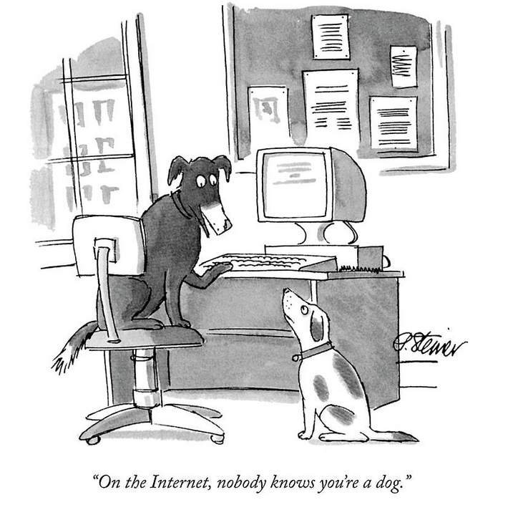
Credentials
On the Internet, nobody knows you're a dog.
Peter Steiner
The New Yorker
July 5, 1993
Notes:
Now a classic Internet meme. So, don't leave your terminal signed on at home.
NIST SP 800-63-3 DIGITAL IDENTITY GUIDELINES
https://doi.org/10.6028/NIST.SP.800-63-3 Executive Summary, p.iv, second paragraph
https://en.wikipedia.org/wiki/On_the_Internet,_nobody_knows_you're_a_dog
http://www.ontheinternetnobodyknowsyoureadog.com/
AKA "Catfish" https://www.urbandictionary.com/define.php?term=Catfish

Slide 9
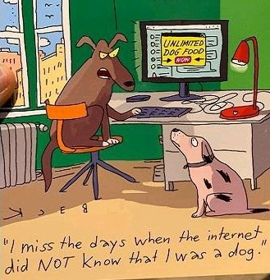
Credentials
I miss the days when the Internet did NOT know I was a dog.
Notes:
"I miss the days when the Internet did NOT know that I was a dog."

Slide 10
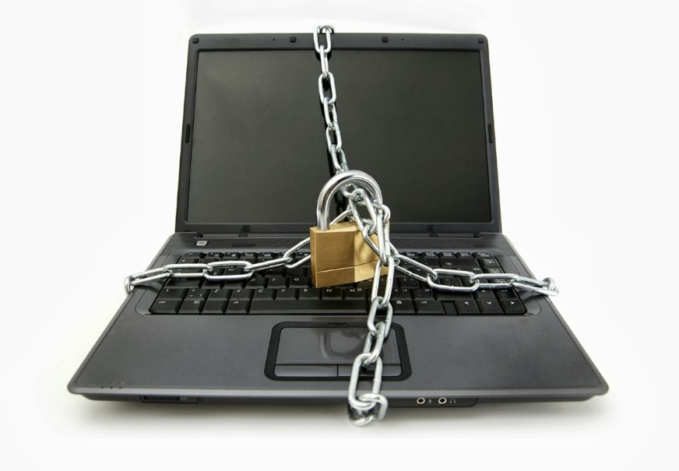
Credentials and Authentication
Credentials:
Identification
Association
Authentication:
Verifying the identity
implies valid association
Notes:
Credentials represent who you are:
passport identifies someone as a citizen of a country,
driver’s license identifies someone who is allowed to drive a car in Ontario. We assume it also means they know how to drive but, in Toronto, it's obvious this is true only about half the time.
Your Seneca student card has data for biometric identification. What is that data?
Photo ID is used to verify that the person showing the ID is the person it belongs to. With your name, student number, and photo, your Seneca ID is a form of two factor biometric identification (more about this later) but photo ID requires a human being to do the verification. Human brains are wired to recognize faces. No one says, "I remember your name but, sorry, you don't look familiar." Software may say that when it tries to recognize your face but not people.
Showing your Photo ID confirms that your face belongs to the name on the ID.
Because Seneca issued the ID, it signals that you are associated with the Seneca community.
Because that same name is on your Seneca graduation diploma, it means you have knowledge of programming.
How would someone know the diploma is not a forgery? Now, Seneca's Registration Office verifies it by issuing a transcript directly to the inquiring person, bypassing you.
Upon graduation from Seneca, your diploma and transcript will be verifiable on a blockchain. MIT and 8 other institutions are collaborating with BlockCerts to publish their respective institutions’ credentials. Blockcerts is an open source platform and is freely available for adaption. https://www.blockcerts.org/ has a nice video on their home page that explains how it works.
– per email from Radha Krishnan, Associate Vice President of Information Services, Seneca.
User ID & Password are theoretically known only to you so it must be you signing on.
User ID & Password – signifies your identity and your association with the system you sign on to. The system trusts that only you know the password belonging to that User ID so it must really be you.
Banks used to have even more secure and reliable authentication than they do now.
A criminal stealing your money would have to:
- Walk into your home branch (geographic restriction)
- Between 10am and 3pm on weekdays (time restrictions)
- Know your account number
- Put a signature on a withdrawal slip in front of the teller who watched it happen. (a form of biometric if demonstrated in real time with quick, fluid motion)
- The teller would then use the worlds’ most sophisticated biometric authentication: facial and voice recognition. They would say, “Hello, Mr. Smith. How are you today?” and you knew your credentials had been validated, and that the teller accepted your authenticity.
- But the teller will not know the criminal's face, so the teller goes to the account files, looks up the account number on the slip, and matches the signature on the account card to the slip…and on their way to the file cabinet, they likely asked a coworker, “Hey, do you know that guy over there?”
- There wasn’t much highjacking of people’s bank accounts but the security constraints were very inconvenient.
Passwords are not a bad idea, they are just poorly implemented. All authentication methods have issues. Nothing is perfect yet but we are getting closer.
See https://www.microsoft.com/en-us/research/wp-content/uploads/2016/02/QuestToReplacePasswords.pdf

Slide 11
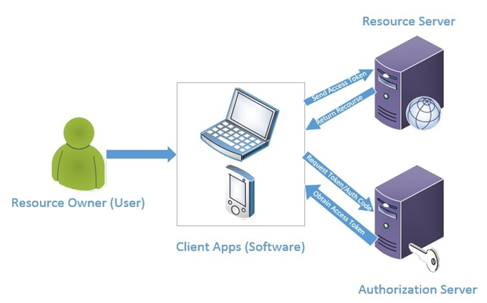
Authorization after Authentication
Authorization: “giving someone permission to do or to access something.”
e.g. access to a system/network, a directory/folder, to read and/or write a file.
“principle of least privilege” grants only the minimum authority needed
Role Based Access/Auth. Control (RBAC) for job functions, not individual users
  Enterprise security apps simplify management
Permissions for ICT developers:
All for developer's PC
Specific for testing/staging server
Read Only for production server
Separate profile for admin and security roles
  be SuperUser (sudo) or root only when necessary
  – mistakes can be fatal to your career and company
Notes:
In a perfect world, we don't need security, locks on doors, police, passwords, privacy rules, the Charter of Rights and Freedoms, or the UN Declaration of Human Rights. Meanwhile, back in the wild…
Physical security example
The office building's front door is unlocked only when your employee card credential is authenticated. Now, you need authority to do something besides stand around in the lobby. Authorization gives you permission to do something (call the elevator and go to a floor) or to access an area (stairwell, internal offices). All are accessed per employee card permissions.
Once your UserID and pwd credentials are authenticated, you have only simple access to the system. Now, you need authority to resources on that system or you'll be staring at a blank screen.
Grant the minimum: Users should not sign on with high authority, e.g. root, super-user, or administrator, unless they need it to do their job. No one should be granted high levels of authority "just in case" or to lazily avoid authorization issues…unless everyone is thoroughly trustworthy and no one ever makes a mistake, in which case never mind about all this security stuff.
Matrix reminder: change default security so no one else can access your files
$ chmod 700 IPC144_Csource
There are Enterprise user & resource security apps, such as from 1Password and Red Hat, to deal with this complexity that are far beyond Linux's basic RWX for user/group/other
https://1password.com/webinars/
https://www.redhat.com/en/technologies/linux-platforms/enterprise-linux/security
Developers need authority to everything…rarely.
All for developer's PC: it is yours to mess up and rebuild
Specific for testing/staging server: Read Only for everything, All for your projects
Read Only for production server prevents "Sorry, I thought I was on the staging server when I deleted all the files."
Where high level authority is needed for a specific use case, e.g. reset user password | unlock account, wrap it inside a program/script which inherits the needed authority but restricts action and effects.
How to stop attackers from moving laterally through your network | IT World Canada News
https://www.itworldcanada.com/article/how-to-stop-attackers-from-moving-laterally-through-your-network/510375
Cyber hygiene is vital to survive today’s attacks, says Microsoft report | IT World Canada News
https://www.itworldcanada.com/article/cyber-hygiene-is-vital-to-survive-todays-attacks-says-microsoft-report/511706
Inherit or adopt authority: e.g. create a program/script which allows your system operator to reset a user's password. The program is compiled/run to inherit the security officer's authority. Your sysop can now handle the most common security issue without having access to everything in user profiles/accounts or other security functions. Reasonably safe to do on IBM systems, use great care on *nix systems with sudo or SUID. https://en.wikipedia.org/wiki/Setuid https://www.redhat.com/sysadmin/suid-sgid-sticky-bit
On each PC, two user accounts: regular and admin. Yes, it is a PITA when installing software – must sign out of regular user, into admin, install, out of admin, into regular user. But it does a lot to limit ransomware exploits.
High and medium security environments maintain audit logs as to who accessed a resource and what changes were made – allows an audit of who used their authority and how.
See https://en.wikipedia.org/wiki/Superuser

Slide 12
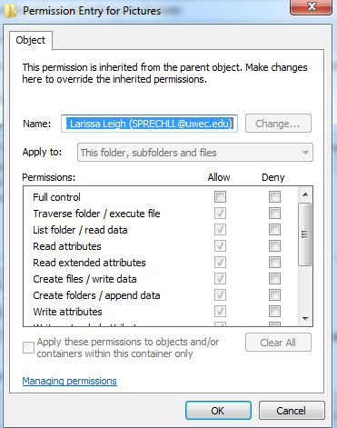
What is “Authorization”?
Permission = access rights = Authorization
*unix > chmod (change mode)
  Permissions: read, write, execute
  Classes: user, group, others
  Security-Enhanced Linux
OS security controls what users can view, change, navigate, or execute
Notes:
Determining how much authority users get is based on their job functions and responsibilities and the organization's policies on access to information. Only the most trustworthy users get to be the security officers who grant authority.
Authority is almost always related to Credentials, i.e. a UserID.

Slide 13


Internet & Browser Security
DNS Domain Name System translates name.tld to IP address
  for security and blocking of malware, botnets, malicious domains:
  CIRA Canadian Shield Quad9 CISCO OpenDNS Cloudflare 1.1.1.1
Domain Validation (DV) certificate. Where did you arrive?
  Iogitech.com rnicrosoft.com G00GLE.com Domain Checker
Always use a VPN from public access points
HTTPS needed for sign on
EFF anti-tracking: Privacy Badger blocks, Panopticlick tests
see Increase Your Privacy Online and this and test browser
Notes:
DNS: Domain Name System translates domain names to IP addresses.
Are you going to where you think you are going? Use a trusted DNS server.
DV: checking the Domain Validation certificate ensures you arrived at the right place.
A web server certificate is necessary for HTTPS.
VPN: Virtual Private Network Take a secure route to where you are going. (avoids man-in-the-middle attacks in coffee shops, transit stations, "free Wi-Fi")
> nslookup senecacollege.ca
Server: CIRA Address: 192.168.2.1 Name: senecacollege.ca Addresses: 34.243.56.93 52.60.173.6 52.24.251.32
CIRA.ca (Canadian Internet Registration Authority) Canadian Shield, OpenDNS and Quad9 prevents contact with malware, phishing, and botnets regardless of application, protocol or port.
Helps to ensure that you are talking to who you think you are talking to, e.g. security certificate spoofing.
https://www.itworldcanada.com/article/cira-officially-launches-free-dns-firewall-for-consumers/429887
CIRA Canadian Shield Primary 149.112.121.20 Secondary 149.112.122.20 Protected: Malware and phishing protection.
OpenDNS Primary 208.67.222.222 , secondary 208.67.220.220
Quad9 Primary 9.9.9.9 , secondary 149.112.112.112
!!! After changing DNS servers, reboot Windows to enact, then run from Windows terminal > ipconfig /flushdns (works immediately to fix unresolving DNS requests caused by DNS changes)
DoH – DNS encryption over HTTPS
DoT – DNS over TLS ()
https://www.thesslstore.com/blog/dns-over-tls-vs-dns-over-https/
https://github.com/jedisct1/dnscrypt-proxy/blob/master/README.md
https://www.ghacks.net/2018/02/19/encrypt-your-dns-traffic-with-simplednscrypt-for-windows/
https://simplednscrypt.org/
https://www.opendns.com/about/innovations/dnscrypt/
First rule of password security: never enter your password unless the site is using HTTPS. i.e. Secure HTTP. Sending sensitive information over any network in plain text is a bad idea. Most browsers now warn/block you when they see plain HTTP and a password type input field. But the smarter blackhats do not name or type their password harvesting input field as "password" or similar variations to avoid this hard block.
https://support.mozilla.org/en-US/kb/firefox-page-info-window
https://support.mozilla.org/en-US/kb/how-do-i-tell-if-my-connection-is-secure
HTTPS IS ONLY transport layer security. It is not application level. You still need to follow secure coding practices and various other techniques to ensure that your site is secure.
A padlock (with or without an organization name) indicates that:
* The connection between Firefox and the website is encrypted to prevent eavesdropping.
* You are definitely connected to the website whose address is shown in the address bar; the connection has not been intercepted.
* But VERIFY the address is what you think it is. And, you still don't know who owns the domain in the address bar
Do all your users' PCs need Internet access? A small business "set up a separate work station not connected to their intranet for staff to use when searching information on the web." e.g. set up a PC on the wireless 'guest' network. Everyone still has email retrieved via central server. Business level applications needing web services operate through the server.
A Few Simple Steps to Vastly Increase Your Privacy Online
https://thetoolsweneed.com/a-few-simple-steps-to-vastly-increase-your-privacy-online/
Use HTTPS on your website. It requires a Domain Validation (DV) certificate on the web server. If the web server does not have a certificate, get one or switch to a responsible web service provider. Don’t be lazy. DV certs are not expensive anymore.
ssl certificates are essential for every website https://www.linkedin.com/learning/ssl-certificates-for-web-developers/why-ssl-certificates-are-essential-for-every-website?u=2169170
eLearning Tutorials Login needs your Seneca credentials and a LinkedIn account since LinkedIn bought Lynda
https://www.senecacollege.ca/student-services-and-support/linkedin-learning.html
https://www.linkedin.com/checkpoint/enterprise/login/2169170?application=learning
Smart Webmasters register all common TLDs with their domain name: .ca, .com, .net, .org
https://en.wikipedia.org/wiki/List_of_Internet_top-level_domains
See https://www.cracked.com/article_30052_a-history-of-whitehousecom-aka-the-biggest-internet-controversy-of-the-1990s.html
https://krebsonsecurity.com/2018/03/look-alike-domains-and-visual-confusion/
https://holdintegrity.com/checker
IDN Checker
Results for google.ca
ALERT: 162 suspicious domain(s) registered with different TLDs.
WARNING: 140 possible domain(s) that can be misrepresented with one character from non-English alphabet.
Other TLDs also have results using punycode
https://en.wikipedia.org/wiki/IDN_homograph_attack
Spoofing attacks based on these similarities are known as homograph spoofing attacks. For example, 0 (the number) and O (the letter), "l" lowercase L, and "I" uppercase "i". In certain narrow-spaced fonts such as Tahoma (the default in the address bar in Windows XP), placing a c in front of a j, l or i will produce homoglyphs such as cl cj ci (d g a).
A Google project: Certificate Transparency see https://scotthelme.co.uk/certificate-transparency-an-introduction/
Certificate Transparency is an open framework for monitoring and auditing the certificates issued by Certificate Authorities in near real-time. By requiring a CA to log all certificates they generate, site owners can quickly identify mis-issued certificates and it becomes much easier to detect a rogue CA. https://www.certificate-transparency.org/ Certificates issued after April 2017 that are not CT qualified will not be trusted in Chrome.
https://www.tunetheweb.com/security/certificate-transparency/
https://en.wikipedia.org/wiki/DNS_Certification_Authority_Authorisation
https://www.techrepublic.com/article/how-to-add-a-certificate-authority-Authorisation-record-in-google-domains/
https://www.wordfence.com/blog/2017/03/chrome-secure/
* Although a gray lock means that the website is encrypted and verified, a green lock means that the browser considers the website more likely to be authentic. This is what EV certificates are supposed to resolve but they don't.
Extended Validation (EV) certificate requires a more rigorous identity verification process but a) it is mostly a cash grab , b) the big sites have dropped using it, c) browsers have stopped showing it, and d) it is a good way to spoof a real company for phishing purposes (https://en.wikipedia.org/wiki/Extended_Validation_Certificate#Colliding_entity_names)
https://www.troyhunt.com/extended-validation-certificates-are-dead/
https://scotthelme.co.uk/are-ev-certificates-worth-the-paper-theyre-written-on/
https://www.tunetheweb.com/blog/what-does-the-green-padlock-really-mean/
* Firefox has the best UI for this and easy access to security info. Other browsers have similar user interfaces.
Browsers have built in security features to defend against various exploits but the white hats are always catching up to the black hats.
https://en.wikipedia.org/wiki/NoScript
General Browser security info: http://its.ucsc.edu/software/release/browser-secure.html
https://owasp.org/www-project-top-ten/ identifies the most critical security risks to web applications
https://owasp.org/about/ Open Worldwide Application Security Project

Slide 14
What's the password?
Marx Brothers - Password Scene
- Horse Feathers - Chico and Groucho
https://www.youtube.com/watch?v=p0Gwe5gKgjo
Who loves passwords?
What if someone else knows your password?
Notes:
https://www.youtube.com/watch?v=p0Gwe5gKgjo
Passwords are like keys for locks.
Did you lock your door when you left your residence this morning? Isn't that a pain? Then, when you return home, you have to UNLOCK the door, walk through, and lock it AGAIN before you go to sleep. Isn't all that locking and unlocking just wasting your time?
Who loves passwords…and unlocked doors?
-- CRIMINALS!
What if someone else knows your password?
-- if that someone is a criminal, see next slide.
If you have a car, isn't it a pain to lock it when you get out? After all, the car has done its job – it got you there – and just when you think you are done with it – after driving in Toronto, we are so done with it once we've finally arrived…after SUVs and pickup trucks have bullied you into letting them go first, after you've waited for pedestrians who think the countdown timer imbues them with the speed of an Olympic sprinter who has lots of time to cross the road no matter how close the counter gets to zero (oh, there is no zero…so therefore, there is always time left to cross)…and don't get us started on the electrified wheels zooming in the bicycle lane – apparently, if it doesn't have a motor that runs on fossil fuels and if you don't have to pedal it, then obviously it is not a vehicle subject to traffic laws…if your neck is sort from swivelling your head 180 degrees both left and right to plot that scooter's trajectory on the time/space continuum (Heisenberg was not only right about sub-atomic particles, he was also right about scooters: you can know the position OR the velocity, but not both at the same time.) If, after all that, you remember to lock your car before walking away from it while seriously considering whether the TTC is the lesser of evils, then don't you feel having to lock the car doors is just adding insult to injury? The solution to driving in Toronto is to leave your car unlocked, with the keys in it, while it is still running, and hope someone just steals it.

Slide 15
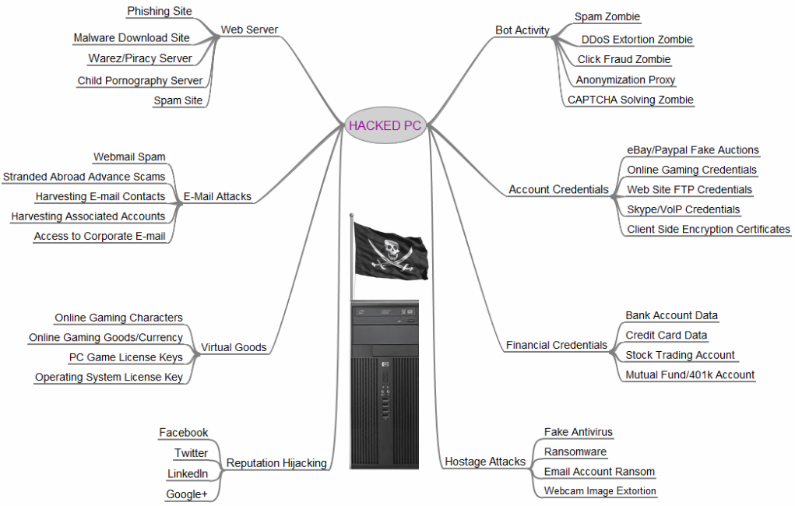
Notes:
Have you every received a message from an email address belonging to someone you know which was an obvious phishing ploy or spam? Well, their email account was cracked. https://en.wikipedia.org/wiki/Phishing
https://krebsonsecurity.com/2013/06/the-value-of-a-hacked-email-account/
https://krebsonsecurity.com/2012/10/the-scrap-value-of-a-hacked-pc-revisited/ (Oct.12, 2018)
https://krebsonsecurity.com/wp-content/uploads/2012/10/HackedPC2012.png
https://krebsonsecurity.com/tools-for-a-safer-pc/
Once a bot (robot program) cracks your email account, the criminal now signed on to your account changes your password; now you are locked out.
You probably use that email, if not the password too, at iTunes, Amazon, Netflix, and everywhere else.
If the password doesn’t work, the cracker goes to those services and says, “I forgot my password” and they reset the password through a link sent to what used to be your email account. Those services have your CRcard info to make purchasing from that site easy for the criminal. Some of those services even show all the CRcard details…hope you have a really low credit limit but, with enough personal information taken from your Facebook and other accounts, they can probably get your credit limit increased.
Your email account likely has a recovery email and recovery phone. This provides a cross reference to your other addresses and devices that may use the same or similar passwords.
Apple says “add extra email addresses to your account to help people find you on Apple services like FaceTime, iMessage, Game Center, and Find My Friends.” – go ahead, expose more aspects of your digital life.
2012 Horror story: https://www.wired.com/2012/08/apple-amazon-mat-honan-hacking/
IN THE SPACE of one hour, my entire digital life was destroyed. First my Google account was taken over, then deleted. Next my Twitter account was compromised, and used as a platform to broadcast racist and homophobic messages. And worst of all, my AppleID account was broken into, and my hackers used it to remotely erase all of the data on my iPhone, iPad, and MacBook.
In many ways, this was all my fault. My accounts were daisy-chained together. Getting into Amazon let my hackers get into my Apple ID account, which helped them get into Gmail, which gave them access to Twitter. Had I used two-factor authentication for my Google account, it’s possible that none of this would have happened.
Had I been regularly backing up the data on my MacBook, I wouldn't have had to worry about losing more than a year’s worth of photos, covering the entire lifespan of my daughter, or documents and e-mails that I had stored in no other location.
A long horror story follows.

Slide 16
#1 most common cracking method
Weak Passwords
  guessable or reused across sites
  password is weak if it's not unique
  Breached admin & cloud app passwords
    Top three: 123456, admin, 12345678
  25 passwords used in 10% accounts
  10,000 passwords used by 30% users
  Credential Stuffing and Cracking
Notes:
Successful cons: duplicate top level pages on a bank's website to a very similar domain, manipulate SEO (Search Engine Optimization) to get your dummy site at the top of web search results. This works for people too lazy to enter the genuine URL (Google myBank, click) or don't have a password manager and probably reuse their bank password with other accounts.
https://en.wikipedia.org/wiki/Credential_stuffing
Stuffing: using lists of breached credential pairs (UserID & Password) to sign on to many sites.
A password is weak if it's not unique: used only for a single web account and not in any list of commonly used passwords
Humans do not create random values: credential cracking through brute-force is unnecessary.
Credential Harvesting – it is much better for criminals to infect a server and collect thousands of credentials, than attempt a user by user client side infection.
followed by
Credential Stuffing - user level defense: use Firefox Relay for unique userID on each site, just like password -- never reused. even if credential is stolen, it is only good on one site.
https://nordpass.com/fortune-500-password-study/
https://xkcd.com/792/ ⬅ password reuse. Websites that insist you set up an account for no good reason may be using your credentials to try logging into your valuable sites.
https://www.youtube.com/watch?v=zUM7i8fsf0g ⬅ Your Password Complexity Requirements are Worthless
This article https://xato.net/10-000-top-passwords-6d6380716fe0 revises old info (from 1000 passwords used in 91% of user accounts. To 10,000 used in 30% account )
Top 200 Most Common Password List | NordPass
https://nordpass.com/most-common-passwords-list/
Sign up with any service online, and it will almost certainly use your email address as a user ID. A robot cracking program uses a spam list of email addresses, yours is probably on it. The email domain tells the "bot" where to start, e.g. @gmail.com, @hotmail.com, @yahoo.com, @mySeneca.ca. It tries the first commonly used password in its list to crack your email. But it does not keep trying other passwords else it will lock out your account with too many unsuccessful tries in a short space of time. Instead, it goes to the next email on the spam list. After it has gone through the entire spam list, it returns -- sometime later -- to your account and tries the next most commonly used password. No red flags are raised for a single invalid sign on attempt every once in a while.
A robot program, a "bot", loaded on some unsuspecting person's PC or a server, can easily get a spam list of millions of email addresses, probably one of yours which means it has your User ID.
Run this on many thousands of bots each taking a portion of the SpamList and it will not take that long to crack accounts.
FOR EACH password in the CommonPasswordsList
FOR EACH email in the SpamList
attempt sign on using email as UserID
IF successful THEN INSERT UserID@domain.email, password into Cracked_Accounts_file
FOR EACH website in the WebAccountsList // Apple, Amazon, eBay, PayPal, banks, credit cards, financial, investments, ecommerce, social media, online gaming
attempt sign on with UserID@domain.email & password
IF successful THEN INSERT UserID@domain.email, password, website into Cracked_Accounts_file
END FOR
END FOR
END FOR
…and it gets much more sophisticated from there.
See https://null-byte.wonderhowto.com/how-to/password-cracking/
https://haveibeenpwned.com/ and/or https://sec.hpi.uni-potsdam.de/ilc/search?lang=en to see if your email is on a list of breached security.
o See https://pages.balabit.com/rs/855-UZV-853/images/Balabit-top-10-hacks.pdf#_ga=1.183907937.639091324.1489939037
o https://www.balabit.com/news/press/social-engineering-leads-the-top-10-list-of-most-popular-hacking-methods-balabit-survey-results-from-black-hat-usa
o http://www.computerweekly.com/news/4500272941/Social-engineering-is-top-hacking-method-survey-shows
See https://www.pcisecuritystandards.org/pci_security/educational_resources
https://itsupport.smu.edu.sg/hc/en-us/articles/220172367-IT-Security-Incident-News
https://esupport.trendmicro.com/en-us/home/pages/technical-support/internet-security-2017/1099580.aspx
https://en.wikipedia.org/wiki/List_of_the_most_common_passwords
https://en.wikipedia.org/wiki/Password_cracking
Poor, weak passwords have the following characteristics:
▪The password contains fewer than eight characters.
▪The password is a word found in a dictionary (English or foreign).
▪Names of family, pets, friends, coworkers, fantasy characters, etc.
▪Computer terms and names, commands, sites, companies, hardware, software.
▪Birthdays and other personal information such as addresses and phone numbers.
▪Word or number patterns like aaabbb, qwerty, zyxwvuts, 123321, etc.
▪Any of the above spelled backward.
▪Any of the above preceded or followed by a digit (e.g., secret1, 1secret)

Slide 17
Forget / Recover your password
“I forgot my password” – relies on the strength of your email account’s security and its password
Answer Security Questions
  "knowledge-based authentication" easy to hack
  Google you, social media exposure, stolen wallet | bag
Security Questions Defence: never tell the truth
  But how do you keep track of the lies? (see below)
Notes:
You get the message "Your user ID or password is incorrect. Please try again."
So make your password "incorrect" and you will always be reminded what it is.
No more hints and knowledge-based authentication
Knowledge-based authentication (KBA), sometimes referred to as “security questions”, is no longer recognized as an acceptable authenticator by SP 800-63. See
National Institute of Standards and Technology NIST Special Publication 800-63: Digital Identity Guidelines
Answering security questions is how Hollywood actress Jennifer Lawrence’s account was cracked. Security questions are much easier to hack than passwords. Security questions are now considered security holes by most security experts. Research shows 5 minutes on somebody’s Facebook page made study subjects able to answer questions as accurately as the owner’s partner could.
Always lie in answers to security questions. But lies are very hard to remember.
Defence: use a truly random phrase as a security answer and use that answer regardless of the question. The phrase should be at least 12 characters long to help avoid cracking and never actually be an answer to any security question. Mother's maiden name? Answer “CP4P is great.” or generate a Diceware phrase (later in slide deck) or use a classic Canadian phrase as an answer: "double double“, "cold enough for you?”, "How's it goin', eh?", "take off, eh?"
https://www.theatlantic.com/technology/archive/2012/08/security-questions-the-biggest-joke-in-online-identity-verification/260835/
If a service sends your password in plain text, it is stored either in plain text or with encryption (which, of course, can be decrypted). That’s a bad thing and too many sites still do this. It is attributable only to laziness and careless IT. Passwords are properly stored if they are salted and hashed – more on this later in the slide deck.
Note that some sites will send you a temporary password; if done well, their system stored that temporary password properly and flagged it as expired; you will sign on with the temporary and the host system will insist you change it before allowing you to continue.
e.g. https://excal.on.ca/tixhub-in-plaintext/
http://plaintextoffenders.com/
https://krebsonsecurity.com/2019/03/facebook-stored-hundreds-of-millions-of-user-passwords-in-plain-text-for-years/

Slide 18
Password Edit Rules
Enter new password:
Too short; minimum 8 characters.
Must have an UPPERCASE character.
Must have a special character.
Must have a number.
Expired. Must be changed.
password
passwor
passwo
passw
pass
pas
pa
p
Password
Password!
Password!1
Password!2
Notes:
Ironically, typical edits do not check for “password” within the password.
Shift F5 to see the animation

Slide 19
Password Edit Rules
Rules that are BAD rules:
Length: min – max → both too short
Strength: alphA + digits + 5?#80!$ [symbols]
→ too complex
Not in Dictionary → not memorable
Expiry: periodic change → too often
Notes:
First, lazy programmers force your email address to be their UserID which makes guessing your account's credentials only half as hard. (An email address is only valuable if other people know it.)
These bad policies were an attempt to thwart crackability of passwords. But the more password rules became secure against cracking, the more users made those passwords insecure by storing them outside their heads.
1. Length: minimum and/or maximum length requirements that are too short, e.g. minimum 6 or 8 and maximum as few as 12 characters
Password minimum length was often set low enough that users would not complain about having to remember long passwords (or would not have to write them down).
Password maximum length was often constrained by the systems accepting those passwords, e.g. short database field size; old, never updated hashing algorithms cannot deal with passwords longer than N characters
Administrators were afraid of allowing easily crackable passwords: dictionary attacks resulted in the strength and not-found-in-a-dictionary rules.
2. Strength rules designed to thwart a dictionary attack. Often, the complexity rules are complex: number of… UPPER and lower case alphas; digits; symbols (sometimes none, or some but not others) Spaces allowed? (usually not)
-- leet speak translations to satisfy Strength have been built into cracking logic https://www.gamehouse.com/blog/leet-speak-cheat-sheet/ https://en.wikipedia.org/wiki/Leet
3. Non-Dictionary – passwords, or even portions of passwords, that matched words in a standard dictionary were not allowed and thus almost impossible to remember.
Cracking optimizations easily substitute digits and symbols for characters such as 3 for E, 5 for S, 2 for Z, ! for I, @ for a, and so on. Strength adds insufficient difficulty to crackability to be worth the insecurity of hard-to-remember passwords. See https://en.wikipedia.org/wiki/Munged_password
4. Password Expiry because it took X days for other people to see the complex password you wrote down,
or our security is so bad, we are successfully hacked every X days
so password must be changed every X-1 days.
5. Password History was kept to prevent password reuse. Users figured out how satisfy the password requirements, then alternately used two passwords repeatedly. Not reusing passwords is the only traditional password policy that is a good policy (see later in slide deck for NIST guidelines)
https://xato.net/perilous-password-policies-3ad038aa33b1
https://www.youtube.com/watch?v=zUM7i8fsf0g Your Password Complexity Requirements are Worthless - OWASP AppSecUSA 2014
Insecure passwords really means guessable passwords. Only incompetent administrators/programmers feared crackable passwords because they had poor password storage (not hashed or salted). E.g. LastPass had user credentials stolen but most security experts did not fear password cracking because of the deep hashing and salting that LastPass used to store the passwords. They got a free pass on this the first time. But they have been hacked and cracked many times since.

Slide 20
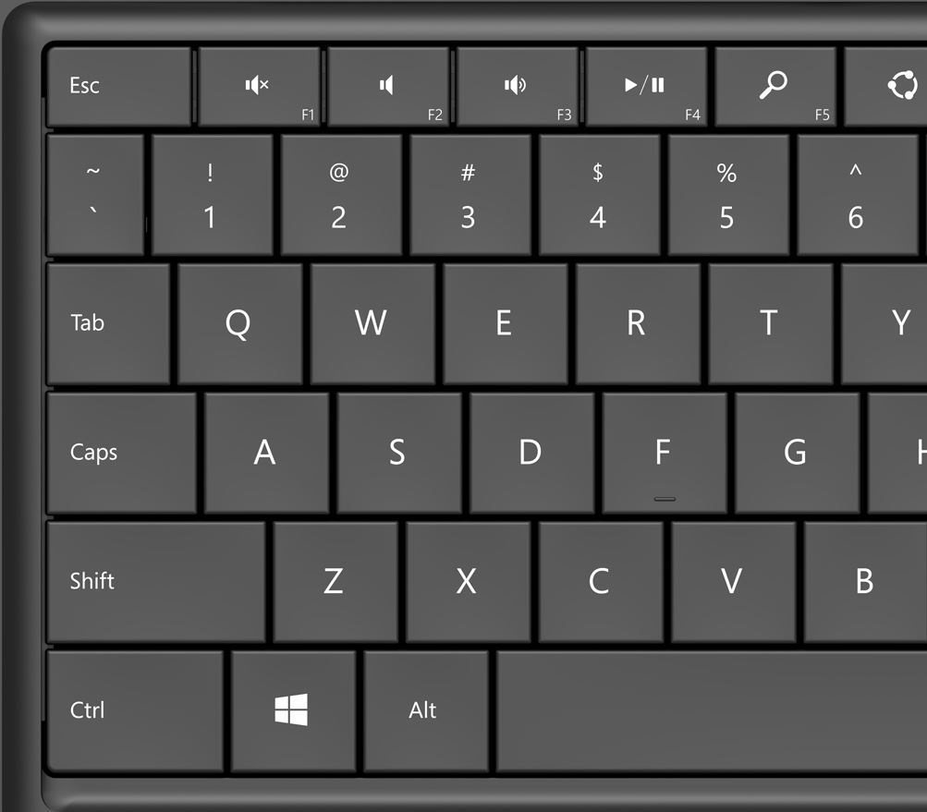
Long, Strong, and INSECURE
Long and Strong
13qeadzc@$WRSFXV
Satisfies all edit rules
Is easy to remember
Keyboard walk algorithm will find the pattern
easy to remember
= easy to crack
Notes:
Shift F5 to see the animation
How to Satisfy Bad Password Policies
–> users employ a keyboard pattern that fools the password editing based on BAD password rules but is easily cracked by a keyboard walk generator. Or shoulder surfing – characters are hard to remember but patterns are not.
E.g. 13qeadzc@$WRSFXV looks long and random enough to a password editor…now, look at your keyboard.
Every time the password must be changed, the user just changes the use of the shift key or starts the pattern at the next number, e.g. 24wrsfxv#%ETDGCB
See https://github.com/hashcat/kwprocessor for
Advanced keyboard-walk generator with configurable base chars, keymap and routes
Essay on keyboard walks
Use it to check or create walks that go into the disallowed password list.
https://cyberarms.wordpress.com/2018/02/13/creating-hashcat-keymap-walking-password-wordlists/
Checking logic is, simply put, if the distance between successive pwd chars as plotted on a keyboard is consistent and/or shows a repeated pattern, it is a keyboard walk.
See https://digi.ninja/projects/passpat.php "Passpat uses data files containing the layouts of common keyboards to walk a password through the keyboard and generate a score based on how close it is to being a pattern"
https://anixis.com/doc/ppe803ag/index.html?ppe_keyboard_pattern_rule.htm

Slide 21
Password Defense
memorable Length instead of complex Strength
  j3ArQk+B0! (10) time to crack: 3 years
  mylongpassword (14) time to crack: 3 years
  LongPassWord (12) time to crack: 19 years
  long strong is not much longer than complex strong
  PassPhrase can be long, memorable, and satisfy the bad rules *Opal1Quizzical2Dreamlike3and_So_On
Generate a long random passphrase. Check strength entropy
Notes:
https://specopssoft.com/blog/passphrase-best-practice-guide/
Why use passphrases over passwords? | Passphrase best practice guide
TIME TO CRACK: MD5 Hashed Passwords
Three Simple Rules for Protecting Your Data - The Atlantic
https://www.theatlantic.com/technology/archive/2023/09/managing-digital-privacy-personal-information-online/675184/
Be NICE: The best passwords are
New (not reused between sites),
Impersonal (don’t include birthdays, addresses, names, etc.),
Complex (contain lots of special characters and mixed-case letters), [but this is far less important than length]
Extensive (length at least 14 characters). [SpecOps 2024 recommends 15 minimum, ideally 20]
Using a passphrase with punctuation and a numeral satisfies this and is memorable.
Do the same with your security questions: The answer to “Where were you born?” (which is easy to figure out based on public information) should be gibberish, as though it were another password field.
Get a password manager.
Brute force attack is no more efficient cracking eight random characters "fI5*qnpd" than the word "password" because brute force is blind to meaning. Brute force success is inversely proportional to password length * symbol set. Dictionary rainbow attacks are effective only against poorly stored pwds, ie. Hashed but not salted. Hashed and salted passwords are too computationally expensive to test by brute force.
Strength isn't as strong as you might think. password entropy is log₂ of the number of trials an adversary would have to make in order to guess your password.
24 long [a-z] = 20 [a-z][A-Z] = 19 [a-z][A-Z][0-9] = 17 [a-z][A-Z][0-9][32 special char]
Twenty to twenty-four letters spelling words is far easier to remember than 17 ~random characters.
9 Diceware words is roughly equivalent if both upper and lower cases are used.
https://en.wikipedia.org/wiki/Password_strength#Entropy_as_a_measure_of_password_strength
An 8 random character password from only lower case letters has 37.6 bits of entropy =LOG(26^8,2) [26 possible chars raised to power of 8 length] needing 5 seconds to brute force guess.
A 12 random character password from the set of {lower, upper, digits, and 32 special chars} has 78.66 bits of entropy =LOG((26+26+10+32)^12,2) needing 34,000 years to brute force guess. That's better but not enough better because the only way to know it is to WRITE IT DOWN thus making it insecure.
A 16 random character password from a US keyboard of 94 characters has a very good entropy of 105 bits needing 1 trillion years to crack
Brute force guess times from https://www.security.org/how-secure-is-my-password/
https://www.omnicalculator.com/other/password-entropy
https://www.okta.com/identity-101/password-entropy/
Nobody bothers with brute force. Just try "password", 123456, admin, 12345678.
Hacking by trying known passwords is much more efficient now that common passwords are known from previous cracks.
Trying a known password is as efficient as varying one single character in an inefficient brute force attack.
So, consider common passwords equivalent to a single character. More words means no matches to common passwords which are all single words or common patterns.
The 100 most commonly used passwords have 6.6 bits of entropy or almost the same complexity as any SINGLE character you type on a std keyboard (assuming a set of 94 symbols = 26 + 26 + 10 + 32)!
The 1000 most commonly used passwords have 10 bits of entropy or ~= two random upper or lower case letters.
The 10000 most commonly used passwords have 13 bits of entropy or ~= two random keyboard characters.
Would you allow a two character password? No? Then don't allow the 10,000 most commonly used passwords.
Entropy is measured as =LOG(number of possibilities,2) i.e. base-2 logarithm of n possibilities.
https://blog.1password.com/how-1password-calculates-password-strength/
https://www.zdnet.com/article/fbi-recommends-passphrases-over-password-complexity/
https://arxiv.org/pdf/1505.05090.pdf?
Stop saying "passWORD", say PassPhrase to encourage the concept of length, i.e. not just a word
Testing via Kaspersky…
P@5$w0rd1 – clever right?
• bruteforced with an average home computer in approximately 2 months.
→ But likely by an optimized password cracker in a few seconds
1qaz2wsx3edc looks fairly random, 12 char length
• bruteforced with an average home computer in approximately 11 seconds because of keyboard walk pattern.
“really long password”
• bruteforced with an average home computer in approximately 10,000+centuries
However, it contains widely used combinations and is in hacked lists.
Most password edits do not allow spaces although they should. If spaces are allowed, test for stupid programming. If a PassPhrase can be set to This is a really long PassPhrase. then try to sign on using only the first word This. A lot of programmers and the utilities they use stupidly assume a space is a separator, not a character. Check if the system signs you on using only the first word.
For the paranoid using the slide's links, start a browser in private mode, load password testing web pages, then disconnect PC from all networks. The pages use local javascript. Then close the browser.
https://www.microsoft.com/en-us/research/blog/avoiding-vulnerable-passwords-rules/
https://support.microsoft.com/en-us/Search/results?query=Create+and+use+strong+passwords
https://www.microsoft.com/en-us/research/wp-content/uploads/2016/06/Microsoft_Password_Guidance-1.pdf
Remember, any criminal organization in the business of cracking systems, has done password analysis and knows commonly used passwords, phrases, and strategies. They’ve got the title, first line, or chorus of every popular song. They know the popular phrases and memes just like you do. They know the names of all the sports teams, the best players, and the last year they won the championship. They know all the quotable lines and titles of classic movies.
Think hard about a pass phrase then don’t use the first ten things you think of. Humans are lousy at coming up with random, unpredictable stuff.
Use a long, personal sentence that unique to you, that includes non-factual info and truly random words. Not something out of a movie, poem, play, or song. See Diceware.
Google: World Password Day, May 3
https://hostingcanada.org/email-hosting-services/
https://www.servermania.com/kb/articles/setup-your-own-email-server/

Slide 22
Password Defense
Check if previously breached / leaked / hacked
  ';--have i been pwned? email passwords
  API https://www.passwordping.com/docs-password-strength-meter-example/
  Full service such as Specops Password Security Tools
Use an email alias for UserID
  Like passwords, UserIDs should be single use across accounts
  Firefox Relay, Mailfence (integrated with Thunderbird), Fastmail
  Your own domain & cloud email server: create virtual email address
  for each account. netflix@myDomain.ca, google@myDomain.ca
Notes:
- get your own domain.tld and email service.
- Add Email Account Forwarders: Tin Foil Hat types will get their password manager to generate a random password and use that random value as the UserID @somewhere.com. Your own email system will send that email where you tell it, i.e. to your real email user that you never share with anyone.
Those with normal hats will use the service's name as the UserID
Email Address Forward To
rAnd0m@your-domain.tld the-real-you@your-domian.tld
GOOGLE@your-domain.tld the-real-you@your-domian.tld
APPLE@your-domain.tld the-real-you@your-domian.tld
NETFLIX@your-domain.tld the-real-you@your-domian.tld
Like passwords, UserIDs should also be single use only for any account registration.
https://www.hover.com/email (owned by Tucows.com, a Toronto company)
USD$37 / ~CAD$50 per year for 10GB email and .ca domain registration.
You will never ever have to change your email address again.
https://www.servermania.com/kb/articles/setup-your-own-email-server/

Slide 23
Password Defense – keeping track
Password Managers: 1Password (CDN), BitWarden (OSS), MS Authenticator (free)
  unique, long, random, optionally strong passwords, per account.
  Must remember one long PassPhrase.
Diceware PassPhrase: long, memorable, random
  Generate a 5 digit random number using dice. Look up the word on the list. Repeat. Good for password managers and security questions.
  1Password has a Diceware feature to satisfy bad password policies
I have a User ID and Password!
  End-User → sign on request → Client ← OpenID Connect → Auth. Server
  OpenID Connect authenticates user to many sites via a single account.
  e.g. your Apple / Google / Facebook / X [twitter] / Discord account.
  Read the permissions requested to the authorization account!
Notes:
People try to make memorable, difficult to guess passwords but people are lousy at this. Almost 3/4 of all passwords people choose are based on person or place names, dictionary words, and other things of personal significance or memorable patterns. People’s attempts to obfuscate or strengthen passwords usually follow predictable patterns. People almost never create truly random passwords or PassPhrases; see Bonneau and Shutova, 2012. Linguistic Properties of Multi-word Pass-Phrases
The answer to this problem is simple: The only secure password is the one you can’t remember. See https://www.troyhunt.com/science-of-password-selection/ That is usually but not always true. (more below)
https://www.troyhunt.com/tag/passwords/
https://arstechnica.com/information-technology/2012/03/passphrases-only-marginally-more-secure-than-passwords-because-of-poor-choices/
https://blog.mozilla.org/firefox/how-to-create-strong-passwords/
https://opensource.com/article/18/3/behind-scenes-bitwarden
BitWarden's local data needs backup. See https://bitwarden.com/resources/guide-how-to-create-and-store-a-backup-of-your-bitwarden-vault/
https://support.1password.com/1password-security/
https://www.1password.university/learn
https://www.androidpolice.com/microsoft-authenticator-guide/
https://youtu.be/Q0GeMSFGIgI
A critical issue is not reusing passwords on web sites. If one web site where you have an account stores your password in a less than secure manner, your exposure is limited if they are hacked so long as it is not the same as any other password you are using. You have no control over how services store your password…so don’t reuse passwords.
Password managers help with this by maintaining a unique password for each online account.
Now, the fear is that the Pwd-Mgr becomes a "single point of failure" for all your accounts. Actually, a Pwd-Mgr is more like a bank, and/or a safety deposit box. Does anyone consider the bank where they keep their money a "single point of failure"? If a criminal gets into a bank, will they steal all your money? (No. That's not how banking works.)
The "single point of failure" for all your accounts is the email address used as a UserID on those accounts.
Pwd-Mgrs rely on one long (and optionally strong) PassPhrase for security. How to come up with an unhackable PassPhrase? Diceware.
The Diceware concept creates long, random but memorable pass phrases…very useful for creating a PassPhrase for your password manager.
5 word PassPhrase = 64 bits of entropy (good) 6 word PassPhrase = 77.5 bit of entropy (really good). 10 words = 129 bits (cryptographically strong).
Next, Pwd-Mgrs use your PassPhrase to encrypt the data of your accounts tens of thousands of times before it leaves your system to be stored at the Pwd-Mgr site. (to make your data portable across devices and available even if all your devices are compromised, e.g. by ransomware). Your PassPhrase is stored only in your brain meaning the Pwd-Mgr site has 'zero knowledge' of your data. There are many other layers of security superior to what any individual could do on their own. See https://support.1password.com/1password-security/ Your accounts data is decrypted only on your system by your master PassPhrase. 1Password is a Toronto, Ontario company; they have over 100,000 companies using their enterprise product.
Diceware is a good way to generate a security question answer to be used for all security questions. Keep a record of your security answers in your password manager's notes section. Diceware is a good way to generate a PassPhrase for your password manager.
Note: Using a diceware list, there are only 6^5 = 7,776 password combinations throwing 5 dice or 1 die 5 times to randomly generate a number pointing to a list word. That determines the first word which does not sound very secure. But do it five times to get 5 Diceware words = 7776⁵ = 28,430,288,029,929,701,376 possible PassPhrases…which sounds like a lot but https://arstechnica.com/information-technology/2014/03/diceware-passwords-now-need-six-random-words-to-thwart-hackers/
1Password and LastPass employ per user salts, which makes guessing a master password 'computationally expensive' if they were hacked. "Further, because a user’s password is encrypted 100,100 times (default) before being sent to LastPass, and is again encrypted 100,000 times before being stored, guesses can’t be done at significant speed."
https://blog.mozilla.org/firefox/myths-about-password-managers/
Myth 1: Password managers aren’t safe or trustworthy,
Myth 2: Password managers aren’t 100% secure, so I shouldn’t use one,
Myth 3: Storing all my passwords in one place makes them vulnerable to hackers,
Myth 4: Remembering all my passwords is safer than trusting technology to do it for me,
Myth 5: It’s a huge pain to set up a password manager.
https://arstechnica.com/information-technology/2013/05/how-crackers-make-minced-meat-out-of-your-passwords/
http://world.std.com/~reinhold/diceware.html
https://www.rempe.us/diceware/#eff
https://en.wikipedia.org/wiki/Diceware
Use a password manager. If so, why so? If not, why not?
https://blog.dashlane.com/a-skeptics-guide-to-password-managers-and-security/
PassPhrase creation. If so, why so? If not, why not?
https://en.wikipedia.org/wiki/Diceware
http://world.std.com/~reinhold/diceware.html
https://theintercept.com/2015/03/26/passphrases-can-memorize-attackers-cant-guess/
E.g. https://www.rempe.us/diceware/#eff to generate random PassPhrase
Or random.org and https://www.eff.org/files/2016/07/18/eff_large_wordlist.txt
https://www.random.org/integers/?num=6&min=11111&max=66666&col=1&base=10&format=html&rnd=new
Should you rely on third party authentication? How is that better than a Password Manager?
OpenID Connect is an open standard. It allows Clients to verify the identity of the End-User based on the authentication performed by an Authorization Server, as well as to obtain basic profile information about the End-User in an interoperable and REST-like manner. (Therein may be the rub. OpenID standard itself is not evil, you hope the Client & Authorization Service are not evil. Google no longer says 'Don't be evil', Alphabet says "Do the right thing".) OpenID Connect allows clients of all types, including Web-based, mobile, and JavaScript clients, to request and receive information about authenticated sessions and end-users so the client does not have to manage its own user identity system.
https://openid.net/connect/
Some sites are now insisting on a third-party sign in so they can always get additional info on you. E.g. https://www.udio.com/
Now Google and FB know another site you use. That site will ask for access to your Google or FB account info.
A student reports: "I recently logged in to a site with a (largely unused) twitter account. To do this, that site wanted permissions to do basically anything it wanted on twitter: read my tweets, access my friends lists, and I believe it even wanted to be able to post tweets."
http://lifehacker.com/5918086/understanding-oauth-what-happens-when-you-log-into-a-site-with-google-twitter-or-facebook
https://www.avg.com/en/signal/is-it-safe-to-log-in-with-facebook-or-google
https://www.startpage.com/sp/search?query=Should+you+rely+on+third+party+authentication+using+google+or+facebook+to+sign+on
https://security.stackexchange.com/questions/133065/why-is-it-a-bad-idea-to-use-plain-oauth2-for-authentication
"OAuth2 is meant for a user to authorize an application to load the user's resources from some resource provider. In other words: OAuth2 is a mechanism for delegation of Authorisation. The protocol does not support authentication (although it is commonly misused for exactly that)." OpenID Connect is a simple identity layer on top of the OAuth 2.0 protocol to do authentication.
https://openid.net/connect/faq/
https://spin.atomicobject.com/2016/05/30/openid-oauth-saml/
https://security.stackexchange.com/questions/44611/difference-between-oauth-openid-and-openid-connect-in-very-simple-term
https://diacc.ca/wp-content/uploads/2015/05/DIACC-Building-Canadas-Digital-Future-May-6-2015.pdf
http://www.itworldcanada.com/article/corporate-password-practices-still-lacking-says-dashlane/395532
http://www.itworldcanada.com/article/hbo-suffers-game-of-thrones-sized-hack/395329
http://www.itworldcanada.com/article/why-the-hbo-breach-was-no-surprise-to-a-forrester-analyst/395435
Password Policy Enforcer helps you to secure your network by ensuring that users choose strong passwords.
https://anixis.com/doc/ppe803ag/index.html?ppe_whats_new.htm

Slide 24
2nd most common cracking method
Social Engineering
  You are your own security vector the more
  you post your life on the internet
  Spear Phishing has 35% success rate
  Social media makes it easier to guess birthdays, credentials, answer security questions, pretend to be you when calling the help-desk,
  or steal your identity
    Nobody can abuse information about you that they don’t have.
Notes:
Social Engineering is no longer personal, it's just business. That's where the real money is.
Nigerian prince phishing exploits are from suckers who bought a phishing toolkit on the dark web.
The real criminals are far more sophisticated. E.g. manipulate SEO techniques to get their fake bank site above the real bank site when lazy users type their bank's name into a search engine instead of their bank's URL.
84 per cent of business email compromise (BEC) messages detected by Trustwave came from free webmail addresses like gmail.
https://www.itworldcanada.com/article/business-email-compromise-scams-getting-more-sophisticated-report/545321
BEC Trends: Payroll Diversion Dominates and Sneaky Multi-Persona Attacks Emerge (trustwave.com)
https://www.trustwave.com/en-us/resources/blogs/spiderlabs-blog/bec-trends-payroll-diversion-dominates-and-sneaky-multi-persona-attacks-emerge/
https://www.itworldcanada.com/article/phishing-campaign-tries-to-evade-defences-with-qr-codes/544930
https://xkcd.com/1121/ - verifying identity
https://www.youtube.com/watch?v=lc7scxvKQOo – Simple Social Engineering Trick with a phone call and crying baby sounds
https://www.cybersecuritymastersdegree.org/2017/11/top-5-social-engineering-attacks-of-all-time/
https://www.trustedsec.com/social-engineer-toolkit-set/
https://www.theglobeandmail.com/opinion/article-are-you-really-you-please-authenticate-yourself/
https://www.ptsecurity.com/ww-en/analytics/social-engineering-2018/ and also https://www.ptsecurity.com/ww-en/analytics/corp-vulnerabilities-2019/
First, your User ID is usually public knowledge, i.e. your email. Spam is proof of this.
Gmail, Apple, and a host of other web sites use your email as your user ID because:
a) email@addr.com is guaranteed to be a unique identifier of you in their system
b) which you will remember
c) thus reducing their programming and user support
As for the password, everyone should know about phishing exploits where some known organization asks you to verify your credentials. https://en.wikipedia.org/wiki/Phishing You click on a link and it displays a sign in page that looks exactly like that organization (it is easy to steal a web page…start with Ctrl-U)
Social engineering: “(in the context of information security) the use of deception to manipulate individuals into divulging confidential or personal information that may be used for fraudulent purposes.”
Edward Snowden copied and leaked classified information from the National Security Agency (NSA) in 2013. How did he get all those documents? Snowden simply asked his colleagues to sign on for him. Once you are in the office or signed on, they trust you.
Or just look under someone’s keyboard or in the top drawer of their desk – their password is likely written down on a sticky note. If the company's password policies are really stringent (more on this later), they most certainly wrote down their complex password.
A secure password reset is usually sent to your email but, if you have forgotten your email's password, you need the help desk and this is where the social engineering comes in: a con man talks to an innocent help desk person.
https://www.itworldcanada.com/article/maplesec-session-examines-how-best-to-end-email-havoc/509262
"Cloudflare Area 1 is a cloud-native email security platform; it identifies and blocks attacks before they hit user inboxes, enabling more effective protection against spear phishing, business email compromise (e.g. ransomware), and other advanced threats that evade existing defenses.
Alkin Gorgun, the Cloudflare CISO, said that "machine learning is only as good as the data that you’re feeding it. We’ve built one of the world’s largest web crawlers that crawls the entire world wide web and we ingest about six petabytes of data every two weeks. And we feed that through our AI agent.
"Through the use of this machine learning, we’re watching every attack, every URL, every web, every IP address, to really understand what is happening from an attacker perspective."
You are your own security hole by posting your life on the Internet.
DO NOT post your birthday. Facebook loves it but it is a vector for identity theft. When you must give a birthday—to anyone but a bank, CRcard, gov’t, employer, insurance company, factor yours by +/- 1. e.g. 1997-09-13 becomes 1998-08-14 (+1, -1, +1). Use a constant formula. Your friends and family know your real birthday. Use a negative factor for the month or day so you can decide if those who wish you Happy Birthday early need to know the real date.
Photographs used to be a way of hiding information…not anymore. Facial, text, and location recognition within photos is getting better and better and better.
https://www.startpage.com/sp/search?query=Social+media+makes+identity+theft+easy
https://www.startpage.com/sp/search?query=Spear+phishing
https://en.wikipedia.org/wiki/Social_engineering_(security)
https://en.wikipedia.org/wiki/Phishing#Spear_phishing
https://en.wikipedia.org/wiki/ICloud_leaks_of_celebrity_photos
https://www.fireeye.com/current-threats/best-defense-against-spear-phishing-attacks.html
▪ Balabit security company has developed Blindspotter as a real-time user behaviour analytics monitoring tool a logical progression for the company in terms of its guiding contextual security intelligence (eCSI) concept, aimed at changing existing IT security methods that restrict users' access and activities by control-based security tools.
▪ The eCSI concept seeks to avoid introducing additional security control tools, extra authentication layers and policies. Instead, it seeks to improve security capabilities using continuous monitoring, context and proven algorithms that focus on finding unusual activity in the behaviour of users to highlight anomalies that are worth investigating.
▪ This would have prevented Edward Snowden from begin able to get away with downloading huge numbers of documents. Also, his colleagues would have been similarly flagged because Snowden simply asked his colleagues to sign on for him; Snowden used their credentials to gain access to documents not available to him. Such extensive downloads would have been anomalous behaviour, especially to people in the same office.

Slide 25
There are two kinds of people:
1. Those who can extrapolate from incomplete data
Notes:
In the case of Social Engineering exploits,
criminals are Those who can extrapolate from incmplt data

Slide 26
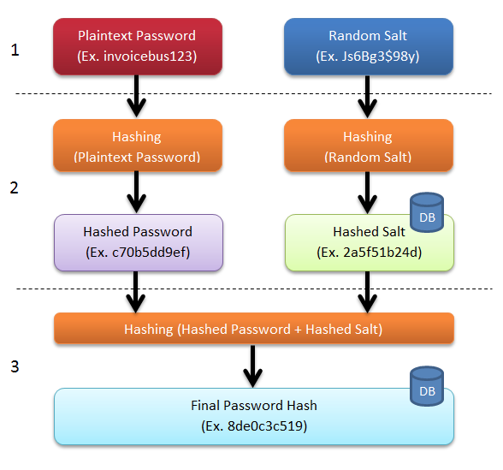
Create User Account
1. GET User-ID and Pwd from user input. GEN Random Salt value
2. One-way Crypto Hash of password and salt.
3a. Hash the hashes together n thousand times.
3b. STORE User-ID, hashed Salt, and Final Pwd+Salt Hash in DB
Notes:
Tech background: Hashing encodes passwords to hide their length and value; it is a one-way function and is very difficult to reverse. The only way to discover the original data is to hash all possible inputs and check for a match to the stored hash; this is known as a brute-force crack and is “computationally expensive”.
A crypto-hash “is a mathematical algorithm that maps data of arbitrary size to a bit string of a fixed size (a hash function) which is designed to also be a one-way function (the crypto aspect), that is, a function which is infeasible to invert.”
Step 0: validate UserID is not already in User DB. Additional edits usually done for form and content, e.g. it looks like an email address, or better, it does not look like an email address (see later slide about this)
Step 1: Generate random text string called a “salt”, unique for every user. Get pwd from web form submit over HTTPS encrypted connection.
Step 2: Generate hash values from the plain text password and the salt. The hashed salt will be stored in the database (DB) for validating the password in future (at login).
N.B. set the plain text password variable to blanks [not simply a null string] ASAP in the sequential logic. This will overwrite the plain text password in memory guarding against exploits such as Heartbleed, Spectre and Meltdown. If all programmers had done this in their custom server-side programming for user registration, these exploits would have been less of a problem.
Clear sensitive data in variables after last use. Clean up before end of job: pwd = " "; // n blanks to max allowed field/variable length (not just \0)
Also overwrite variables with blanks/zeros for credit card, and any PII such as UserID, birthday, …
Step 3: Generate hash value of the concatenated hashes from the previous step. This is the final password hash that will be stored in the database (DB). Rehash thousands of times. LastPass does this 100,100 times on the client side before sending it to the server which does it again.
https://en.wikipedia.org/wiki/Key_stretching
https://nakedsecurity.sophos.com/2013/11/20/serious-security-how-to-store-your-users-passwords-safely/
Image source is https://invoicebus.com/garage/sleep-tight-your-data-is-secure-part-2/
http://lifehacker.com/5919918/how-your-passwords-are-stored-on-the-internet-and-when-your-password-strength-doesnt-matter
For a hashing example and explanation, see https://md5hashing.net/hash
https://en.wikipedia.org/wiki/Cryptographic_hash_function
https://nakedsecurity.sophos.com/2013/11/04/anatomy-of-a-password-disaster-adobes-giant-sized-cryptographic-blunder/
https://en.wikipedia.org/wiki/Password_Hashing_Competition

Slide 27
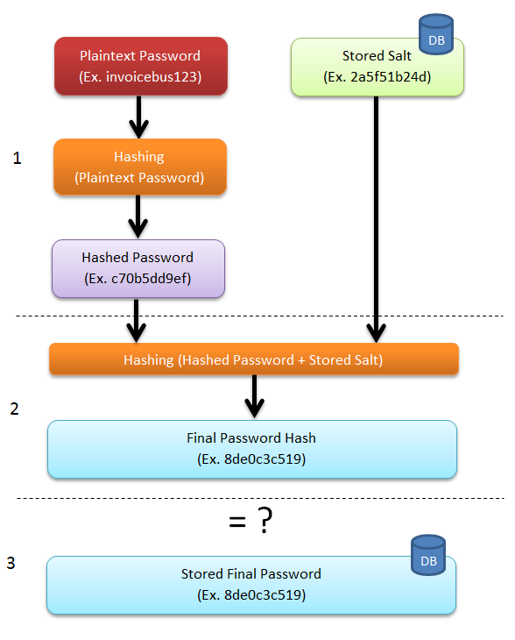
Authenticate User
1a. LOOKUP User-ID in DB,
GET user’s Salt-Hash.
1b. One-way Crypto Hash
of entered password.
2. Hash the hashes
n thousand times
3. COMPARE computed
Password-Salt-Hash input to
Password-Salt-Hash in DB.
Attack on whole password space of 8 letters / numbers / punctuation
OR 4 random Diceware words for a
single salted 100K hashed password
by GPU @ 5M guesses/second:
32,500 years
Notes:
Image source is https://invoicebus.com/garage/sleep-tight-your-data-is-secure-part-2/
Step 1a: Look up UserID in User DB. Get the user’s SaltHash.
Step 1b: Generate hash value for submitted plain text password.
N.B. set the plain text password variable to blanks ASAP in the sequential logic. This will overwrite the password in memory guarding against exploits such as Spectre and Meltdown. If all programmers had done this, the Heartbleed bug would have been less of a problem.
Step 2: Generate hash value of the concatenated values from the previous steps. Rehash n thousand times.
Step 3: Compare the resulting hash from Step 2 with the final password hash retrieved from the database. If equal, the user is authenticated to access the system.
“computationally expensive” to crack: guess a password, hash it, and perform step 2. and, at each iteration of hashing/rehashing, check if computed hash equals Final Password Hash stored in DB. Do this for every user. Even if every user set their password to "password123", the Stored Final Password hash would be different because each user's Salt is different.
The longer the password, the more computationally expensive it is to guess, i.e. longer passwords make cracking exponentially more difficult. Usually, cracking algorithms give up trying to crack passwords beyond a certain length. Why spend weeks of computer time cracking a single long password when many people's short passwords can be cracked in minutes.
May 3, 2018: https://www.reuters.com/article/us-twitter-passwords/twitter-says-glitch-exposed-substantial-number-of-users-passwords-idUSKBN1I42JG
Twitter Inc urged its more than 330 million users to change their passwords after a glitch caused some to be stored in readable text on its internal computer system rather than disguised by a process known as “hashing”.
Here is a pseudocode example without error handling
Get password from sign-on screen form.
Get userID from sign-on screen form.
Lookup userProfile record with userID
Get passwordHash from (userProfilePasswordSalt, password)
If passwordHash = userProfilePasswordHash
Set authenticated to True
Else
Deal with unauthenticated use case
Endif
/*
here’s the most important part at the end of each script/module/program/function/method:
some values will be on the stack and must be cleared before the function ends (local variables), some will be on the heap to be cleared before the program ends (global variables)
OS does not clean out memory no longer in use, just forgets the location was ever used. The byte values in the memory location remain what they were. It's why you must initial C variables else they will contain whatever binary happened to be there when the memory was allocated.
*/
Set every piece of memory with sensitive data or PII to blank/empty string after their values are no longer required:
current variables: userID, password, passwordHash
original web server data from sign-on screen form
Data structures, variables, or DB result set with values from User profile record lookup, e.g. userProfilePasswordHash
Any related object's instance variables/attributes,
only then deallocate object instance or leave for garbage collection or end function / program / script.
By deliberately assigning blank/empty to each variable, e.g. password = " " // set all possible positions within variable to null/blank value
The OS will generally overwrite all bytes the variable's memory location.
For all technologies you are using, understand their underlying implementation.
In languages like C, a string is stored in a char array with a null terminator.
password of "qwerty\0"
password = "" // set variable to blank value
results in memory containing: "\0werty\0" // this is efficient but not secure
password = " \0" // set all potential positions in variable to blank value
Lessons from a Professional Password Cracker – The Markup
https://themarkup.org/newsletter/hello-world/lessons-from-a-professional-password-cracker?utm_source=pocket_collection_story
https://security.blogoverflow.com/2011/11/why-passwords-should-be-hashed/
https://www.csoonline.com/article/2134124/network-security/adobe-confirms-stolen-passwords-were-encrypted-not-hashed.html
https://cryptosense.com/blog/parameter-choice-for-pbkdf2/ reference for 32,500 years on slide.
see https://support.logmeininc.com/lastpass/help/about-password-iterations-lp030027
LastPass client side default PBKDF2 iterations is 100,100 == how many times your credential is hashed using PBKDF2 before being sent to LastPass servers. Then the servers do it again. If servers then use the same PBKDF2 100,100 times to store hashed data, then it will take 1B years to crack an 8 character password. The sun will go nova before a 12 char password space stored on LastPass can be cracked. But that is no longer considered (by OWASP) to be enough.
1Password now uses 650,000 PBKDF2 iterations to store password hashes.
https://www.reddit.com/r/1Password/comments/10u6tjs/iteration_count_secret_key_and_master_password_a/

Slide 28
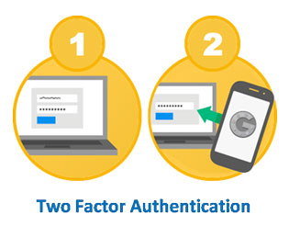
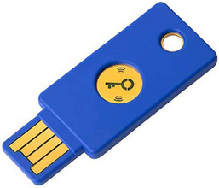
Two Factor Authentication – 2FA
Many organizations use two factor authentication to verify password sign on and guard against phishing & cracking:
Something I know
user ID & password, PIN
Something I have
FIDO2 Universal 2nd Factor (U2F), phone Authenticator (OTP), bank | credit | access card, YubiKey
Seneca students must use a
2FA Authenticator app to sign on.
KNOWN & OWNED
Notes:
ALWAYS use 2FA on Password Manager and financial accounts!
https://myid.senecacollege.ca/mfasetup
Students can enable additional security on their accounts by setting up Multi Factor Authentication.
https://explainxkcd.com/wiki/index.php/2522
Two-Factor_Security_Key
Fast IDentity Online, FIDO2 Universal 2nd Factor (U2F) is current state of the art / gold standard in 2FA
https://en.wikipedia.org/wiki/Universal_2nd_Factor
Google's Advanced Protection Program requires their employees to sign on with ID and password and a YubiKey. No other second factors, such as an Authenticator code (One Time Password – OTP), are accepted because they are not as secure as a YubiKey hardware key.
1Password can store a passkey for an account. This is okay so long as usage of the 1Password app is secured by biometrics or a YubiKey; each time 1Password is accessed to sign on to an account, fingerprint verification is requested. Fingerprint|facial authentication is easy to use securely on most smartphones. On laptops, Windows Hello or Apple Touch|Face ID can take the place of a YubiKey for verification.
Phones are used for NFC tap, Google/DUO/YubiKey/Microsoft Authenticator app, code via SMS message. These add a significant layer of security but are not as secure as biometrics or hardware keys for the second factor.
Ideally two factors are something I am (biometric identification) and something I have -- not something I know because most of us don’t know anything that is impossible for others not to know. (…no matter how smart you think are; all security experts will admit they are not that smart.)
The newer smartphones are something you have with a detector for something you are, e.g. fingerprint readers to enable payment systems using NFC (same as a physical card tap but with the addition of a biometric factor).
Authentication is the validation and acceptance of Credentials, i.e. something that proves you are really you. 2FA is two somethings.
Some organizations ask you for two pieces of identification, e.g. driver's license and credit card. This is a weak form of two factor authentication: two things you have.
Secure systems have moved to 2FA as a minimum.
Caution: the presence of a second factor caused users to pick much weaker passwords than if passwords alone were used to protect an account (Microsoft - Quest to Replace Passwords, 2012)
Google’s Authenticator is widely used on smartphones. However, Microsoft, 1Password, LastPass and others also have better reputations for privacy and have the same authenticator functions. Today, smartphones are the something most people already have.
https://landing.google.com/advancedprotection/ Google's Advanced Protection Program uses a physical Security Key as the second factor
Webauthn – Web Authentication: An API for accessing Public Key Credentials Level 1, W3C Recommendation, 4 March 2019
Is backward compatible with FIDO2. More on Webauthn later in this slide deck.
https://www.w3.org/TR/webauthn/
https://en.wikipedia.org/wiki/WebAuthn
See https://twofactorauth.org/ for list.
Web search?q=fido+u2f+security+key
https://www.yubico.com/solutions/fido2/
https://www.yubico.com/solutions/fido-u2f/
https://www.gartner.com/reviews/market/user-authentication/vendor/yubico/product/yubico-yubikey/alternatives
https://www.howtogeek.com/232360/how-to-secure-your-google-dropbox-and-github-accounts-with-a-u2f-key/
https://www.zdnet.com/article/best-security-key/
https://www.nytimes.com/wirecutter/reviews/best-security-keys/

Slide 29
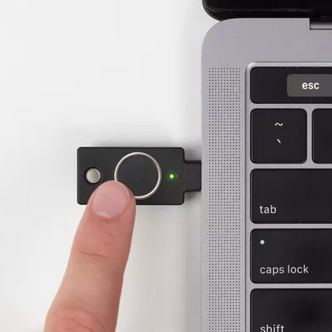
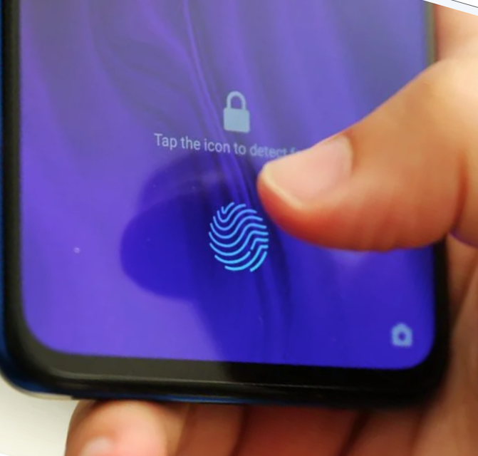
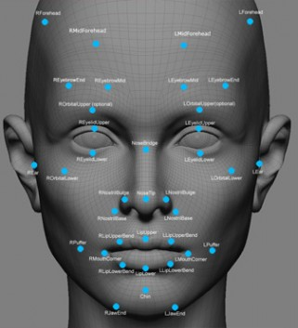
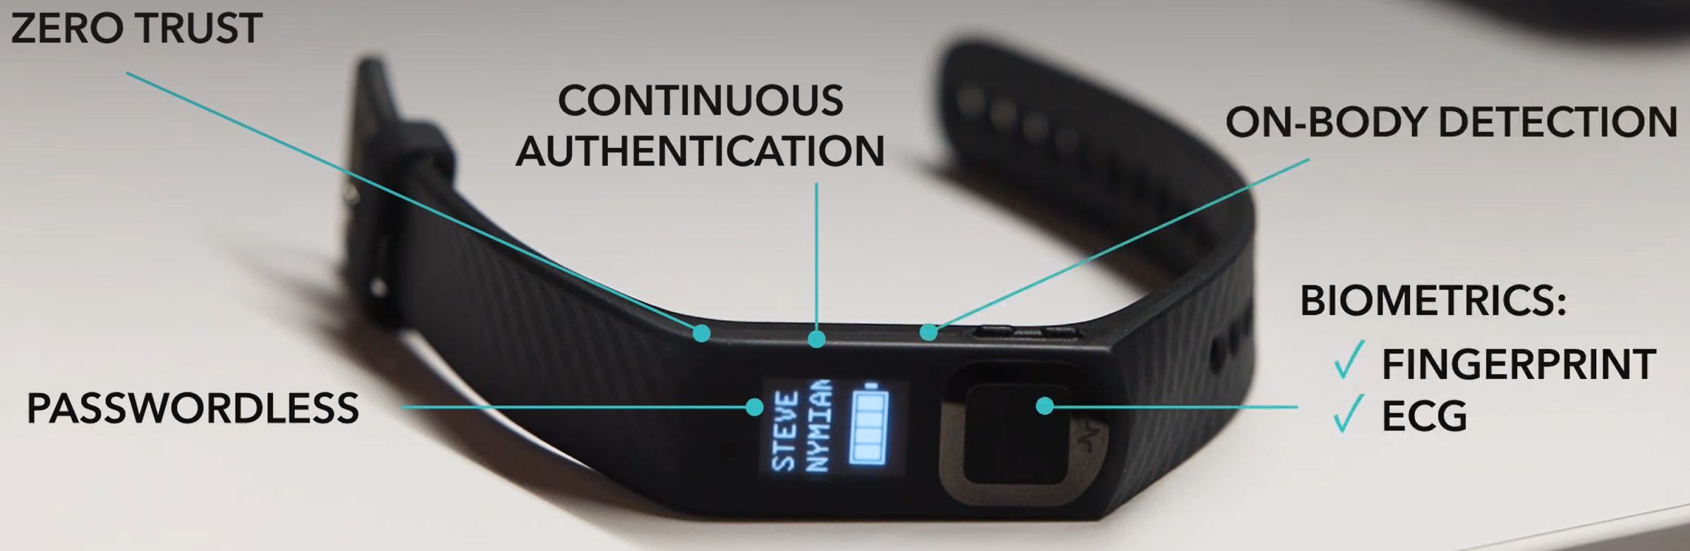
Three Factor Authentication – 3FA
Most secure
Something I know
user ID & password, PIN
Something I have
YubiKey, access card, Authenticator, device
Something I am
fingerprint, facial recognition, ECG heartbeat pattern
Nymi band
Notes:
A password, and its digital salted and hashed equivalent, is exactly the same every time. However, your biologic identifier is not scanned exactly the same every time. E.g. slight differences in orientation and features.
Bio-authentication is based on the high probability that your fingerprint today with a little scar is mostly the same as the reference enrollment fingerprint without the scar – that means comparing the current with historical bio-data: do these two things (today's fingerprint, facial scan, and/or ECG pattern versus yesterday's) look like they came from the same person? Secure biometric scanning looks for proof of life such as blinking eyes and natural head movement or a pulse | capillaries | capacitance | 3D with the 2D fingerprint pattern.
Your biometric data is stored and digitally signed for that bio-validation device only. If someone steals your phone, it is highly unlikely their fingerprint would pass as yours. In the unlikely event that malware circumvents OS security and steals the biometric data, it will not work on any other device even if the bad actor could somehow spoof your fingerprint|face.
https://www.nymi.com/privacy-and-gdpr-compliance-at-nymi
https://www.androidauthority.com/how-fingerprint-scanners-work-670934/
The YubiKey Bio, like a Nymi band or a phone with a fingerprint scanner, encapsulate two factors: something one has and something one is because they are unique devices which require biometric identification to work.
A Nymi is 3FA: the band itself and two biometrics, a fingerprint and ECG pattern, in identifying the person. Conditions of use are the person is wearing the device, is alive, and is physically active. Zero trust means every machine/door/system the user accesses requires new authentication. Continuous authentication means once user is signed on to a PC/terminal, it lasts only as long as user is within Bluetooth / NFC range.
https://www.itbusiness.ca/wp-content/uploads/2018/01/Visa-biometric-study-infographic.png
http://www.cbc.ca/news/business/biometrics-banks-canada-security-1.3691198
https://www.nymi.com/post/nymi-achieves-fido2-certification-for-the-nymi-band-3-0 <== a Canadian invention.
http://mashable.com/2017/06/27/token-wearable-ring-authenticator/#4k83w6Cq4qqM
http://resources.infosecinstitute.com/newest-biometric-technology-vein-pattern-recognition/ (see page's pull down list for information on other biometric types)
--VPR is highly reliable, robust to real world conditions, and user acceptable (no physical contact with sensor needed, no light shining on your retina) but not portable. Hand must be scanned at reader stations.
http://resources.infosecinstitute.com/biometrics-todays-choice-future-authentication/

Slide 30
PIN: Probably Insecure Number
4 digit PINs used by banks and credit cards as 2FA
  Ten thousand possibilities, right?
Most people use a date to make it memorable.
12 mos * 31 days = 372
13 – 31 days * 12 mos = 228
1924 – 2023 years * = 100
Total = 700 PINS or 7% of the range
* 2001 – 2024 years already included in day/month combos
Notes:
Personal Identification Number – something known to go along with something owned
Based on industry analysis of a large base of cracked 4 digit pins…
Most people's pins are the month/day or day/month of some significant date in their lives. Or, pins start with 19 or 20, signifying a year with a rather small range of perhaps 100 values 1917-2016. Rarely do pins start with a number over 31 (day). And rarely do people use more than a 4 digit pin even if a 6 digit pin might be allowed which is also rare. So 10,000 pins become 12 * 31 (12 mos & 31 days) = 372 + 19 * 12 (13—31 * 12 months) = 228 + ~100 (4 digit years) for a total of 700 PINS or 7% of the possible range
[Documentation note: in programming, day can mean one of the seven days of the week or the 01 – 31 day of the month. Similarly, date can mean day of month or the full YMD. Be clear of usage when choosing variable names and in comments.]
Note: the presence of a second factor caused users to pick much weaker passwords (or PINs) than if passwords alone were used to protect an account (Microsoft - Quest to Replace Passwords, 2012)
So, just because the PIN is a second security factor (what you know with the debit/credit card you have), it does not mean the PIN can be weak.
Google: contactless EMV transactions
For smaller purchases, always tap your credit/debit card because the purchase is completed without exposing your PIN.
Use Apple Pay or Google Pay – it is better than the actual credit card because the merchant will not know your credit/debit card number and your PIN is your fingerprint.
Consumer Device Cardholder Verification Method (CDCVM)
https://support.apple.com/en-ca/HT202527

Slide 31
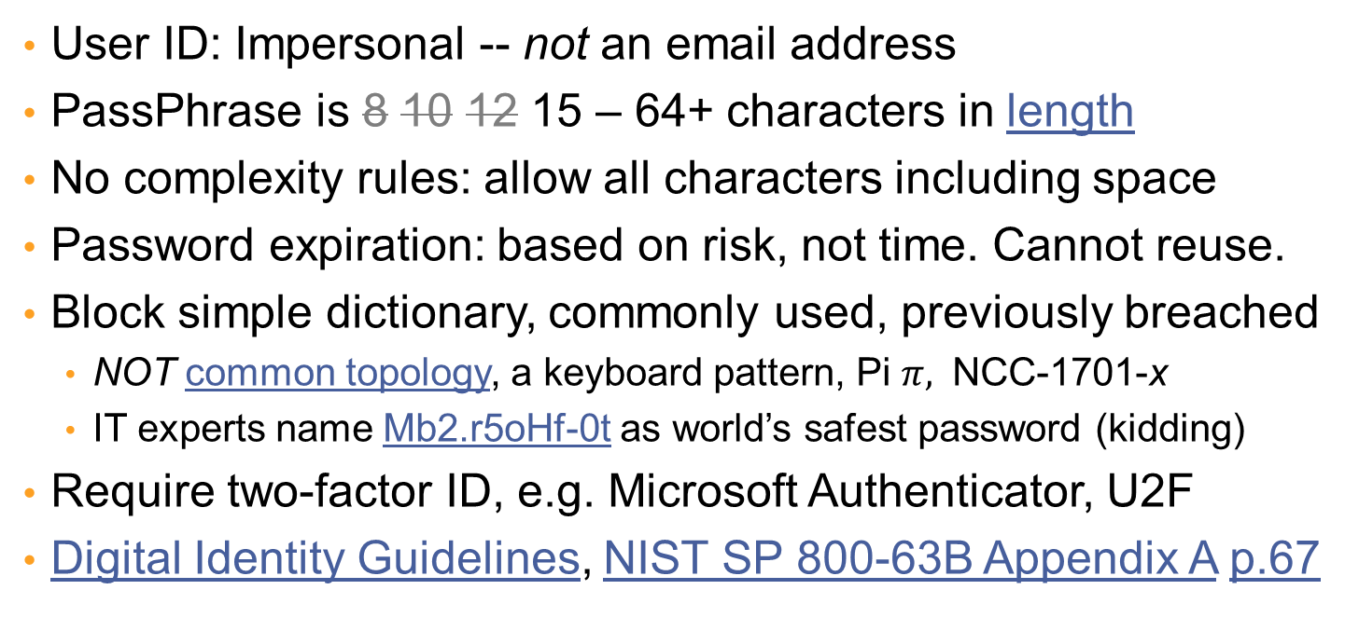
Better Password Policies
User ID: Impersonal -- not an email address
PassPhrase is 8 10 12 15 – 64+ characters in length
No complexity rules: allow all characters including space
Password expiration: based on risk, not time. Cannot reuse.
Block simple dictionary, commonly used, previously breached
  NOT common topology, a keyboard pattern, Pi $π,$ NCC-1701-x
  IT experts name Mb2.r5oHf-0t as world’s safest password (kidding)
Require two-factor ID, e.g. Microsoft Authenticator, U2F
Digital Identity Guidelines, NIST SP 800-63B Appendix A p.67
Notes:
Will this be the last World Password Day? | IT World Canada News
https://www.itworldcanada.com/article/will-this-be-the-last-world-password-day/446997
information for server admins and CSIO
Passwords were introduced in 1962 to access a computer time-sharing system at MIT. "It was a reactionary measure that unfortunately has become what we refer to as a security control." … i.e. passwords are a SIXTY-YEAR-OLD HACK!
Security intrusions by cracking a single user id and password are unconscionable and inexcusable.
Contrast this with an age-old security technique of requiring two signatures on company cheques.
https://blog.1password.com/how-long-should-my-passwords-be/
https://www.explainxkcd.com/wiki/index.php/1820:_Security_Advice
https://www.hpe.com/us/en/insights/articles/two-truths-and-a-lie-about-corporate-password-policies-2105.html
https://cheatsheetseries.owasp.org/cheatsheets/Password_Storage_Cheat_Sheet.html
https://github.com/OWASP/CheatSheetSeries/blob/master/cheatsheets/Authentication_Cheat_Sheet.md
Details found at https://github.com/OWASP/CheatSheetSeries/tree/master/cheatsheets
https://en.wikipedia.org/wiki/Password_strength#Guidelines_for_strong_passwords
Disallowing email addresses and names as User IDs DOUBLES the number of things a cracker from the outside must know to break in. It is a great defense against the bot exploit which uses email spam lists to guess passwords for known UserIDs.
e.g. of common topology Ullllldd – Upper case, 5 lower case, 2 digits
Do not allow keyboard patterns that a keyboard walk could find.
Geeks love to show how many digits of Pi they can memorize.
Disallow popular culture codes, e.g. NCC-1701 is Star Trek's Enterprise call sign.
https://www.welivesecurity.com/2017/05/03/no-pointless-password-requirements/
https://www.troyhunt.com/passwords-evolved-authentication-guidance-for-the-modern-era/
https://www.troyhunt.com/how-long-is-long-enough-minimum-password-lengths-by-the-worlds-top-sites/
https://www.ncsc.gov.uk/guidance/password-guidance-simplifying-your-approach
NIST SP 800-63-3
The newest password guidelines are a swift about-face in strategy as compared to previous NIST suggestions. Instead of a strategy of ensuring that all passwords meet some type of arbitrary complexity requirements, the new strategy is to create passwords that are easier and more intuitive. Here are some of the highlights:
Passwords should be compared to dictionaries and commonly-used passwords. See https://github.com/danielmiessler/SecLists/tree/master/Passwords/Common-Credentials
Eliminate or reduce complexity rules for passwords
All printable characters allowed, including spaces
Expiration of passwords no longer based on time password has been in use
Maximum length increased to 64 characters. The NIST max length of 64 is not intended to limit but to ensure the hashing routines can handle at least 64 bytes. Most password systems that restrict the length of the password do so because they are using old, limited hashing routines.
https://www.caiservice.com/blog/understanding-the-new-nist-guidelines-for-password-security
https://www.csoonline.com/article/3243929/password-security/unraveling-the-truth-about-the-nists-new-password-guidelines.html
https://www.caiservice.com/blog/understanding-the-new-nist-guidelines-for-password-security
https://nakedsecurity.sophos.com/2016/08/18/nists-new-password-rules-what-you-need-to-know/
https://www.passwordping.com/strong-password/
https://www.passwordping.com/faq/
https://www.passwordping.com/surprising-new-password-guidelines-nist/
https://www.nist.gov/blogs/taking-measure/easy-ways-build-better-p5w0rd
https://pages.nist.gov/800-63-3/
https://www.caiservice.com/blog/understanding-the-new-nist-guidelines-for-password-security
https://www.schneier.com/blog/archives/2017/10/changes_in_pass.html
http://resources.infosecinstitute.com/prevent-weak-passwords/
Most commonly used passwords will be disallowed by a minimum 15 character rule. see https://en.wikipedia.org/wiki/Password_strength
"prudent to set a minimum PassPhrase length of 15 characters, as this is the critical length where easily cracked LANMan hashes will not be stored in Windows server systems" (http://resources.infosecinstitute.com/prevent-weak-passwords/)
https://support.microsoft.com/en-us/help/299656/how-to-prevent-windows-from-storing-a-lan-manager-hash-of-your-passwor
For the many cracking services available, see https://www.startpage.com/sp/search?query=hash+cracker
Don’t allow easy-to-enter passwords that contain simple sequences or physical keyboard patterns, even if they are longer than 14 char. Include Pi in the list of not allowed numbers 3.14159265358979323846264 because geeks and science types like to use it. There is even Pi day: 3.1415 March 14 with pie at 15:00 hours. Don't allow obviously easy to guess things like "passwordpassword", "password1234"
That's it. No other restrictions. Allow spaces! Allow multiple dictionary words so people can create long pass phrases!
When newly breached password lists become known, check your user DB for matches. i.e.
FOR EACH user authentication record
FOR EACH newly breached password
RUN login process
IF login was successful,
THEN EXPIRE user's password, send user msg that their password was found on a breached list.
END FOR
END FOR
Note: this will consume significant CPU cycles. Schedule during off-peak times. Consider throttling the process by inserting a short sleep() after each login attempt.

Slide 32
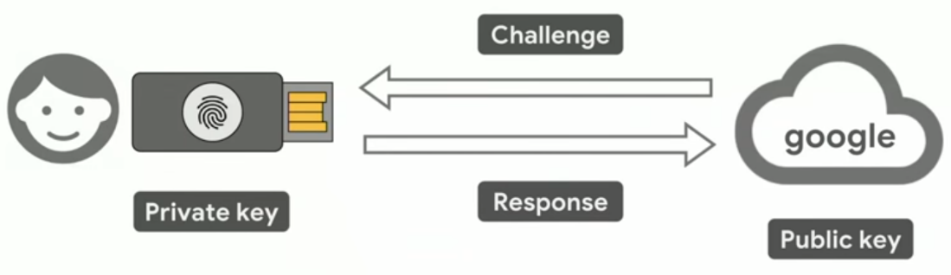
Better Password Policies
Storage
In a salted and hashed format using a standard library with Argon2id or PBKDF2 properly implemented. See OWASP Cheat Sheet
Do not invent your own. Obscurity ≠ Security
Even better: just say no to passwords
Use a passkey instead. Start with Microsoft or Google.
FIDO2
hardware + biometric
or YubiKey & hardware
Notes:
For a passkey to replace a password with true MFA, you always need TWO devices, each with their own access security.
This tech is not new, Google has been using it with great success since 2017.
Accessing an account using a passkey requires the host system to issue a security challenge to be answered with a passkey. The passkey is sent only after MFA on the client system.
Use a physical FIDO2 hardware security key, such as YubiKey, to access your password manager and/or other accounts from your device (smartphone or laptop or tablet).
Using a physical key requires touching it + PIN entry, or pressing on its fingerprint reader if so equipped. i.e. the physical key itself requires 2FA. (the cloning of a physical key into a virtual one by NinjaLab in 2021 required the plot of a Mission Impossible movie; the extraordinarily unlikely exploit has likely be remedied since.)
Usually, the host system's authentication process requires the key to be paired with your device's Trusted Platform Module (TPM) security chip. That adds a third factor: something else you have. The device almost always has its own security access which adds one or more factors, e.g. fingerprint, face recognition. This provides robust MFA.
A smartphone itself can be a FIDO2 hardware security key to authorize another device to access an account. A smartphone cannot be both a physical key and the accessing device.
For convenience and almost as much security on a device, install a password manager that requires a physical passkey to access it, e.g. BitWarden or 1Password on iOS or Android, soon for laptop/desktop. Then use the password manager to supply virtual passkeys for all other accounts. (You can also use a password manager app with traditional password access to supply virtual passkeys but this closer to 2FA than MFA. Using YubiKey to access only your device is similarly just 2FA; malware can still run on the device. Malware cannot steal passkeys from a TPM or physical key.)
Have a second physical key as a backup, or access to the password manager's setup credentials to recover from a lost key. (requires access to the email account registered with password manager service. This means knowing TWO crucial passwords: to both email and pwd mgr.)
https://www.pcworld.com/article/2225483/you-should-always-memorize-these-two-passwords.html
https://www.enzoic.com/blog/hashing-what-you-need-to-know-about-storing-passwords/
https://www.enzoic.com/active-directory-lite/ -- scans for unsafe passwords in MS Active Directory
https://support.1password.com/passkey-security/
https://passage.1password.com/post/seven-misunderstandings-about-passkeys
https://www.youtube.com/watch?v=3OjzJSnkh5Q
https://duo.com/blog/what-are-passkeys
https://www.yubico.com/solutions/multi-factor-authentication/
https://resources.yubico.com/53ZDUYE6/at/qktm8c96t5ts4p4zrrhnr84s/Yubico_White_paper_mobile_authentication_vs_YubiKey_phishing_resistant_MFA.pdf?format=pdf
https://www.techradar.com/news/1password-is-to-get-rid-of-passwords-with-passkey-support-on-the-way
https://www.youtube.com/watch?v=1325F2uvImI
https://www.beyondidentity.com/developers/blog/fido2-vs-webauthn-whats-difference
https://www.strongdm.com/blog/fido2#:~:text=FIDO2%20and%20WebAuthn%20are%20not,was%20developed%20by%20the%20W3C.
https://duo.com/blog/webauthn-passwordless-fido2-explained-componens-passwordless-architecture
https://support.google.com/accounts?p=passkey_unsdev&hl=en_GB
https://support.google.com/accounts/answer/13548313
Password policy recommendations - Microsoft 365 admin | Microsoft Learn
https://learn.microsoft.com/en-us/microsoft-365/admin/misc/password-policy-recommendations
https://cheatsheetseries.owasp.org/cheatsheets/Password_Storage_Cheat_Sheet.html
Hashing encodes passwords to hide their length and value; it is a one-way function and is very difficult to reverse, unless you have clues like commonly used passwords (a dictionary attack, see https://en.wikipedia.org/wiki/Rainbow_table) where you hash the dictionary words once and just check each user's hashed password against the hashed dictionary list. Salting (adding a unique sequence to the original password) makes each hash unique so knowing the hashed value of common passwords subverts these attacks. There is also Peppering: secrets stored in "secrets vaults" or HSMs (Hardware Security Modules) used to hash all passwords in a security/credentials database.
Only when passwords have been salted and hashed is brute-force cracking necessary but also unproductive. Good library functions make it computationally expensive to crack passwords: fast enough for practical use, slow enough to make brute-force ineffective.
Don’t be lazy, never be clever. Use a standard, well reviewed library function such as Argon2id or PBKDF2. E.g. PHP Secure Login and Registration Package https://www.phpclasses.org/blog/package/10087/post/1-secure-login-and-registration-system.html
https://www.owasp.org/index.php/Password_Storage_Cheat_Sheet
https://nakedsecurity.sophos.com/2013/11/20/serious-security-how-to-store-your-users-passwords-safely/
https://password-hashing.net/
https://cryptosense.com/blog/parameter-choice-for-pbkdf2/
https://medium.com/@mpreziuso/password-hashing-pbkdf2-scrypt-bcrypt-and-argon2-e25aaf41598e
https://www.wired.com/story/bcrypt-password-hashing-25-years/
Avoid passwords entirely. Use Web Authentication API. Demo at https://webauthn.io/
The new standard known as Web Authentication, or WebAuthn for short, is a credential management API that will be built directly into popular web browsers. It allows users to register and authenticate with web applications using an authenticator such as a phone, hardware security keys, or TPM (Trusted Platform Module) devices.
Note that the google cloud could be any website using the new as of March 4, 2019 W3C standard for WebAuthn
https://duo.com/blog/web-authentication-what-it-is-and-what-it-means-for-passwords
https://venturebeat.com/2019/03/04/w3c-approves-webauthn-as-the-web-standard-for-password-free-logins/
https://en.wikipedia.org/wiki/WebAuthn
https://www.securitymagazine.com/articles/89958-no-more-passwords-webauthn-becomes-an-official-web-standard
https://developer.mozilla.org/en-US/docs/Web/API/Web_Authentication_API
https://developers.google.com/web/updates/2018/05/webauthn
https://www.w3.org/TR/webauthn/

Slide 33
Security protects Privacy
Authentication: MFA (Multi-Factor Authentication)
  esp. for administration, security, VPN access
Authorization: Least Privilege Principle
Enterprise SSO with IdP and MFA via SAML
  Single Sign On, Identity Provider, Security Assertion Markup Language for authentication and Authorization
IBM Future of Identity DIACC Ontario-DID
Notes:
Stop fixing, blaming, and micro-managing the user for their behaviour. Security must work given or despite what people do. It must be usable, flexible, mostly invisible -- as frictionless as possible.
But less friction, as with SSO (Single Sign On), means users need secure credentials with good passwords and/or MFA. This is the same idea as a Password Manager but on an enterprise, instead of individual, level.
IdP (Identity Provider) authenticates user (e.g. via MS Azure Active Directory), passes SAML (Security Assertion Markup Language) to requester with info about what user can do in requester's system.
https://en.wikipedia.org/wiki/Identity_provider
https://en.wikipedia.org/wiki/Security_Assertion_Markup_Language
What’s the Difference Between OAuth, OpenID Connect, and SAML? | Okta
https://www.okta.com/identity-101/whats-the-difference-between-oauth-openid-connect-and-saml/
Okta and 1Password integration https://support.1password.com/scim-okta/
System for Cross-Domain Identity Management (SCIM)
https://learn.microsoft.com/en-us/azure/active-directory/fundamentals/sync-scim
OpenID Connect | OpenID – Internet Identity Layer
https://openid.net/connect/
SAML explained: How this open standard enables single sign on | CSO Online
CSO = Chief Security Officer
SAML for enterprise SSO to intranet and service providers (e.g. Salesforce, Box, or Workday)
https://www.csoonline.com/article/3232355/saml-explained-how-this-open-standard-enables-single-sign-on.html
https://www.csoonline.com/article/3564695/5-best-practices-to-secure-single-sign-on-systems.html
Digital ID & Authentication Council of Canada, Ontario Digital-ID
https://www.itbusiness.ca/news/app-users-value-security-over-convenience-and-biometrics-over-passwords-ibm-finds/100933
https://www.itbusiness.ca/wp-content/uploads/2018/04/Infographic_FutureofIdentityStudy_FINAL.jpg
http://ieeexplore.ieee.org/document/7676198/citations
Stop Trying to Fix the User: Users aren't the problem with security. It's that we've designed our computer systems' security so badly that we demand the user do all of these counterintuitive things.
Overall, we must stop trying to fix the user to achieve security. Usable security does not mean "getting people to do what we want." It means creating security that works, given (or despite) what people do. People do what is easiest, not always what’s best.
First, Security must be usable. That means easy to install, not frustrating to use, and no confusing terminology.
Second, it needs to be flexible. It has to work across various platforms and be compatible with a large variety of authentication technologies.
Last, It needs to be mostly invisible to the user. The more we can accomplish with limited interaction, the better.
From Microsoft’s “The Quest to Replace Passwords”…
The difficulty of guessing passwords was studied over three decades ago with researchers able to guess over 75% of users’ passwords; follow-up studies over the years have consistently compromised a substantial fraction of accounts with dictionary attacks. A survey of corporate password users found them flustered by password requirements and coping by writing passwords down on post-it notes.
On the web, users are typically overwhelmed by the number of passwords they have registered. One study found most users have many accounts for which they’ve forgotten their passwords and even accounts they can’t remember registering. Another used a browser extension to observe thousands of users’ password habits, finding on average 25 accounts and 6 unique passwords per user.
Digital ID & Authentication Council of Canada https://diacc.ca/
How blockchain could have prevented the Facebook data breach
https://www.itworldcanada.com/article/how-blockchain-could-have-prevented-the-facebook-data-breach/403122
Interac outlines how it plans to secure Canada’s digital identity service
https://www.itworldcanada.com/article/interac-outlines-how-it-plans-to-secure-canadas-digital-identity-service/399268
A real digital identity, for individuals and organizations, could introduce accountability and responsibility in Web 2.0 environments, e.g. social media or posting comments.
OTOH, there's this…
https://restofworld.org/2023/weibo-legal-display-name-influencers/
https://global.chinadaily.com.cn/a/202310/31/WS6541068aa31090682a5ebbb9.html
"WeChat announced that it is implementing the [government mandated] policy [of displaying real names] to "enhance the credibility" of content creator accounts and "facilitate public supervision for the public interest"." the first benefit is acceptable, the second is not.

Slide 34
Security protects Privacy
Systems: Zero Trust Architecture
  Only Trusted Applications can run on OS
  Application’s users: “never trust, always verify”
  Includes server to server inside intranet
IaC = Infrastructure as Code
Encrypt both local and backup data
  So data exported by Ransomware cannot be read for double extortion. Then rebuild from backup.
Notes:
The IBM/z (mainframe) series encrypts all data in secondary storage and temporary data in primary storage (RAM). If the most secure OS in the IT industry encrypts everything everywhere – just in case – then we all should.
Web search?q=IaC+practices
IaC is the practice of managing cloud computing infrastructure such as virtual machines, containers, virtual networks, etc, via machine-readable templates and definition files. i.e. that code builds the infrastructure (IaaS) properly and securely…instead of a bunch of ad hoc configuring.
Stop fixing, blaming, and micro-managing the user for their behaviour.
Security must work given or despite what people do. It must be usable, flexible, mostly invisible -- as frictionless as possible.
Digital ID & Authentication Council of Canada, Ontario Digital-ID
https://www.startpage.com/sp/search?query="zero+trust"+environment
https://www.paloaltonetworks.com/cyberpedia/what-is-a-zero-trust-architecture
https://www.darkreading.com/perimeter/never-trust-always-verify-demystifying-zero-trust-to-secure-your-networks/a/d-id/1334995
https://www.csoonline.com/article/3626432/7-tenets-of-zero-trust-explained.html
https://www.itworldcanada.com/article/dont-be-tripped-up-by-zero-trust-myths/462098
Trusting what is inside the network (Intranet) assumes it is surrounded by a Great Wall of China. The reason we know the name of an eighth century leader, Genghis Khan, is because his forces breached that wall several times with different exploits. Trusting what is inside the network assumes a false sense of security. Pretend you have no firewall. This is even more important during and after the COVID-19 pandemic because people are working remotely by an assumed safe and secure VPN (i.e. tunnelling. Genghis Khan exploited what were thought to be secret and secure tunnels. )
https://www.itworldcanada.com/article/28-million-canadians-impacted-by-data-breaches-in-last-12-months-privacy-commissioner/423577
Know what personal information you have, where it is, and what you are doing with it. When and where do you collect personal information? Where does that information go? Who can access it, and what do they do with it? You must understand your data before you can protect it.
Know your vulnerabilities. Conduct risk and vulnerability assessments and/or penetration tests within your organization to ensure that threats to privacy are identified. Don’t just focus on technical vulnerabilities, though. Are third parties collecting personal information on your behalf without appropriate safeguards? Are your employees aware of risks and their privacy responsibilities? Over the last year, the OPC has seen each of these scenarios lead to a breach. Identify your organizations’ weak points before a breach identifies them for you.
Be aware of breaches in your industry. Attackers will often re-use the same attacks against multiple organizations. Pay attention to alerts and other information from your industry association and other sources of industry news.
https://www.cisa.gov/sites/default/files/publications/19_1106_cisa_CISA_Cyber_Essentials_S508C.pdf
https://www.cyber.gc.ca/en/guidance/baseline-cyber-security-controls-small-and-medium-organizations
https://www.itbusiness.ca/news/app-users-value-security-over-convenience-and-biometrics-over-passwords-ibm-finds/100933
https://www.itbusiness.ca/wp-content/uploads/2018/04/Infographic_FutureofIdentityStudy_FINAL.jpg
http://ieeexplore.ieee.org/document/7676198/citations
Stop Trying to Fix the User: Users aren't the problem with security. It's that we've designed our computer systems' security so badly that we demand the user do all of these counterintuitive things.
Overall, we must stop trying to fix the user to achieve security. Usable security does not mean "getting people to do what we want." It means creating security that works, given (or despite) what people do. People do what is easiest, not always what’s best.
First, Security must be usable. That means easy to install, not frustrating to use, and no confusing terminology.
Second, it needs to be flexible. It has to work across various platforms and be compatible with a large variety of authentication technologies.
Last, It needs to be mostly invisible to the user. The more we can accomplish with limited interaction, the better.
From Microsoft’s “The Quest to Replace Passwords”…
The difficulty of guessing passwords was studied over three decades ago with researchers able to guess over 75% of users’ passwords; follow-up studies over the years have consistently compromised a substantial fraction of accounts with dictionary attacks. A survey of corporate password users found them flustered by password requirements and coping by writing passwords down on post-it notes.
On the web, users are typically overwhelmed by the number of passwords they have registered. One study found most users have many accounts for which they’ve forgotten their passwords and even accounts they can’t remember registering. Another used a browser extension to observe thousands of users’ password habits, finding on average 25 accounts and 6 unique passwords per user.
Digital ID & Authentication Council of Canada https://diacc.ca/
How blockchain could have prevented the Facebook data breach
https://www.itworldcanada.com/article/how-blockchain-could-have-prevented-the-facebook-data-breach/403122
Interac outlines how it plans to secure Canada’s digital identity service
https://www.itworldcanada.com/article/interac-outlines-how-it-plans-to-secure-canadas-digital-identity-service/399268

Slide 35
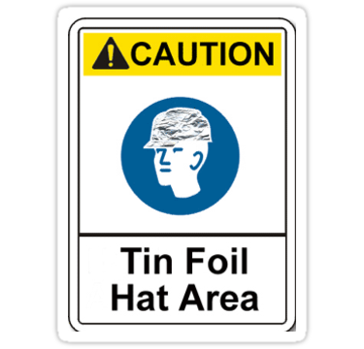
Notes
…not on the quiz but here
for further information
and explanation.

Slide 36
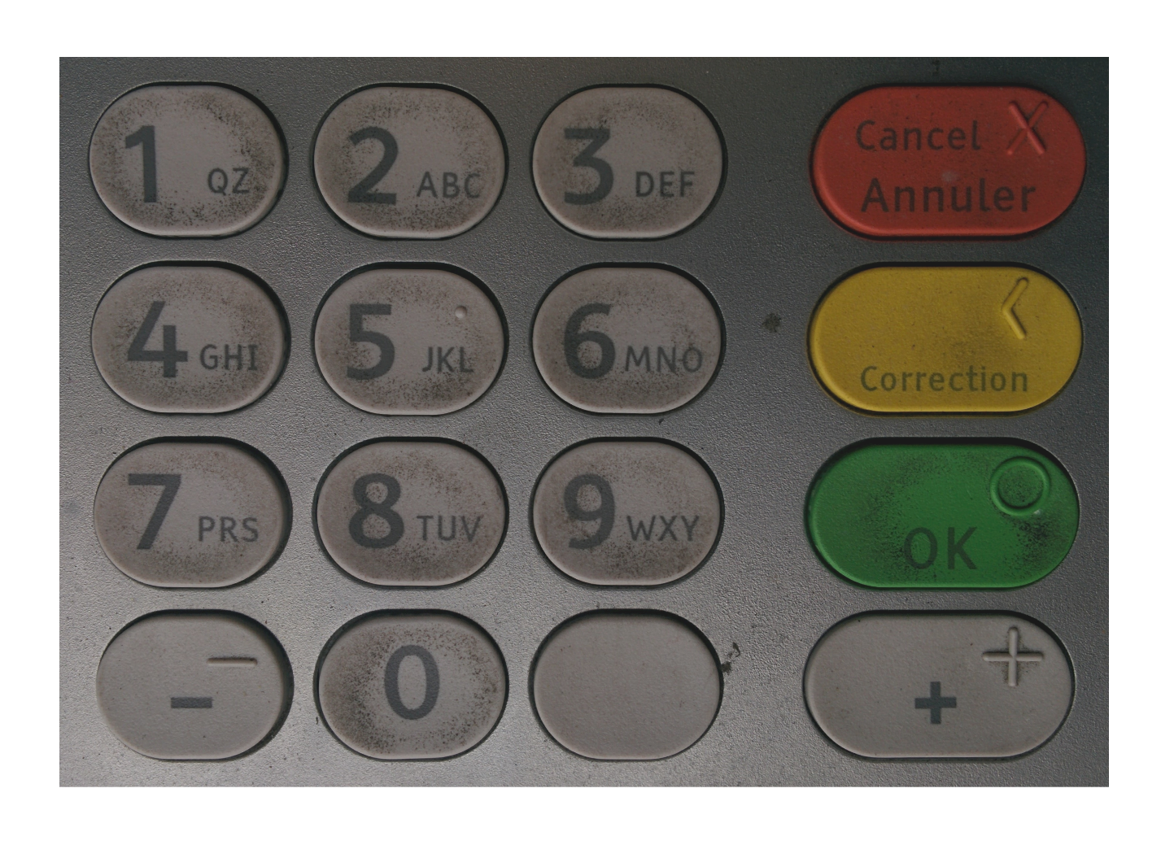
PIN: Probably Insecure Number
Input pad at a Toronto ATM. Panel is on a sidewalk open to busy street. Dirt reveals:
1,2,5,7 used most.
1,5,7,1 could be a pattern PIN.
1,2,3,4 worth a try to crack password.
6,8,9 used least.
Notes:
Coxwell Ave and Danforth Ave.
pre-COVID when the keypad was not cleaned daily.
Numbers used most often are easy to see: 1 appears to be the most popular.
1-2-3-4 might be only the second most used PIN here.
A likely PIN is 1-5-7-1 or 1-7-5-1

Slide 37
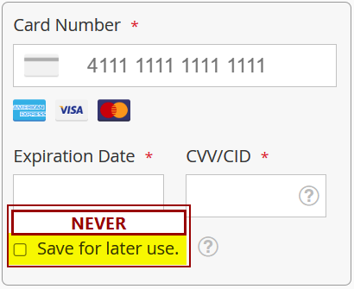
Safe Payment Practices
Minimize reveal of financial credentials
Make 'contactless purchases'
  Use Apple Pay or Google Wallet on smartphone
  Use prepaid card: Seneca OneCard, Mastercard, Visa, gift cards
  Tap payment card to avoid exposing PIN
eCommerce
  Use ShopPay, PayPal, Visa Secure,
  Click to Pay (Mastercard) – with 2FA
  Never save credit card at merchant
Notes:
The concept is to use an insulating layer between the merchant (bricks and mortar or online) and your financial credentials.
Avoid using your actual debit or credit card by employing a payment mechanism that pays the merchant and charges your account.
There's always good ol' cash money.

Slide 38
What happens when free social media meets inadequate security management:
Dear Art Lovers, [ from a professional artist ]
So sad to lose contact with so many of you online.
It has been a crazy few weeks - I have been going down the rabbit hole trying to find a way to get my social media accounts back. From what I have heard, it could take 5 or 6 months...if I am even able to get my accounts back at all. This includes my personal and business Facebook page, my Instagram page, the ArtAlchemyEast Instagram page, as well as the Art Alchemy studio pages.
Between all these accounts, over 9,000 people shared my art journey…
Notes:
… from an email on 2022-10-28 to Tim McKenna from an artist whose work is hanging in his home.
An artist who runs a successful business selling her art. i.e. not a hobby. She makes a living doing it.

Slide 39
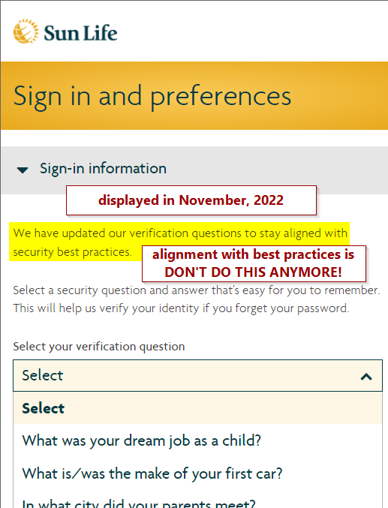
Obsolete practices are still in practice.
Sun Life doesn't read the ICT news.
Notes:
Choosing and Using Security Questions - OWASP Cheat Sheet Series
that is, DO NOT DO THAT!
https://cheatsheetseries.owasp.org/cheatsheets/Choosing_and_Using_Security_Questions_Cheat_Sheet.html

Slide 40
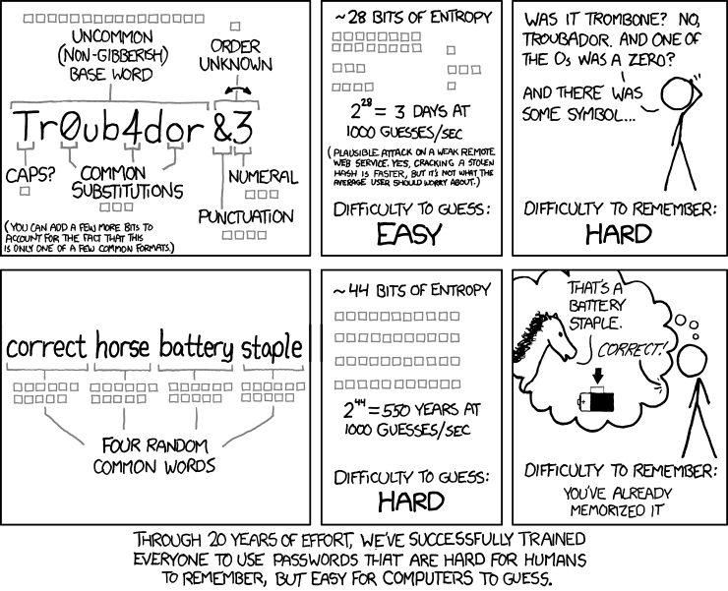
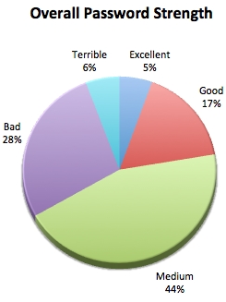
2013 analysis of 2M intercepted logins from real humans.
Notes:
Through 20 years of effort, we’ve successfully trained everyone to use passwords that are hard for humans to remember but easy for computers to guess. https://xkcd.com/936/
https://www.explainxkcd.com/wiki/index.php/936:_Password_Strength
https://xkcd.com/1820/ -- Security Advice
https://en.wikipedia.org/wiki/Password_strength
Pie Chart: The Top-10 passwords were trivial, 123456 and other simple sequences, “password”, “admin”, but just less than 2% of total. Overall, over 1/3 of passwords were Bad or Terrible. Less than 1/4 were Good or Excellent.
https://www.trustwave.com/Resources/SpiderLabs-Blog/Look-What-I-Found---Moar-Pony!/
https://en.wikipedia.org/wiki/List_of_the_most_common_passwords
The following may be inflated data but…SplashData, which collates passwords from data breaches in America and Western Europe to build samples, said "123456" was, for the fifth year running (as of 2016), the most common password used by nearly 17% of users.
The top 25 passwords account for 50% of all user passwords.
The top 1,000 passwords account for 91% of all user passwords. (Xato.net)
You don’t need a supercomputer to crack those.
This has led to password policies immortalized in this famous XKCD cartoon.
For organizations without password policies, almost all of the most common passwords are simply patterns on a keyboard, usually horizontal, or are simple sequences of letters and/or numbers.
“Smart” vertical, diamond, parallelogram keyboard patterns are also already in the crackers’ lists.
So passwords are either trivially easy to guess or extremely difficult to remember. What do we do?
SplashData references below
http://www.telegraph.co.uk/technology/2016/01/26/most-common-passwords-revealed---and-theyre-ridiculously-easy-to/
https://blog.keepersecurity.com/2017/01/13/most-common-passwords-of-2016-research-study/
https://www.balabit.com/blog/password-privacy-the-importance-of-total-password-secrecy/
http://www.itworldcanada.com/article/password-analysis-shows-employees-still-arent-getting-the-message/392287
20 per cent of 974,000 passwords were cracked in six days of intensive work
–2 minutes – the time taken for the first pass with a wordlist and 64 rules to crack the first 38,000 passwords
–Just under five days – time taken to brute force all passwords up through eight characters in length;
–12 – average number of passwords cracked per user account (either because they used a poor password, or it was eight characters or less, or both) The pwd DB had user history of previously used pwds.
–87.8 per cent of the passwords cracked were broken using the easily available CrackStation password cracking wordlist, a compilation of dictionary words, leaked password databases and books. i.e. almost all cracked passwords were NOT random strings.

Slide 41
Security Architecture
Multi-factor authentication is a mandatory requirement
Web serving uses micro-services architecture with security baked in.
Zero Trust model: never trust, always verify.
segregate client processes from internal resources via highly constricted view of internal network. e.g. only to a switch, or to a port, or to specific services – not to the actual resources themselves such as a DB or file location or to IP addresses of other machines on the network
Notes:
Fatal assumption: trusting all software just because it is inside your system.
Micro-services are small, modular services each running a unique process and communicating through a well-defined, lightweight mechanism. E.g. your program asks a micro-service for a DB record. Your program does not have access to the DB and the service's security ensures it only gives out data to authenticated and authorized programs. Ask, and the system will get it for you. Your program is not allowed into the candy store and get whatever it likes.
Most networks are built with security protecting them from outside threats, e.g. the firewall. Once inside the network, well, you must be OK because you got inside so go ahead and search all ports on every internal IP address.
Newer network security treats sub-nets, client machines, and software processes the way we treat user security: minimal privileges – you get to see and do only what is necessary for your specific task. Requesting all records in a database is never part of anyone's job. Zero Trust embeds security within the system’s operation, rather than layering it on top like perimeter security.
References:
https://martinfowler.com/articles/microservices.html
https://info.townsendsecurity.com/three-core-concepts-from-zero-trust-to-implement-today
https://www.paloaltonetworks.com/cyberpedia/what-is-a-zero-trust-architecture
https://www.plixer.com/blog/netflow/network-segmentation-zero-trust/

Slide 42
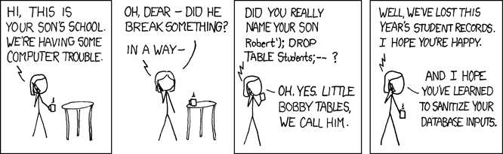
SQL Injection Attacks
INSERT INTO Students (name) VALUES ('Robert');DROP TABLE Students;--');
  Do not run dynamic SQL statements that include outside data.
Defence: Use SQL Prepared Statements or parameterized SQL calls. E.g.
INSERT INTO Students (name) VALUES ('?');
Notes:
SQL Injection attacks
https://www.xkcd.com/327/
https://www.explainxkcd.com/wiki/index.php/327:_Exploits_of_a_Mom
INSERT INTO Students (name) VALUES ('Robert');DROP TABLE Students;--');
Do not run dynamic SQL statements that include outside data.
defence: Use Prepared statement or parameterized SQL calls. E.g.
INSERT INTO Students (name) VALUES ('?');
This coding style allows the database to distinguish between code and data, regardless of what user input is supplied. There is also performance optimization because prepared statements are pre-compiled. If that had been done, Little Bobby Tables given name would have appeared in the DB as mom intended.
http://phpsecurity.readthedocs.io/en/latest/Injection-Attacks.html
https://www.owasp.org/index.php/Injection_Flaws
https://www.owasp.org/index.php/SQL_Injection_Prevention_Cheat_Sheet

Slide 43
Local and backup security
Device encryption, e.g. Windows BitLocker or VeraCrypt
Works on local drives and/or USB drives.
The defence against any ransomware is to have backed up your system yesterday.
Backups mean your data has left your system’s control and its security and authorization controls. Encrypt all backups.

Slide 44
Safe Online Banking & Finance
Tinfoil Hat: cold boot computer (from powered off state)
Use one browser only to access financial accounts.
  Ensure that browser has no add-ins or extensions.
Open browser with NO TABS, only a plain local page.
Go into private / incognito mode.
Do your banking.
Empty all caches, close browser.
Tinfoil Hat: then cold boot to return to normal tasks.
In Windows, this means Restart instead of Shutdown.
Notes:
https://heimdalsecurity.com/blog/ultimate-guide-secure-online-browsing/

Slide 45
Encryption/Decryption Process
Encryption
Key
Note:
Interceptor Cannot Read
Cyphertext Without the
Decryption Key
Plaintext
“Hello”
Encryption
Method &
Key
Ciphertext “11011101”
Interceptor
Network
Decryption
Key
Party A
Ciphertext “11011101”
Decryption
Method &
Key
Plaintext
“Hello”
Party B
Notes:
Network traffic should be encrypted. There is little point in having good passwords if they travel the Internet in plain text. Network connections use reversible encryption; (unlike Passwords stored on the server with one-way hashing). Encryption uses sophisticated mathematical formulae with long prime numbers and a random value for each connection.
See https://md5hashing.net/crypto for an example of how this happens.
Encrypt Text of “password” and Password salt of “key” representing the crypto key used to establish a symmetrically secure connection.
https://support.microsoft.com/en-ca/help/257591/description-of-the-secure-sockets-layer-ssl-handshake

Slide 46
Notes on Authentication
Authentication is to verify the identity of a user when they log in to a network using a username and password. It is the process or action of “proving or showing something to be true, genuine, or valid.” In Computing World, it is the process or action of “verifying the identity of a user or a process” (mostly used while logging into a computer software/network/website.)
The network administrator creates an account and assigns a username + password to it.
The account is usually created when IT receives instruction from HR about a new hire or a change in duties. Mostly a username is based on organization standard and a password is a temporary password which is changed on first login by the user.

Slide 47
Programmer’s Perspective of Encryption
Popular symmetrical encryptions include AES and RC4. Popular Asymmetric encryptions include RSA and EIGamal.
Many programming languages have libraries for implementing encryption and decryption algorithms to secure data across insecure networks.
These are just some examples:
  Jasypt library: a Java simplified encryption library
  CryptoAPI: .NET encryption library
  OpenPGP: available for different platforms

Slide 48
What is Encryption?
Encryption is the “process of converting information or data into a code”, especially to “prevent unauthorized access,” even while data is being transmitted over insecure computer networks.
In other words, Encryption is a process of encoding or enciphering a message to hide its meaning, called cyphertext, and secure it across insecure networks such as Internet.
Encryption is the most effective way to achieve data security in transit across insecure networks. To read an encrypted file, you must have access to a secret key or password that enables you to decrypt it.

Slide 49
What is Decryption?
Decryption is the process of taking encoded or encrypted data and “converting it back” into something (text or other data) that either a human or a computer program can read and understand.
In other words, Decryption is a process of decoding or deciphering an encrypted message so as to recover plaintext from cyphertext.

Slide 50
What is an “Encryption Algorithm?”
An Encryption algorithm is the sequence of data processing that goes into transforming plaintext into cyphertext (some examples in the next slides.)
Some Encryption terminology is listed here:
  Plaintext: This is what you want to encrypt.
  Cyphertext: The encrypted output.
  Enciphering or Encrypting: Converting plaintext into cyphertext.
  Cryptosystem: A system for encryption and decryption.

Slide 51
An intro to some types of Encryption Algorithms (Substitutions and Transpositions) with some examples

Slide 52
An intro to some types of Encryption Algorithms (Substitutions and Transpositions) with some examples
All encryption algorithms use a combination of Substitution and Transposition to create cyphertext:
  Substitutions: One letter of plaintext is replaced with another letter or random symbol. We have Monoalphabetic substitution ciphers (like Caesar ciphers) and Polyalphabetic substitution ciphers (the same plaintext character is encrypted to different cyphertext along the way.)
  Transpositions or Permutations: The letters are not changed, but the order of the letters is rearranged (e.g. NEXT = ENTX or JOHN = OJNH)

Slide 53
Monoalphabetic Ciphers
Monoalphabetic substitution ciphers are based on a fixed replacement structure.
Using this substitution and the following cyphertext alphabet
“Toronto” encrypts to “UPSPOUP”. Note that the frequency of each character is retained which makes simple substitution easy to crack.

Slide 54
Polyalphabetic Ciphers
Polyalphabetic Substitution ciphers are based on using multiple alphabets for each character. Let’s have an example using the following alphabets:
Plain Alphabet: A B C D E F G H I J K L M N O P Q R S T U V W X Y Z
Cipher Alphabet #1: B D F H J L N P R T V X Z A C E G I K M O Q S U W Y
Cipher Alphabet #2: Z Y X W V U T S R Q P O N M L K J I H G F E D C B A
Cipher Alphabet #3: V Z A Y B W C T D S E Q F J I M N O P G H K L X R U
This time, “Toronto” encrypts to “MLOCMGC” (We use alphabet #1 for the first letter, alphabet #2 for the second letter, alphabet #3 for the third letter, then cycling from the first alphabet again and continue the process to the end of the phrase.)
Note that the frequency of the characters is obscured. Even though there are repeated characters they are coming from different alphabets and represent different characters. The more alphabets used, the more random the output.

Slide 55
Overview of two types of Cryptosystems (Symmetric/Private Key vs. Asymmetric/Public Key)
Cryptography | NIST
NIST Post-Quantum Cryptography Standardization – Wikipedia
NTRU – Wikipedia
Notes:
Types of Encryption: 5 Encryption Algorithms & How to Choose the Right One - Security Boulevard
https://securityboulevard.com/2020/05/types-of-encryption-5-encryption-algorithms-how-to-choose-the-right-one/
ECDSA vs RSA: Everything You Need to Know (sectigostore.com)
https://sectigostore.com/blog/ecdsa-vs-rsa-everything-you-need-to-know/
Public-key cryptography – Wikipedia
https://en.wikipedia.org/wiki/Public-key_cryptography
AES and RSA Encryption Explained (boxcryptor.com)
https://www.boxcryptor.com/en/encryption/
King RSA Crypto's Successor: Why we need to move away from a Monarchy (securityinnovation.com)
https://blog.securityinnovation.com/blog/2013/08/king-rsa-cryptos-successor-why-we-need-to-move-away-from-a-monarchy.html
Quantum Resistant Public Key Cryptography: A Survey (nist.gov)
https://tsapps.nist.gov/publication/get_pdf.cfm?pub_id=901595
NTRU – Wikipedia
https://en.wikipedia.org/wiki/NTRU
NIST Post-Quantum Cryptography Standardization – Wikipedia
https://en.wikipedia.org/wiki/NIST_Post-Quantum_Cryptography_Standardization

Slide 56
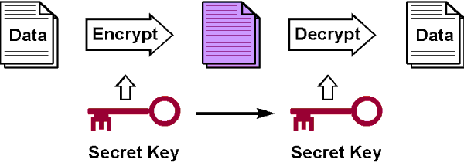
Symmetric Cryptosystem
Symmetric Cryptosystem uses the same key to encrypt and decrypt the message. It is also called “Private Key Cryptosystem”.
A private or secret key is known only to the parties that exchange secret messages and has to be kept secret for security.

Slide 57
Symmetric Cryptosystem (Cont’d)
Plain-text input
Cipher-text
Plain-text output
“The quick brown fox jumps over the lazy dog”
“AxCv;5bmEseTfid3)fGsmWe#4^,sdgfMwir3:dkJeTsY8R\s@!q3%”
“The quick brown fox jumps over the lazy dog”
Encryption
Decryption
Key Distribution Problem
Same key
(shared secret)
Notes:
As we have seen with symmetric encryption the key distribution problem requires:
That the two parties communicate the shared key
And
2. A secure key distribution centre was set up or the key was securely transported to the recipient
Symmetrical keys are small and provide great performance, but need to be frequently changed, ideally with each message. The need to securely and frequently change keys is know as the “key distribution problem .”
Whitefield Diffie and Martin Hellman, both University of Stanford professors, argued that the #2 negated the very essence of security. They set about creating a system that solves the key distribution problem. They based their work on a paper written by Merkle and have asked the public to call the system Diffie-Hellman-Merkle, but it hasn’t caught on.
A second problem they investigated was related to digital signatures. If the use of digital signatures became widespread (they were writing in 1976) the electronic documents will become like paper documents and would need the equivalent of signatures used in paper documents for non-repudiation.
They set out to improve symmetrical encryption by developing a pair exchange protocol. A requirement of the protocol that it must be computationally infeasible to determine the decryption key even if the user has the cryptographic algorithm, the cyphertext, and the encryption key.
Diffie-Hellman protocol developed in 1976 was a breakthrough and solved the key distribution problem and addressed the other problems as well.
DH is a mathematical algorithm that allows two computers to generate an identical shared secret on both systems, even though those systems may never have communicated with each other before. That shared secret can then be used to securely exchange a cryptographic encryption key. That key then encrypts traffic between the two systems.

Slide 58
Symmetric Cryptosystem – Advantages vs. Disadvantages
Advantages | Disadvantages
Very secure if using key greater than 100 bits | Safely distributing key to other party is major concern. Face to Face exchange is best
Keys are shorter than Asymmetric encryption | The number of keys increases exponentially with the number of users exchanging secret information
Very fast performance | If compromised, cracker can decrypt everything -- serious problem

Slide 59
Asymmetric Cryptosystem
Asymmetric Cryptosystem uses two different keys; one to encrypt the message and one to decrypt the message.
The keys are mathematically related to each other so that only a message encrypted with the public key can be decrypted with the private key. It is also called “Public Key Cryptosystem”.
This is a system that uses a public key known to everyone and a private or secret key known only to recipient of the message.

Slide 60
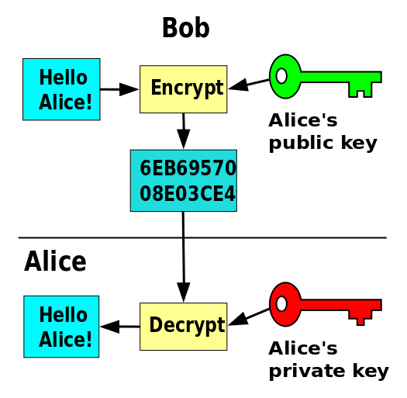
Asymmetric Cryptosystem (Cont’d)
For Bob to send a secure message to Alice, he uses Alice's public key to encrypt the message.
Alice uses her private key to decrypt it.

Slide 61
Asymmetric Cryptosystem (Cont’d)
Clear-text Input
Cipher-text
Clear-text Output
“The quick brown fox jumps over the lazy dog”
“The quick brown fox jumps over the lazy dog”
“Py75c%bn&*)9|fDe^bDFaq#xzjFr@g5=&nmdFg$5knvMd’rkvegMs”
Encryption
Decryption
Different keys
public
private
Recipient’s public key
Recipient’s private key

Slide 62
Asymmetric Cryptosystem – Advantages vs. Disadvantages
Advantages | Disadvantages
Very secure if using key greater than 1000 bits | Each user has one key pair and user’s public key is exchanged with all users
Keys are longer because the are exchanged infrequently and public key is shared | If private key compromised, cracker can decrypt messages sent to you, but can not decrypt messages you send to others because encrypted with a different key pair
Slow performance 1000 X slower than symmetric encryption | Requires a key distribution infra-structure

Slide 63
What is Cryptanalysis?
Cryptanalysis is the study of cryptosystems to find weaknesses in the system which will reveal the plaintext without necessarily knowing the key or the algorithm. This could be done via:
    Attempt to recognize patterns in encrypted messages
    Attempt to find general weakness in an encryption algorithm
An encryption algorithm may be breakable, meaning that given enough time and data, a cryptanalyst could determine the algorithm.
If there exists 10³⁰ possible decipherments for a given cipher scheme and a computer performs 10¹⁰ operations per second, finding the decipherment would require 10²⁰ seconds (or roughly 10¹² years)!

