Slide 1
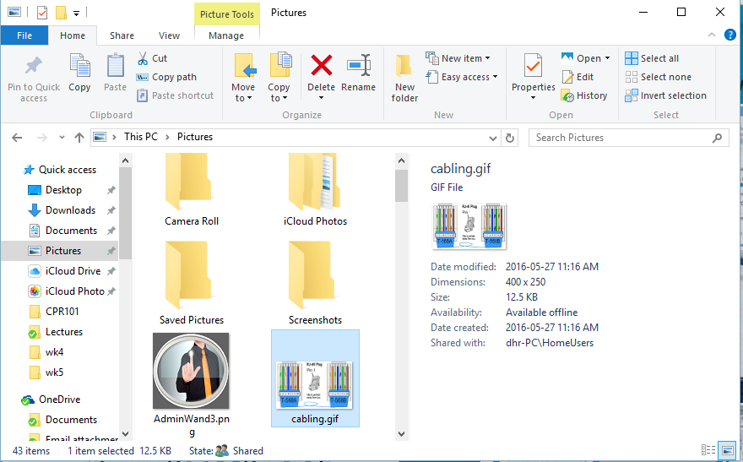
File Explorer
Notes:
Most of the same Windows select, copy, cut, paste shortcuts work in File Explorer

Slide 2
File Explorer Terminology
Quick Access Toolbar
Ribbon
Menu Bar
Address Bar
Navigation Pane
Content Pane
Preview Pane

Slide 3
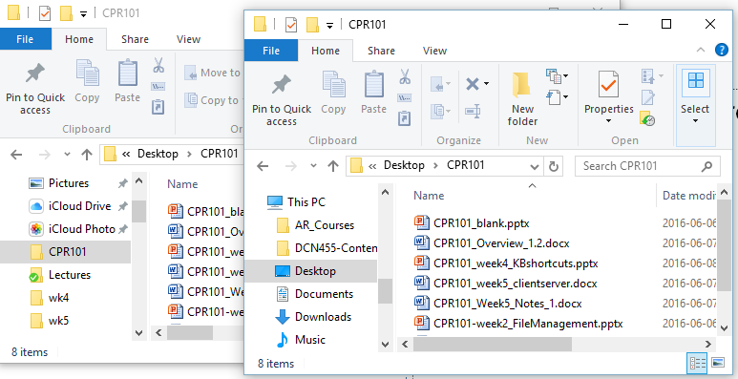
File Explorer – Opening New Window in Same Folder
CTRL + N does so. (CTRL + SHIFT + N creates a new sub folder)
Handy when dragging and dropping or copying files.
Just change path, to destination folder, in the second window.

Slide 4
File Explorer – Moving and Copying Using Mouse

Slide 5
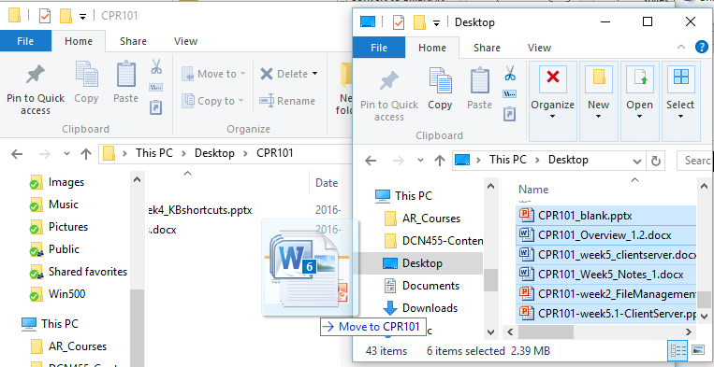
File Explorer – Moving and Copying Using Mouse
Be careful with drag & drop
Dragging files to
the same drive moves files
a different drive copies files
hold CTRL to copy or
Click & drag with Right mouse button

Slide 6
File Explorer – Moving and Copying Using Mouse (Cont’d)
When dragging files to a different drive, the default behavior is to copy the files, not to move.
During dragging, press the SHIFT key to move the files. Release the SHIFT after the drop operation.

Slide 7
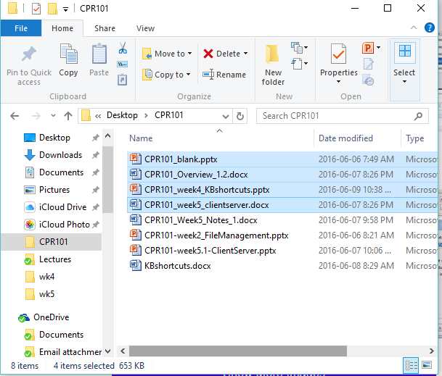
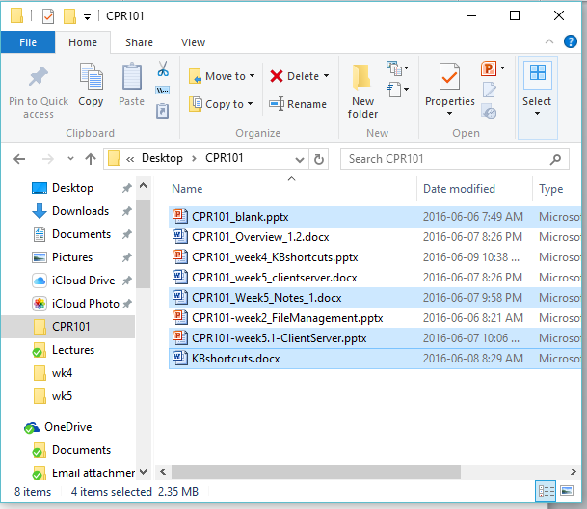
File Explorer – Selecting Files
To copy a group of files, click the first one.
Hold the SHIFT key.
Click the last file.
To select individual files, hold the CTRL Key.
SHIFT
CTRL

Slide 8
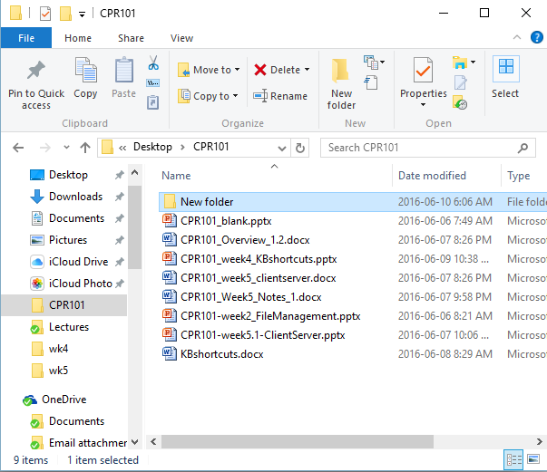
File Explorer – Renaming Selected Item, Opening Search, and Refreshing Current Window
F2 is used for renaming.
F3 is used for searching for a file or folder in the active window.
F5 is used for refreshing the current window.

Slide 9
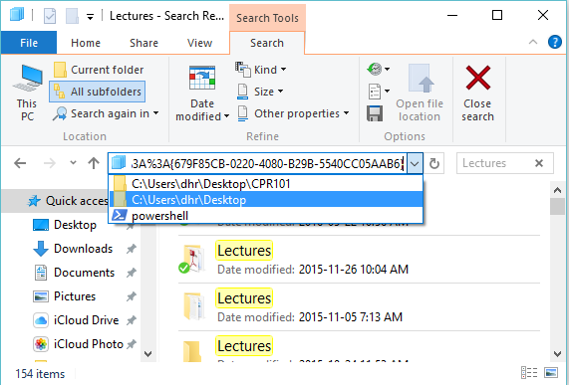
File Explorer – Opening Address Bar, and Cycling Through Window Elements
F4 is used for displaying the address bar history.
F6 is used for cycling through Window Elements.
Test F6 when you have selected a file. Get in the habit of adding a Tag/Category to the file header. It would be ideal for general search criteria.

Slide 10
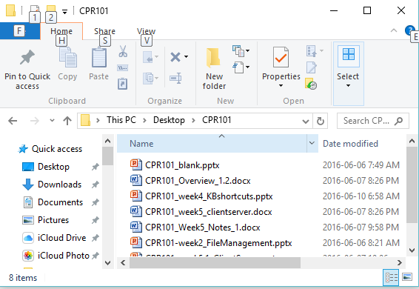
File Explorer – Activating the Menu Bar
F10 does so.
Press the letter shown to select the menu items and sub items.
You could also use ALT + letter to access the menu item from the beginning.

Slide 11
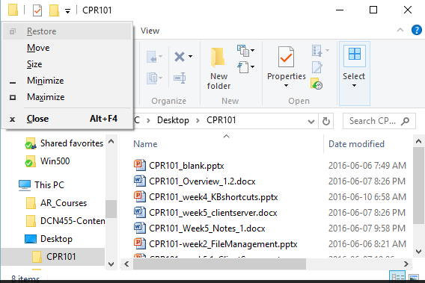
File Explorer – Opening the Short Cut Menu, and Closing Current Window
ALT + Spacebar does this for you.
You could then choose the menu selection letter if you want.
You could also use CTRL + W or ALT + F4 to close current window.

Slide 12
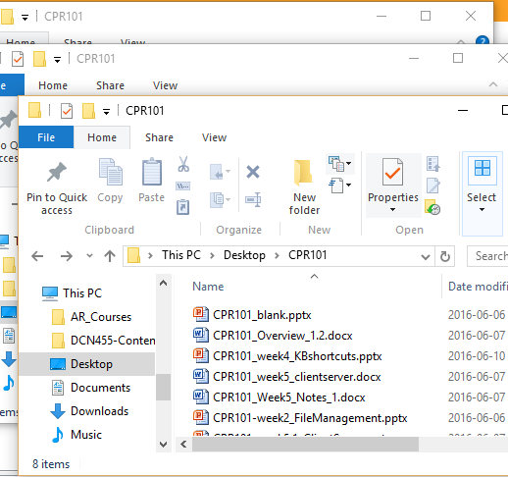
File Explorer – navigates like browser
Browser window navigation
ALT + ← go back to previous folder
ALT + → go forward to next folder
F11 toggles full screen mode

