Slide 1
Computer Principles for Programmers
Compression , 3ncrypt10n, Backup
How many programmers does it take to change a lightbulb?
rKR0sCfVHXydWGwgIS5UbodHXjlpENq6TeXWEE12PSU=
(copy encrypted punchline and click, enter secret: CP4P )
Notes:
How many programmers does it take to change a lightbulb?
Punchline is encrypted with Advanced Encryption Standard (AES).
Decrypt it…
https://encode-decode.com/aes-128-cbc-encrypt-online/
Paste secret.: CP4P
Click Decrypt string
"3ncrypt10n" is "Encryption" in B4S1C L33T SP34K – BASIC LEET SPEAK see https://www.gamehouse.com/blog/leet-speak-cheat-sheet/
See https://cryptobook.nakov.com/encryption-symmetric-and-asymmetric

Slide 2
News of the Week

Slide 3
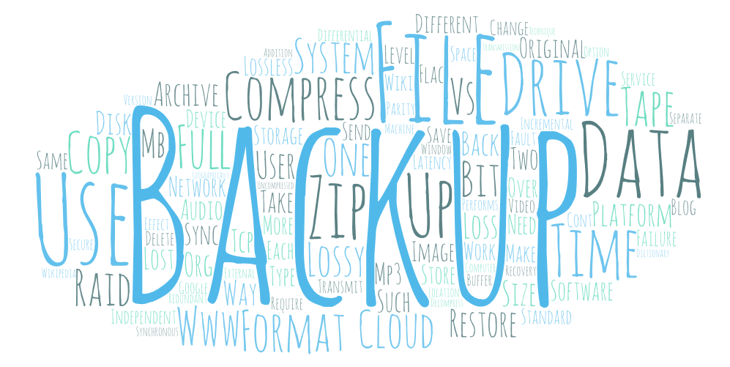
Agenda
Lecture:
What, Why, and How of “File Compression”
… depends on the Use Case
… overview of formats
… Lossless vs Lossy
What, Why, and How of “Backup”
… types of backups
… backup media
Notes:
Today's agenda. Word cloud generated from this slide deck.
What, Why, and How of “File Compression”
… effect on data transfer
… drawbacks
… overview of formats
… Lossless vs Lossy
What, Why, and How of “Backup”
… types of backups
… backup media

Slide 4
Agenda
Activity:
Explore File Compression à la LZW
Compress various file formats within a ZIP archive and compare their compression factors
Do your own 3-2-1 backup

Slide 5


Notes:
Before going to sleep,
a programmer always has a full glass of water
on the bedside table in case she gets thirsty,
[click]
and an empty one in case she doesn’t.
IPC144, Week 3, Logic

Slide 6

What is “File Compression?”
Pink x 4
Green x 5
Blue x 3
Don't store redundant/repeating data.
Notes:
Don't store redundant/repeating data.
But how?

Slide 7
What is “File Compression?”
storing a file’s data in less space by
“minimizing redundancy” in the content
An archive is a collection of folders and files stored in one file, e.g. filename.ZIP
  archives are usually compressed to save space
  archives can be encrypted for security
  ZIP for cross-platform exchange (Katz & Conway, 1989)
local OS options to compress / encrypt local files
Notes:
Definitions above.
https://en.wikipedia.org/wiki/ZIP_(file_format)
ZIP file format in public domain since 1989 (Katz & Conway, 1989) https://en.wikipedia.org/wiki/Phil_Katz
By distributing the zip file format within APPNOTE.TXT [within PKZIP 0.9 package], compatibility with the zip file format proliferated widely on the Internet during the 1990s.

Slide 8
Why use File Compression?
Writing / Sending data takes time (I/O is slow)
  Tape – Linear Tape-Open drives on-board compression & encryption
  NAS – Network Attached Storage (local + backup/passthru to cloud)
  FTP or Cloud Storage AWS Glacier, Google Nearline
  USB – removable drives (ad hoc, user level only)
Encrypt for security
  once drive is dismounted, there is no OS security
  all compression software has an encryption option
Streaming sends compressed, receiver decompresses
VoIP compresses data in real-time
Notes:
When files are copied to backup devices or to remote storage, you not longer have the security of physical access control. Anyone who has the physical media and a reader can see your data.
When files are sent outside your system, i.e. outside your system's security, they should be encrypted. And compressing them at the same time makes sense.
NAS provides local file serving, optional compression & encryption, optional backup or relay
https://www.databarracks.com/blog/is-tape-backup-dead
"The total use of tape has fallen from 42% of businesses in 2008 to just 14% in 2016. use of 'cloud' backup rose from 23 to 43% over that period."
although a small percentage of companies use tape, those are BIG companies.
Be careful what you count. Instead counting businesses using tape, count shipments of tape capacity
https://www.networkworld.com/article/3315156/tape-vs-disk-storage-why-isnt-tape-dead-yet.html
"2017 saw the shipment of more than 1 million petabytes in LTO tape capacity – roughly five times what was shipped in 2008."
tape will always be cheaper than disk storage. Tape separates the medium from the recording device: a few tape drives service thousands of tapes. Tapes do not need power and cooling. Even if disk was free, it might still cost more than tape due to the power and cooling savings alone.
Digital Telephone VoIP (Voice over Internet Protocol) works in a similar way. It blocks a time frame of digitized voice, compresses the block before transmission, and decompress the block at the other end so it sounds like continuous speech. This is harder to do successfully than sending files. Two-way conversation must be perceived in real-time without delays, that is, it must seem synchronous: voice events and TCP/IP packet throughput must be coordinated in time. Call centers that save money on bandwidth by overly compressing VoIP will lose far more money than they saved as soon as the customer says, "I could not hear or understand you; please repeat."
See https://netbeez.net/blog/impact-of-packet-loss-jitter-and-latency-on-voip/
SSH, used in secure terminal and FTP sessions, has a compression option for transmission of data. Chunks of data, e.g. in a keyboard buffer, are compressed before transmission. The CPU time it takes to compress or decompress a small chunk of data is usually unnoticeable relative to the speed of network transmission.
Data can arrive in various pieces and be reassembled. IP packets may be lost, duplicated, or delivered out of order. TCP detects these problems, requests re-transmission of lost data, and rearranges out-of-order data. This preserves the integrity of the original transmission albeit with a throughput cost. Computers will wait patiently for data to arrive completely. Sending and receiving can occur asynchronously, i.e. events that are not coordinated in time.
Streaming audio and video such as digital TV (sent over the air from a TV station or streamed from Netflix) or audio from Spotify, have an easier time of it because they are transmitting previously compressed data, sending as little as possible over high-speed networks. Without a compression stage, latency from the sending side is reduced. The receiving side buffers the received data, decompresses it, and outputs the video/audio in real time. Because the sending side usually transmits compressed data faster than the receiving side can output decompressed video/audio, the humans perceive a smooth analog experience of uninterrupted video/audio. Critically, the receiving device has extra memory for buffering, unlike Network Interface cards which have minimal buffer storage. So long as the server and network can put data into the receiving buffer faster than the decompression software can take data out of the buffer, everyone is happy. This allows variance in overall throughput. When a streaming session begins, it often appears that the streaming service is slow – it is not. The delay is the time it takes to fill up the receiving side's buffer.

Slide 9
How File Compression is done
Data compression combines:
match and replace duplicate strings using a dictionary: unique code = "repeating string"
  Lempel–Ziv–Welch (LZW) compression (1984)
replace 8-bit char with variable bit length symbols based on character frequency
  Huffman coding (1952)
  David A. Huffman was a Ph.D student at MIT
  …who didn't know it could not be done.
Notes:
https://www.youtube.com/watch?v=JsTptu56GM8 – Tom Scott, How Computers Compress Text: Huffman Coding and Huffman Trees
https://en.wikipedia.org/wiki/Lempel%E2%80%93Ziv%E2%80%93Welch
https://en.wikipedia.org/wiki/Data_compression
https://en.wikipedia.org/wiki/DEFLATE
Both use iterative logic, pattern matching and analysis, creating a dictionary to determine how to encode & decode redundancies and frequency of occurrence.
Huffman coding (https://www.huffmancoding.com/my-uncle)
In order to get out of writing the final exam, David Huffman's professor gave the problem of finding the most efficient binary coding for a given set of symbols. Huffman's professor neglected to say that there was no obvious solution despite having worked on the problem with Claude Shannon, the father of information theory and one of the greatest pioneers in computer science. So Huffman, not knowing it was impossible, solved the problem. His algorithm continues to be widely used.
Question to ChatGPT: "When lzw and huffman coding are used together, which is done first?"
ChatGPT answer: (2023-01-09 version, https://help.openai.com/en/articles/6825453-chatgpt-release-notes)
"When LZW and Huffman coding are used together, typically Huffman coding is applied to the output of LZW compression.
LZW is a dictionary-based compression algorithm that looks for repeated patterns in the input data and replaces them with unique codes. Huffman coding, on the other hand, is a prefix coding technique that assigns shorter codes to more frequently occurring characters (8 bit bytes) in the input data.
By first applying LZW compression, the input data is transformed into a series of codes that represent patterns and sequences of characters. These codes will have varying frequencies of occurrence, depending on the patterns in the input data. (e.g. Human language has lots of repeating character sequences.) Huffman coding can then be applied to these codes to further compress the data by assigning shorter codes to the more frequently occurring codes. This can provide an additional reduction in the overall size of the data.
Huffman is a symbol-by-symbol encoder, while LZW is a string encoder. By using both techniques together, LZW compresses the symbol string and Huffman compresses the dictionary symbols."

Slide 10
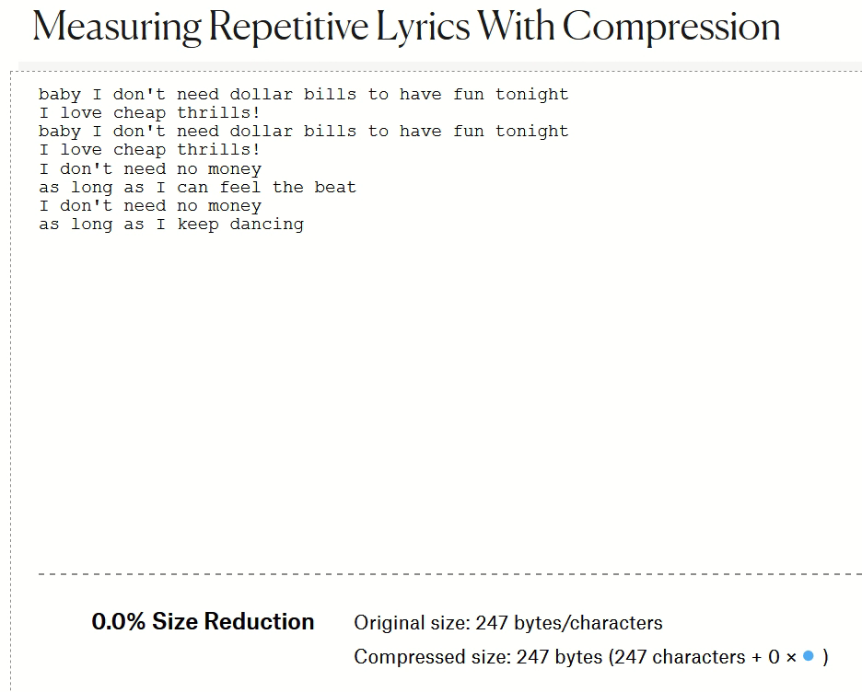
Are Pop Lyrics Getting More Repetitive?
(yes, they are)
Lempel-Ziv-Welch compression ratio used as a measure of repetitive lyric sequences.
Notes:
visual illustration of the matching and replacement of duplicate strings with pointer, i.e. LZW compression
LZW does not drop all the placeholders like the animation shows.
The Lempel–Ziv–Welch lossless compression algorithm powers gifs, pngs, and most archive formats (zip, gzip, rar...).
What does this have to do with pop music?
The Lempel-Ziv algorithm works by exploiting repeated sequences.
How efficiently LZ can compress a text is directly related to the number and length of the repeated sections.
By compressing song lyrics and comparing compression rates, repetition in lyrics can be measured.
https://pudding.cool/2017/05/song-repetition/

Slide 11
Huffman decoding
Encoded: 1 0 1 1 0 0 0 1 0 1 1 1 0 0
Decode
Logic:
? = next
encoded bit,
8 chars × 8 bits = 64 bits compressed to 14 bits (22%)
Encode / Decode info: 0=S, 10=L, 110=O, 111=E.
?
1
?
1
?
1
0
0
0
S
L
O
E
L
10
O
110
S
0
S
0
L
10
E
111
S
0
S
0
Notes:
Huffman coding is a lossless data compression algorithm.
Huffman encoding assigns variable-length codes based on the frequency of characters. (The encoding process is briefly illustrated in the notes below and the algorithm is shown in the animation.)
So how is a meaningless string of encoded bits then decoded back into characters?
Decoding information (shown above as a flowchart) is included along with the encoded data. The more often a character repeats, the higher the compression.
Use cursor to walk thru flowchart, click for each letter found. i.e. 1 0 [click] 110 [click] 0 [click] 0 [click] 1 0 [click] 1 1 1 [click] 0 [click] 0 [click]
The shortest path is for the most frequently used characters, or path length is inversely proportional to character frequency.
Encode / Decode info is included with encoded bit stream in the compressed archive.
0=S, 10=L, 110=O, 111=E.
animation of Huffman binary tree building:
http://lti.cs.vt.edu/OpenDSA/AV/Binary/huffmanCustomBuildAV.html (script is runnable but a bit broken with no titles on buttons)
To encode and decode the word "LOSSLESS" which has 2 L characters, one O, four S, and one E, copy and paste with the quotes "L,2, O,1, S,4, E,1" and click Run which is the top left button or empty square (don't press Enter), then click ( > ) Forward.
Flowchart on slide is representing a binary tree used to decode. They are functionally identical, flowcharts are for people, binary trees are a software data structure. See https://en.wikipedia.org/wiki/Binary_tree
Huffman Coding
raw text: LOSSLESS <== 8 char X 8 bits = 64 bits
charArray: L O S E <== unique chars in text
counterAr: 2 1 4 1 <== count char in text
Huff.Code: 10 110 0 111 <== variable-length binary based on frequency of characters (see above animation for encoding process)
encode: 1 0 1 1 0 0 0 1 0 1 1 1 0 0 <== substitute each char in text for Huffman code, 14 bits or 22% of original
plus charArray and counterAR to recreate binary tree
decode: 1 goes right, 0 goes down/left, stop at end node, get char, restart at top.
shortest path in binary tree for most frequent characters
https://www.youtube.com/watch?v=ZdooBTdW5bM (how to compress )
go to 4:30 in the video to decompress the bits at the end. Each encoded bit takes you down one branch of the tree.
For a quick encode & decode explanation, see David Esposito's mini lecture/demonstration:
https://www.youtube.com/watch?v=AqFliCFNBWI (quick review of compression)
https://www.youtube.com/watch?v=kJE5u7PFY2E (the simplicity of decoding using binary trees)
raw text: sally sells sea shells
charArray: s a l y _ e h
counterAr: 6 2 6 1 3 3 1
Frequency of unique char used to build binary tree.

Slide 12
Lossless vs. Lossy Compression
Lossless: contains all original data with redundancies removed
    Data, PNG / TIFF images, FLAC / ALAC audio
Lossy: sacrifices quality for smaller file size
    JPG images, MP3 / AAC audio, all video
    drops details your eyes and ears may not notice
    for end-use only, not for modification/editing
Notes:
Lossless files use compression techniques which preserve the original data in the file.
Digital, quantitative data such as characters, numbers, and symbols is ALWAYS stored in lossless format.
JPEG XL is roughly 60% more efficient than JPEG. In March 2022, the JPEG XL specification was published as an ISO standard. https://jpeg.org/jpegxl/ (see also "Common Compression File Formats" slide)
WebP adoption has grown since 2019 and was on track to overtake PNG as the second most frequently used format.
But with JPEG XL, it's a horse race.
Data representing qualitative properties in the analog world such as images, audio, and video can be stored as lossless (highest digital resolution of the original encoding/capture.) or "lossy" meaning resolution is reduced resulting in smaller file size. When lossless data is converted from one format to another, there is no loss in quality during the transformation. When lossy data is converted from one format to another, quality may be lost with each transformation.
See Generation Loss – JPEG, WebP, JPEG XL, AVIF – a graphic 40second display https://www.youtube.com/watch?v=qc2DvJpXh-A&t=7s
GIF = Graphics Interchange Format (1987)
PNG = Portable Network Graphics (1994)
TIFF = Tag Image File Format for graphic designers (1992)
JPEG = Joint Photographic Experts Group (1992) variable compression ratio trading off picture quality for smaller file size
FLAC = Free Lossless Audio Codec, ALAC = Apple Lossless Audio Codec.
Lossy compression first degrades the quality of original data to reduce the size, then applies compression techniques on the remaining data.
Lossy files are for end-use only, not for modification/editing which requires original data ( from lossless compression). Be mindful of the Use Case.
Creating a Lossy file from a Lossy file would introduce additional artifacts and further unnecessary information loss; always create a lossy file from the original, high-resolution, lossless source.
https://en.wikipedia.org/wiki/Lossless_compression
https://en.wikipedia.org/wiki/Lossy_compression

Slide 13
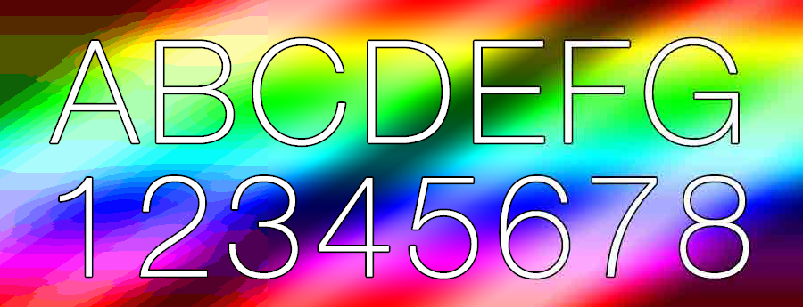
Lossless versus Lossy
GIF lossless, 45.4kb
TIFF lossless, 941kb
JPG lossy, 25.4kb
8 bit colour, LZW 32 bit colour, 32 bit max size 24 bit colour, 16 bit max size
Notes:
Only give a graphic artist/designer a TIFF file: high-rez, no compression
JPG good for images (non-graphics) with built-in variable compression / resolution trade-off. Minimum compression is 90% of original.
PNG good for graphics (non-photo) with lossless compression.
Your eCommerce site must load quickly which means lossy compression of images
but the customer likely wants to sample details which means large files with time-consuming downloads.
You must balance your lossy compression choices to get optimum page load performance.
All image formats have different uses and different attributes. Know exactly what image format to use for web use, print, social platforms, logos and much more with this handy cheat sheet. See https://makeawebsitehub.com/image-formats-mega-cheat-sheets/
https://kinsta.com/blog/optimize-images-for-web/
Google: optimize lossy and lossless compression for page load performance
Compression of analog images and music into digital artifacts is based on this:
https://getpocket.com/explore/item/the-math-trick-behind-mp3s-jpegs-and-homer-simpson-s-face

Slide 14


HiRes CD MP3/AAC/Spotify
9,216 kbps 1,411 kbps 320 kbps
653% 100% 22.7%
Notes:
Image sizes are proportional to the audio formats' kilo bits per second, the amount of musical detail.
Fortunately, ears are better than eyes at filling in the blanks and resolving what isn't there.
High-Resolution Audio’s (HRA) bitrate of 9,216 kbps is the resolution of many recording studio masters, is 6.5 times higher than that of CD WAV files (1,411 kbps) and almost 29 times higher than that of MP3/AAC (320 kbps).
The reproduction equipment and the environment where it is used determines suitability.
On the subway, with so-so earphones getting signal from a weak amplifier on the noisy main board of your smartphone fed by a software DAC, it is hard to notice the difference between an AAC and HiRes source.
In a quiet room, with excellent speakers played at concert volume by a high-power class A/B amp fed by a high-quality outboard DAC,
a 24bit/96kHz source sounds like you are in the recording studio and an MP3 file sounds like you are still on the subway.
Apple iTunes made a brilliant compromise on audio files:
the proprietary AAC format sounded better than MP3 at the same bitrate and file size.
AAC is now playable on Android but is guaranteed to sound worse. This problem is remedied by purchasing an Apple product or using industry standard file formats.
It sounded good enough the way most Apple users listened to their music.
The AAC file size was small enough to
a) not blow up your mobile data plan,
b) not take too long to download,
c) not fill up secondary storage on your iPod / iPhone too soon,
thus allowing you to make many more iTunes purchases, and eventually another iPhone with more storage.
Size of one hour of music:
CD/WAV: 1,411.2 kbps, 16 bit, 44.1 KHz, 635.04 MB 100% baseline
MP3/AAC: 320 kbps, 144.0 MB 23% of WAV, 7% of HRA
FLAC: lossless, about 50% of WAV or HRA native
HRA: 9,216 kbps, 24 bit, 96KHz, ~4 GB native format is 6.5 times the size of a WAV file which is why HRA is always shipped in FLAC file format.
HRA in FLAC format is ~2 GB or 327% of WAV
In one professor's HRA collection of 1,000+ files, the average size is 63 MB per file.
https://www.stereophile.com/features/308mp3cd/index.html
https://www.whathifi.com/us/advice/mp3-aac-wav-flac-all-the-audio-file-formats-explained
https://en.wikipedia.org/wiki/Vorbis describes ogg file extension
https://www.soundguys.com/the-ultimate-guide-to-bluetooth-headphones-aac-20296/
https://www.masteringthemix.com/blogs/learn/113159685-sample-rates-and-bit-depth-in-a-nutshell
This is how mp3 compression is done and why it works:
https://cs.stanford.edu/people/eroberts/courses/soco/projects/data-compression/lossy/mp3/concept.htm
See also Psychoacoustic Models for Perceptual Audio Coding
https://www.mdpi.com/2076-3417/9/14/2854
How Fourier Transformation enables MP3 compression
https://getpocket.com/explore/item/the-math-trick-behind-mp3s-jpegs-and-homer-simpson-s-face?utm_source=pocket-newtab
https://www.rollingstone.com/feature/beatles-sgt-pepper-artwork-10-things-you-didnt-know-107812/

Slide 15


HiRes CD MP3/AAC/Spotify
9,216 kbps 1,411 kbps 320 kbps
653% 100% 22.7%
Notes:
Image resolutions are proportional to the audio formats' kilo bits per second, the amount of musical detail.
Fortunately, ears are better than eyes at filling in the blanks and resolving what isn't really there.
If you are going to listen to streamed music, please use Tidal. They pay artists 2 to 40 times more than other services such as Spotify.
Amazon Prime Music and YouTube audio is only 256kbps.
Most other services offer CD-quality (16-bit/44.1kHz) streams at a minimum, with Hi-Res tier optional offerings.
N.B. If you listen on wireless headphones | earbuds | speakers, CD-quality is as good as wireless gets; don't waste money on the Hi-Res service.
Hi-res music streaming services compared: which should you subscribe to? | What Hi-Fi? (whathifi.com)
https://www.whathifi.com/advice/hi-res-music-streaming-services-compared

Slide 16
Common Compression File Formats
Data
ZIP
.docx .pptx .xlsx
.tar.gz 7z RAR
ZIP
Standard for Lossless
Cross-Platform
data exchange
Music
MP3 AAC MQA
WAV ogg FLAC
Images
JPEG JXL AVIF WebP
GIF PNG TIFF RAW
AVIF WebP JXL
Video
MPG MP4 DIVX
XVID MOV AVI
BOLD formats are Lossless
Notes:
JXL is the new improved JPEG XL, ISO standard in March 2022 to replace .JPG, .GIF, .PNG
-- has both lossless and lossy options, animations like GIF and PNG, royalty free. (more below)
Data archives must be lossless. Higher quality music is lossless if you consider CD quality “lossless”. Scalable images must be vector-based or lossless format. Everything else is a judgement call as to end-user requirements. The only thing that is not a judgement call is to use ZIP archive format because every platform can read/write it.
SEE https://en.wikipedia.org/wiki/List_of_archive_formats
ZIP archive for folders & files, with default compression and optional compression strategies & types. Wide cross-platform support.
Microsoft Office files with .- - - x extension indicate compressed OOXML files.
7z & 7zip – open source standard but for Windows only with slightly better compression and much better encryption than ZIP.
RAR – proprietary format, requires licensed copyrighted code to create .rar files. Many cross-platform utilities available to extract data from .rar files. Although second in popularity after zip files, its feature benefits over zip were workarounds to old technology constraints that are now mostly moot. These days, .rar files just annoy people; requires software (purchase and) installation with negligible benefit over ZIP format.
.tar.gz (*nix) TAR = TapeARchive. aka tarball .tar with additional .suffix indicating the compression used such as .gz for gzip. See https://en.wikipedia.org/wiki/Tar_(computing)
StuffIt (should be considered a proprietary Apple macOS format. As of December 2020, its owner/developer declared “end-of-life”).
https://en.wikipedia.org/wiki/StuffIt
SEE Image file type and format guide - Web media technologies | MDN (mozilla.org) when making web design decisions.
https://developer.mozilla.org/en-US/docs/Web/Media/Formats/Image_types
GIF – Graphics Information File. Oldest format with wide support, has animation option; now a popular retro adornment in place of innumerable emoticons.
JPEG – Joint Photographic Experts Group (IBM, Canon, other heavy hitters. Now an ISO organization.) JPEGs can have varying degrees of lossy compression.
JPEG XL – better than JPEG, GIF, and PNG (WebP?) https://en.wikipedia.org/wiki/JPEG_XL https://jpeg.org/jpegxl/ https://jpegxl.io/articles/browser-support/ -- is slowly rolling out or being debugged.
RAW – raw data from a camera's CCD sensor. Very large files even with built-in compression.
PNG – Portable Network Graphics; has animation option.
TIFF – Tagged Image File Format typically used in graphics design
Newer & better formats with optional lossy or lossless compression, supported only in latest versions of major web browsers:
AVIF – best image compression; has animation option.
WebP – somewhat better support in current browsers than AVIF but with less compression factor; has animation option.
See https://webptojpgs.com/blog/webp-vs-png-vs-jpg-which-is-better-and-when-to-use-which
Music:
AAC = Apple Audio Codec which sounds much better on Apple iPhones than Android; everyone knows why.
FLAC = Free Lossless Audio Codec. Both FLAC and ogg are free and open software, i.e. royalty-free. Not supporting FLAC / ogg is a marketing decision, not a technical or financial one. Neither ogg nor FLAC is supported by Apple; everyone knows why.
WAV files on CDs are called “lossless” but contain music down-sampled from original analog or digital masters to 16bit dynamic range depth / 44.1kHz sample frequency; this is lossy compression but not so lossy to result in reduced musicality on most audio systems to most people’s ears; thus, most people perceive it as “lossless”. WAV has significantly better resolution (musicality) than MP3/AAC formats.
WAV is the native Compact Disc (Redbook) music file often stored in FLAC format at about half the file size. (FLAC stores what is common to both left and right channels, and only the differences for left & right channels.)
MQA is the newest lossy encoding technique. It is a proprietary format (think royalties) which can deliver HiRes Audio in about twice the CD WAV file size but 60% of the size of 24BIT/96kHz file with little noticeable loss in quality; data is stored in FLAC format; used by HiRes streaming services.
Many of these formats use Lempel–Ziv–Welch and/or Huffman Coding.
Note: MS-Office 2007+ files are compressed when saved as .docx, .pptx, .___x formats. Open with 7zip to inspect contents.
Additional file compression into a 7zip .7z file format yields a some extra compression but is generally not worth the incompatibility on non-Windows platforms or the necessity of installing 7zip on Windows. Developers using Windows platforms usually do install 7zip because it can decompress almost any other archive/compression format.
Software/firmware utilizing any Music, Video, Image file formats (e.g. VLC) has built-in decompression functions so the data can be used (e.g. as a temporary, uncompressed stream). Special editing software, e.g. Audacity, is needed to create compressed music or video files.

Slide 17
Drawbacks to Compression
Time: compression needs CPU and primary storage resources
  PCs have lots of both and only one user. Servers on the other hand…
Space: archived files must be uncompressed before use,
extra space needed for both compression & decompression
Integrity: any data corruption can cause loss of entire archive
  Solid or multi-volume archives can be lost with even minor data corruption. Archive repair is possible but not probable.
  Test your archives to confirm integrity.
Recoverability: the Lossy sacrifice is reduced quality
  Lossy compression is appropriate only for specific Use Cases.
Notes:
TIME:
Increases in transmission latency over TCP/IP can reduce throughput significantly.
E.g. from 93.5 Mbps to 16.2 Mbps with 30ms latency or 17% of a zero latency connection.
http://smutz.us/techtips/NetworkLatency.html
SPACE: in addition to the archive’s space, you need space for the unarchived & uncompressed files to be extracted before they can be used. Double clicking on a file within a ZIP archive extracts the file to a temporary area before it is opened. Files with compression built into the software that reads them still require memory or temp work files.
Integrity
Standard compression compresses the individual files, and then archives them into a single file. Data corruption may affect only a single compressed file, not the entire archive, however special zip file recovery tools will be needed and recovery of one, some, or almost all files from a corrupted archive is more about luck than technology.
In a solid archive, all files are first archived into a single data block and then compressed. It is more efficient because compression of redundancies occurs across all data in all files instead of within individual files. However, it makes recovery very difficult, if not impossible, in cases of corruption. https://en.wikipedia.org/wiki/Solid_compression
There is the "potential for corruption" for anything in storage regardless of format. The issue with archives is their data is usually unrecoverable with any data corruption whatsoever -- even a single bad bit can compromise the archive's integrity and all data can be lost. Even if repair is possible, some data will always be lost. Whereas, if a simple text file had a single bad bit, it would corrupt only a single character within the file.
Recoverability
Lossless compression has 100% recovery of original data. Lossy compression does not. The appropriateness and degree of lossy compression depends on the Use Case. E.g. high lossy compression might be used for thumbnail images, or for some audio when portability or low bandwidth streaming is a priority over quality.

Slide 18
Why do we need backups?
2/3 to 3/4
of all
data loss
#1 Accidental deletion by users or IT people
#2 Hardware failure: all storage fails eventually
  Far Less Frequent Causes
    Catastrophe: sabotage (ransomware), fire, flood, theft
    Account on cloud provider is cancelled or accidently closed
    Cloud service provider as a single point of failure
Notes:
Accidental deletion is the #1 cause of data loss.
A distant second is Hardware failure.
Note: servers always have UPS systems to guard against power failures, surges, and brownouts. UPS allows for orderly server shutdown to prevent systems crashing upon power loss. Many servers also have redundant internal power supplies and other sub-system redundancies. All storage devices will eventually fail, HDDs before SSDs. But even solid state devices wear out. Flash memory has a life-time: a limited number of read / write cycles. The higher the quality ($$$), the longer it lasts.
PCs are replaced before their drives wear out now that secondary storage has improved reliability.
web/search?q=cloud+provider+business+failure e.g. https://www.datamation.com/cloud-computing/slideshows/top-10-cloud-computing-failures.html
web/search?q=single+point+of+failure
See https://www.dell.com/support/article/ca/en/cadhs1/sln156899/hard-drive-why-do-solid-state-devices-ssd-wear-out?lang=en
https://www.howtogeek.com/322856/how-long-do-solid-state-drives-really-last/
https://www.researchgate.net/publication/273398289_Soft_Failures_in_Large_Datacenters
https://en.wikipedia.org/wiki/Data_corruption
https://en.wikipedia.org/wiki/Data_degradation
https://electronics.stackexchange.com/questions/27455/how-often-does-bit-rot-occur

Slide 19
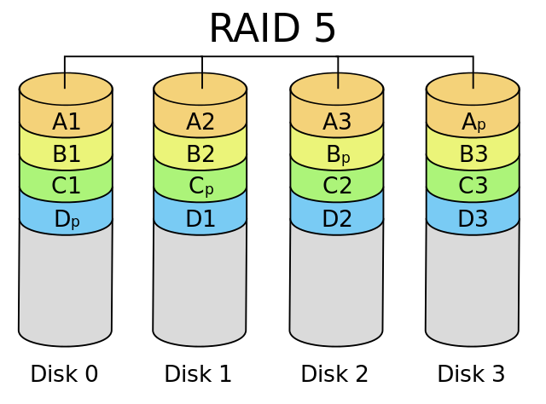
Continuous Data Integrity with RAID
Redundant Array of Independent Disks
RAID 1, 5, 6
tolerate drive failure
RAID 1 pairs drives
RAID 5 +1 parity drive
RAID 6 +2 parity drives
RAID appears as one logical drive space to OS (excluding parity drives)
read/write performance increases with multiple drives doing concurrent I/O
Notes:
RAID is not backup, it is hardware redundancy. One physical drive can fail without interrupting normal server operations.
RAID 1 mirrors one drive on another; doubles storage cost but a good solution for small NAS.
RAID 1 & 5 provides for continuous data integrity when a single drive fails. One (or two with RAID 6) drives can fail without system operations or data integrity being compromised. There is reduced overall I/O performance in case of drive failure but no catastrophic loss as there would be without RAID.
OS is alerted that a RAID drive has failed and hardware maintenance is required. System operator / IT Administrator should monitor for these alerts.
Note that RAID is usually a hardware level feature of the disk storage controller. The OS mounts this secondary storage as a single logical drive – the OS is unaware that the drive it sees is an array of physical drives. RAID requires multiple IDENTICAL drives; allows hot swapping in case of a failed drive. Some *nix systems have a software level RAID feature built into the OS which does not require a hardware RAID disk controller.
A file’s data is “striped” across three drives. A parity value is calculated and written to the fourth drive (minimum three drives needed).
The operating system/RAID controller does performance and space balancing across the drives when stripes are written.
In the event one drive is lost, simple arithmetic can calculate the missing stripe. There is a performance penalty after a disk loss but not a data loss. The OS issues a message to the sysop that a RAID drive has failed. Call the service technician…The bad drive is hot swapped out and the operating system/RAID controller rebuilds the new drive when the service technician activates the replacement drive.
Servers also have a variety of redundancies to avoid other hardware issues, e.g. dual power supplies, UPS power conditioning systems, Error-correcting code memory (ECC memory).
Mainframes can have redundant array of independent memory (RAIM).
Small and personal systems use RAID-1 for data protection. Each drive is mirrored by a twin drive. Raid-1 mirroring, Fault Tolerance: n − 1 drive failures, requires 2X drives
RAID 5 consists of block-level striping with distributed parity. It requires that all drives but one be present to operate. Upon failure of a single drive, subsequent reads can be calculated from the distributed parity such that no data is lost. RAID 5 requires at least three disks. Fault Tolerance: 1 drive failure, requires minimum 3 drives– n with data, 1 with parity. E.g. Data1=3, Data2=2, Parity=5. Lose 1 (5 – 2 = 3). Lose 2 (5 – 3 = 2). Lose Parity, still have original.
https://www.thegeekstuff.com/2010/08/raid-levels-tutorial
https://en.wikipedia.org/wiki/Standard_RAID_levels
https://en.wikipedia.org/wiki/Nested_RAID_levels
In computer storage, the standard RAID levels comprise a basic set of RAID (redundant array of independent disks) configurations that employ the techniques of striping, mirroring, or parity to create large reliable data stores from multiple general-purpose computer hard disk drives (HDDs). The most common types are RAID 0 (striping), RAID 1 and its variants (mirroring), RAID 5 (distributed parity), and RAID 6 (dual parity). RAID levels and their associated data formats are standardized by the Storage Networking Industry Association (SNIA) in the Common RAID Disk Drive Format (DDF) standard.[1]
While most RAID levels can provide good protection against and recovery from hardware defects or defective sectors/read errors (hard errors), they do not provide any protection against data loss due to catastrophic failures (fire, water) or soft errors such as user error, software malfunction, malware infection. For valuable data, RAID is only one building block of a larger data loss prevention and recovery scheme, it cannot replace a backup plan.

Slide 20

Three characteristics of a Backup
A copy in a geographically separate location that is platform independent.
Notes:
https://en.wikipedia.org/wiki/Backup
a copy -- just because the cloud backs up your data doesn’t mean a) the cloud cannot mess it up, b) you won’t accidently delete it, c) your account and the cloud service will always be there.
in a geographically separate location – if the building burns down or your machine is stolen, your external HDD backup drive is going with it.
that is platform independent. OneDrive or Dropbox or Google Backup & Sync (there is a reason they differentiate between Backup and Sync) or anything that does two-way synchronization with your system is not platform independent, it is platform inter-dependent. If the synch software gets confused, it does not know which is good and which is bad. The GOOD version may end up synced to look like the BAD version. This is known as the Byzantine fault tolerance problem. A Byzantine fault is any fault presenting different symptoms to different observers. A failed node can generate arbitrary data, pretending to be a correct one, which makes fault tolerance difficult. https://en.wikipedia.org/wiki/Byzantine_fault_tolerance#Background
Backup Stories
"I need an extension. My work was backed up to a USB drive that I left beside my laptop. When I came home, the house had burned down."
"Data backed up to husband's computer which was located across the room. Thieves broke in and stole ALL the computers. Two weeks later, it would not have mattered. The apartment in New Orleans was underwater after Hurricane Katrina."
"Had complete backup in external drive which was in backpack with laptop. Backpack was stolen."
"I had a big problem going to a customer in Brazil. I was going to attend a meeting with all the Bayer regional managers. Some managers came from other cities. It was a big event and I was responsible for the GIS presentation. Before leaving home, I had a presage. Some angel made me come back and made a backup on a cd disk. I was robbed on the way and someone took my notebook. "
Ransomware will encrypt both live and backup files stored on the same platform. There may be copies in a remote Network-Access-Storage system but if it is not platform independent, the ransomware can see it. This happened to a CDN company in July, 2017 and the ransom paid was $425,000.
Another scenario: two machines running Windows 8.1 synced to OneDrive and, via OneDrive, synced to each other. One is a backup of the other? Wrong. Not platform independent. Performed a Windows 10 upgrade on one machine…a week’s work to undo the disaster: 4,857 files found in Recycle bin, >5,000 disappeared files restored from backup or the Windows 8.1 machine only because, fortunately, the OneDrive synch service stopped.

Slide 21
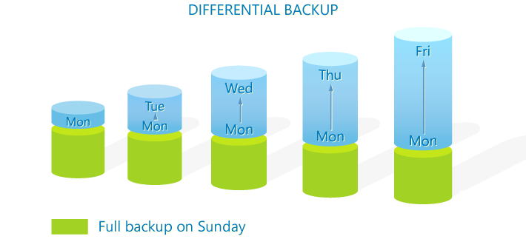
Classic File Backup Strategy
Types: Full (all files) + Differential (only files changed since last Full backup)
Full backup is slow, Differential backup is faster but gets slower.
Restore requires Full + Differential.
Notes:
Full + Differential and Full + Incremental are strategies used to backup to any external device (temporarily connected storage system), location (cloud), or media (tape or industrial optical).
A Full backup of all files takes time and usually requires exclusive use of the system.
How does system know which files are to be differentially backed up? Backup software applications maintain a catalog of all previous backups and compare the current files' date/timestamp, size, CheckSum to the backup catalog’s in order to identify what has changed in the file system. The backup software also records all file renaming, moving, and deleting so that the restore process can recreate the current state of the file system. (Don’t forget to ensure the backup application’s catalog is also backed up.) Most backup software can maintain generational versions of files on external devices or locations instead of simply replacing existing files at the target
For faster restore, the backup software should be set to create a mirror of the source system on the external device or location including all file renaming, moving, and deleting maintenance.
Simple PC backups: full and differential can be created with zip utilites such as 7zip and WinRAR which compare the date/timestamp and size of current files to the files in the Full backup.
Google backup utilities using 7zip
https://portableapps.com/apps/utilities/toucan -- makes the process easier
http://www.techradar.com/news/software/10-essential-tools-for-backing-up-and-protecting-your-pc-1284497
https://www.codetwo.com/admins-blog/difference-differential-incremental-backup/

Slide 22

Classic File Backup Strategy
Types: Full (all files) + Incremental (files changed since last backup of any type)
Incremental backups are faster than Differential.
Restore is slowest because multiple backup types must be done in sequence.
Notes:
How does system know which files are to be incrementally backed up? Server quality backup software maintains catalogs of all previous backups and compares the current files' date/timestamp, size, CheckSum to the backup catalog's.
A simpler method is checking the Archive bit which is set by OS whenever file is changed in any way. The Archive bit is set off when the file is backed up, and set on when the file is changed. WinRAR can use the Archive bit in this way. 7zip cannot – 7 zip would require an intelligent PowerShell script to accomplish this.
Backup Types: full and differential can be created with zip utilites such as 7zip and WinRAR.
https://www.codetwo.com/admins-blog/difference-differential-incremental-backup/
Incremental Pros:
The backup process is even faster than the differential job, not to mention the full backup. It is, in fact, so fast that it can be performed every hour or even minute.
Each iteration of the backup job copies just the data that was changed. Therefore, only a small amount of storage is required each time.
Cons:
In most cases, the backup/restore software requires all iterations of the incremental backup for data restoration. If one of the pieces is missing – the restore is impossible.
The restore process might take some time as the software needs to rebuild data from separate incremental pieces and also the last full backup piece too.
Classic File Backup Schedule
Month-end: Full backup, retained for 2 years
Weekend (Sunday): Differential backup, retained for 2 months (Differences since last Full)
Daily (Monday – Saturday): Incremental backup, retained for 2 weeks (changes since last backup of any type)

Slide 23
Enterprise backup
Backup software does Full, Differential, Incremental strategies
  Options for file versions / generations, and periodic snapshots..
  Enterprise OS provides for backup of continuously running systems.
LTO tape or Optical Disc libraries as nearline tertiary storage
AWS Glacier, Google Nearline, Sync cloud storage
  Inexpensive upload storage, download may be ¢¢¢ slow or $$$ fast
Recovery and Restoration speed is highly variable.
  Depends on data transfer rates from backup device or location, and complexity of rebuilding the relational aspect of data base objects
Data deduplication and Single-instance optimize storage
  eliminate duplicate copies of data within and across systems
Notes:
GoodSync or Bareos are examples of backup software which maintains a DB of the server's file system and what was backed up; when it runs, it compares the requested backup type (Full, Diff, Incr) for files currently in the server to its DB of previous backups.
Tertiary storage is cold storage: safely offline but accessible...in a while from now.
Secondary storage is:
- online drives, SAN, high-performance cloud.
- Hot storage for databases, transactional business data (e.g. debit/credit cards, banking), frequently read data, frequently changed data (AKA volatile).
- Warm storage is file serving, NAS, standard cloud IaaS.
Primary storage is RAM.
https://www.enterprisestorageforum.com/management/cold-cloud-data-storage/
Linear Tape-Open (LTO) - https://en.wikipedia.org/wiki/Linear_Tape-Open
LTOv9 cartridge capacity of 18TB raw or 45TB compressed written at 1GB/sec. Special LTO Streaming Lossless Data Compression rate of 2.5:1
Cartridge size is approx. 10cm X 10cm X 2cm
Save strategies:
- directly to tape (D2T) is slowest because server must wait for data to stream to tape, even at 1GB per second.
- backup to disk then copy to tape (D2D2T) is as fast as writes to disk can be;
- backup to the cloud (D2C/D2D2C) has similar throughput as tape with 10 Gb/sec dedicated bandwidth upload speed and assuming the cloud can receive data at that speed. (see below)
https://medium.com/roxiler-systems-pvt-ltd/amazon-glacier-vs-google-nearline-107de9e3f95c
https://phys.org/news/2018-03-golden-next-gen-optical-disk-storage.html
https://www.google.com/search?q=cloud+hot+warm+cold+storage
Any cloud storage should be “Zero-knowledge”, i.e. encrypting and decrypting data is purely client-side.
See https://www.cloudwards.net/online-storage-vs-online-backup-whats-the-difference/
Two-way cloud sync is not backup, it is synchronizing two (or more) systems via the cloud to keep data on all systems the same. A synchronized file is not a copy, it is the same file co-existing on different systems. Because one system can change the other (for better or worse), there may be no way to recover from data loss or to return to a previous version of a file. If a file is accidently deleted or improperly synchronized, it will be done in both locations. A backup isn’t a backup if it changes dynamically with the original file. Although, some cloud sync services maintain versioning and permanent storage of deleted files – this is highly recommended.
Cloud backup services often have hidden bandwidth throttling. The initial full backup could take as long as weeks to complete. After that, incremental backups are practical. Is the service's restore similarly throttled? Can you download all your data in a practical length of time?
https://www.forbes.com/sites/tonybradley/2013/07/23/the-myth-of-online-backup/#324bd3adef49
http://revuezzle.com/cloud-backup/cloud-backup-articles/news2/faster-backup-carbonite-cuts-throttling/
Top 7 Risks of Cloud File Sync & Share
https://marketplace.mobileiron.com/servlet/servlet.FileDownload?file=00P3400000hF9ynEAC
https://www.zdnet.com/article/why-cloud-sync-not-backup-worked-better-for-business-continuity-during-the-hurricane/
https://www.zdnet.com/article/when-it-comes-to-cloud-storage-the-all-you-can-eat-buffet-is-closing-rapidly/
https://www.zdnet.com/article/ultimate-guide-to-gmail-backup/

Slide 24
User Level File Recovery … is not backup
Windows File History, macOS Time Machine are not exactly backup
Automatic copying of files to external or network drive [good]
Historical versions of user files maintained. Easy to restore. [good]
Must configure and test to ensure copying of all user folders. [okay]
If drive is always connected, it is not a backup, just a copy;
likely not geographically separate or platform independent. [BAD!]
Windows Recycle Bin, macOS Trash can are not backup
Only good for oops! and short-term recovery. [hopeful]
Two-way synchronization is not backup [deluded]
Synchronization is platform interdependent, not independent. [BAD!]
A file on one system does not have a "copy" on other systems, [BAD!]
the same file co-exists on all synchronized systems. [good?]
Notes:
If drive is always connected, it is not a backup, just a copy – i.e. neither geographically separate nor platform independent.
http://www.pcworld.com/article/2974385/windows/how-to-use-windows-10s-file-history-backup-feature.html
By default, Windows 10's File History will back up all the folders in your User folder. If you also want other folders backed up, you must configure it. This is an issue in corporate environments – do you have enough control over where users save their files? Are you always consistent about where you store your own data? File History is for user data recovery, not system recovery.
Apple macOS Time Machine backups up everything. An entire system can be recovered. It automatically makes hourly backups for the past 24 hours, daily backups for the past month, and weekly backups for all previous months. The oldest backups are deleted when the external backup drive is full. Time Machine uses a Full & Differential & Incremental backup strategy. https://support.apple.com/en-ca/HT201250
Trash / Recycle Bin can be emptied – files are gone. If the Bin/Trash is full, new deletions push out oldest deletions.
Low-level utilities can be used to recover only in extraordinary circumstances.

Slide 25
3-2-1 Backup Checklist
3 copies (change only the active file, not the backups)
  1 active, 1 local backup, 1 remote backup
2 different formats/platforms (platform independence)
  External drive is platform independent only when not plugged in
  LTO tape or optical disc. Initially local, optionally moved offsite.
  One-way backup to cloud cold storage (not two-way cloud sync)
1 off-site backup (geographically separate location)
  Cloud storage different from your cloud service provider
  tape/optical media – rotate Full, Diff, Incr to offsite storage services
The near loss of Toy Story 2
Notes:
2 different formats/platforms: do not make copies on the same technology or platform. If the tech fails or system is compromised, you may lose both backups.
A fire proof safe is somewhat in between a local copy and a geographically separate location: It is not likely to be stolen and might survive a disaster. (but see next slide)
Simple small business: rotate external drive from office to home, or home to vehicle.
media rotation and storage services, e.g. Iron Mountain
https://www.ironmountain.ca/en/secure-storage/records-and-media/offsite-tape-vaulting
https://www.ironmountain.ca/en/digital-transformation/iron-cloud-data-management
3 – local files on server,
2 – traditional full/incremental backup to LTO tape, e.g. with Duplicity https://en.wikipedia.org/wiki/Duplicity_(software)
1 – cloud backup, e.g. with Restic which uses deduplication. https://restic.net/ https://en.wikipedia.org/wiki/Data_deduplication
https://www.backblaze.com/blog/the-3-2-1-backup-strategy/
https://www.backblaze.com/cloud-backup.html
https://www.backblaze.com/blog/backing-linux-backblaze-b2-duplicity-restic/
https://www.cyberciti.biz/open-source/awesome-backup-software-for-linux-unix-osx-windows-systems/
https://help.ubuntu.com/community/BackupYourSystem
http://windowsitpro.com/blog/why-3-2-1-backup-rule-still-makes-sense
https://www.youtube.com/watch?v=8dhp_20j0Ys
https://www.petri.com/windows-server-essentials-file-history
https://www.pcmag.com/roundup/353619/best-cloud-backup-services-for-businesses
Toy Story 2 almost disappeared. 2 ½ minute YouTube.
https://www.youtube.com/watch?v=8dhp_20j0Ys

Slide 26
our data is safe in the cloud
UniSuper pension fund, USD$125 billion, 647000 members
Cloud provider configures client's services on May 2, 2024
One active data store at Google Cloud … GONE
Two backup copies on Google Cloud … GONE
…oops "This should not have happened."
UniSuper pension fund also had a proper 3-2-1 backup with a different provider. Services restored May 16, 2024
Notes:
3-2-1 Backup Checklist
3 copies: yes. 1 active data store on Platform as a Service in Google Cloud, +2 copies.
2 independent platforms: NO. all backups on Google Cloud (same platform) under a single account (not independent of active data)
1 different geographical area: yes. each backup on Google Cloud in widely different data centres across Google's global network
UniSuper IT no doubt had to fight for budget to maintain a real 3-2-1 backup with a different provider in addition to the 2 'backups' at Google to guard against something that should never have happened.
UniSuper services fully restored log of messages from May 2 – 16, 2024
https://www.unisuper.com.au/contact-us/outage-update
"UniSuper had duplication in two geographies [of Google Cloud] as a protection against outages and loss. However, when the deletion of UniSuper’s Private Cloud subscription occurred, it caused deletion across both of these geographies." > because they were under the same account with the same cloud system/provider
https://www.theregister.com/2024/05/09/unisuper_google_cloud_outage_caused/
"cloud systems are actually just distributed single points of failure"
/search?q=google+cloud+loses+unisuper+australian+pension+data

Slide 27
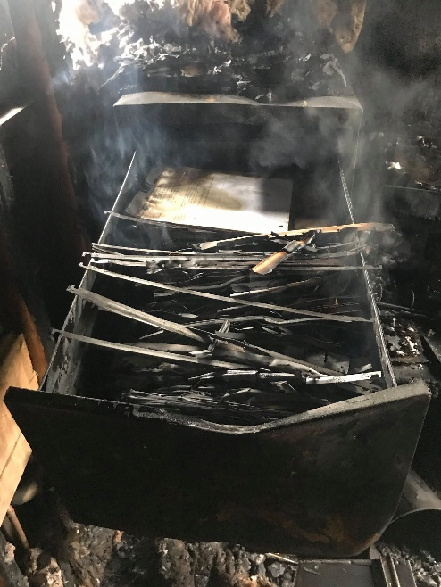
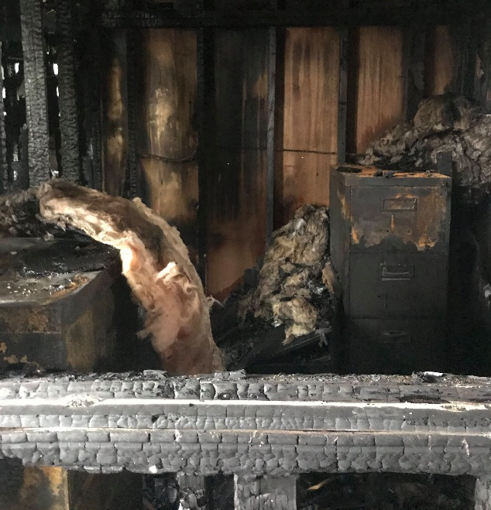
The final word on backups…
Backups do not matter.
Only RESTORE matters.
Notes:
Backups are something we all hope we never have to use. But they are useless without a restore plan. You don't know if the restore plan will work without restoration testing. What if the company runs their backup routine faithfully every day and later finds out it was incomplete?
Photos are of an office ruined by fire that started in another company's building across a parking lot that spread to this company. The business in that office, with a high eight figure revenue, belongs to a builder of single family homes who builds them a large subdivision at a time. About 200 suppliers and tradespeople are involved in the building of each house.
Everything was backed up. They used to kid their finance / comptroller person about the fussiness of doing backups at the end of every day. The day after the fire, that person was the hero of the company.
But how often will your system be infected with ransomware? Or your building burn down? Or be flooded? Or your computer equipment is stolen? Or your backpack – containing your laptop and the external drive with its backups – was beside you when you sat down on the bus, but is gone when you stand up to get off the bus? It. Has. Happened. Sure, it's never going to happen to you. That's what they thought, too.
Restoration of a large amount of data over a network, especially a cloud service, will be slower than a directly attached device such as tape.
Many cloud services throttle I/O, i.e. up and download speed. The speed of the restoration must be considered.
From Toronto, you can fly to Vancouver or drive to Vancouver or walk to Vancouver; all are possible, only one is both fastest and cheapest.
The same goes for restoration of data: it must be practical -- speedy and hopefully cost effective. (However much it costs, it is cheaper than losing the whole company.)

Slide 28
Notes
…not on the quiz but here for further information and explanation.

Slide 29
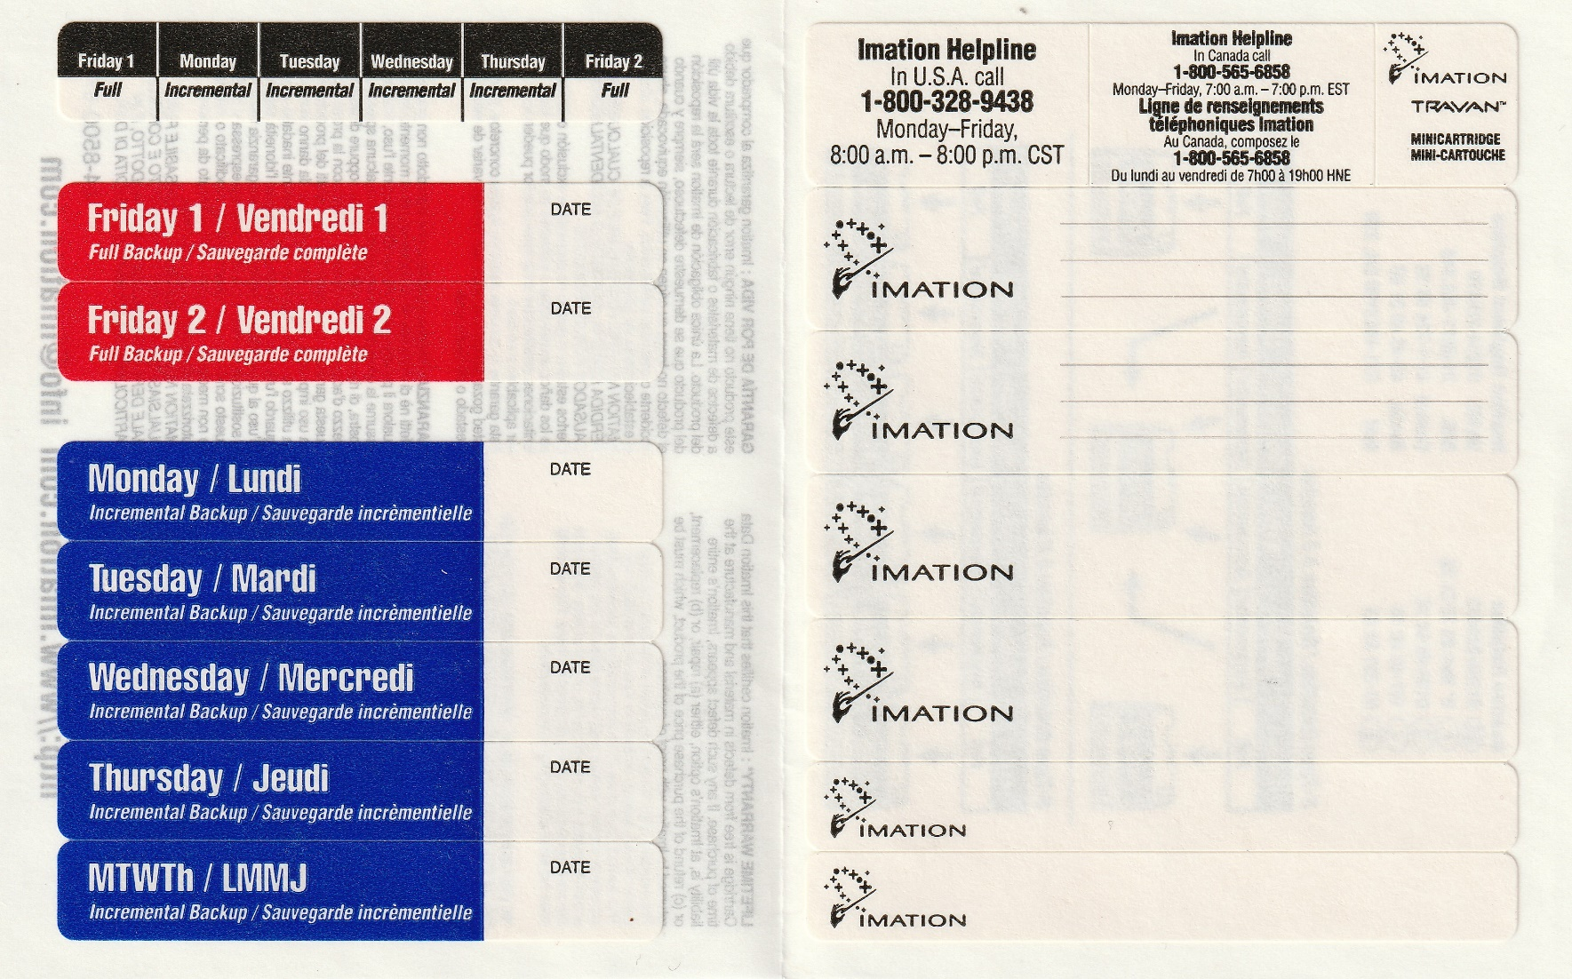
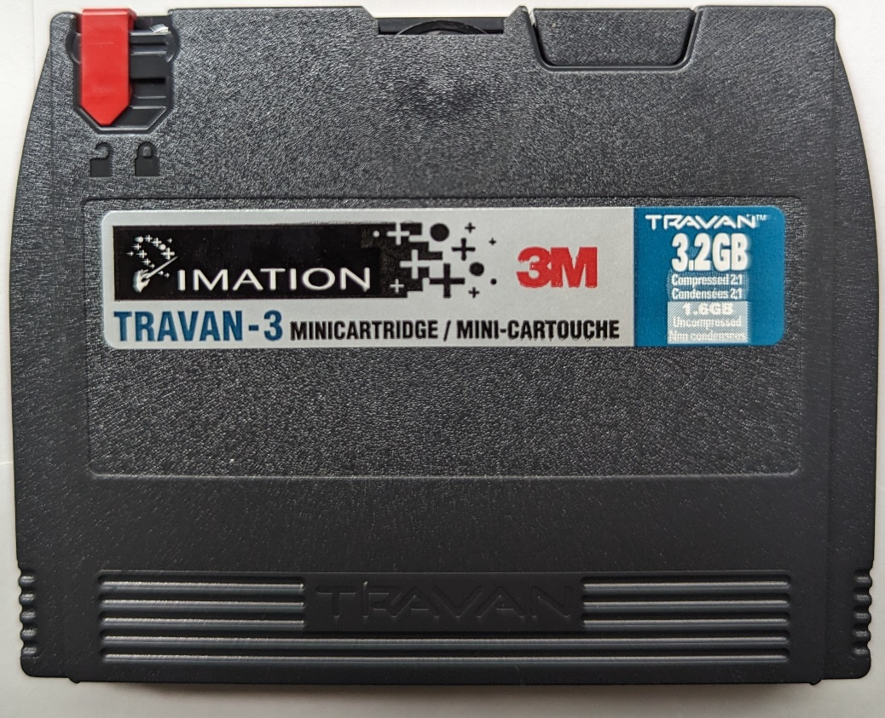
Notes:
Small server backup media rotation…when 1.6GB uncompressed was more like 1.6TB today.
Friday 1 is Full on the first Friday of the
Monday is Incremental since Friday 1
Tuesday is Incremental since Friday 1 + Monday
Wednesday is Incremental since Friday 1 + Monday + Tuesday
Thursday is Incremental since Friday 1 + Monday + Tuesday + Wednesday
Friday 2 is Full
Monday – Thursday Incremental tapes can be overwritten weekly.
Friday 3 is Full
Monday – Thursday Incremental tapes can be overwritten weekly.
Friday 4 is Full
Monday – Thursday Incremental tapes can be overwritten weekly.
Friday 5 is Full when a month has five Fridays.
Monday – Thursday Incremental tapes can be overwritten weekly.
January Month End is Full
Cycle repeats with reuse of Friday 1 on the first Friday of the month.
Above is minimum retention and reuse.
Ideally, there is a set of Monday to Thursday incremental tapes for each of the five Friday full tapes.
Twenty-Four Month End (2 year retention before reuse).
One Year End calendar (7 year retention minimum)
One Financial Year End close (retained permanently, converted to new media when drive nears end of life)

Slide 30
Effect of File Compression on Data Transfer
Assumptions:
1MB plain text file, unique for each of 30,000 users
Network throughput is 2 seconds per file
text compressed to 35% of original, throughput 1 sec/file
 | Data | Time | Size
Original 1MB plain text | 8.24 Mb | 16.6 hours | 241.4Gb
Compressed to 35% | 2.88 Mb | 8.3 hours | 84.5Gb
Notes:
Each user gets a unique, personalized file, e.g. payroll information. 1MB to 30,000 users is much slower than 30GB to one user
Network bandwidth vs throughput: think cars on the highway. If all cars in each lane travelled at the same speed, if cars merged on and off without slowing cars already on the highway, if there was no space between cars, that's bandwidth utilizing 100% of the road capacity. The only time this happens with human drivers is during a traffic jam. 100% utilization of the road but very poor throughput for any individual vehicle.
The reality is space between cars is a necessary safety margin, weather affects the speed of traffic, too much traffic causes congestion, ½ the drivers of cars on the road are incompetent: they have a low level of skill in operating a vehicle and don't follow the rules.
Plain text compression to 35% of original is a safe assumption, normal range for text is 25% to 50% of original depending on repeating patterns within data.
Compression to 35% results in ~ half the time (latency is the same, still have 30,000 separate transfers to do) but ~one third the data resulting in less network congestion.
TCP packet overhead adds ~3% to original data
Original 1MB = 1024 * 1024 = 1,048,576 + 3% TCP overhead = 1,080,033 * 8 bits = 8,640,264 = 8.24Mb
Compressed to 35% of original = 1,048,576 *.35 = 367,002 + 3% TCP overhead = 378,012 * 8 bits = 3024096 = 2.88Mb
Compression can make delivery feasible.
https://dsp.stackexchange.com/questions/3474/what-are-some-typical-lossless-compression-ratios
survey paper on compression, "A Survey Of Architectural Approaches for Data Compression in Cache and Main Memory Systems", shows that most practical techniques on general benchmarks achieve compression ratio ~2X and some up to 4X, although higher potential (e.g. ~16X in some cases) exists (see Section 2.2). The reason for not achieving full potential is that techniques with higher compression ratio also have higher overhead (e.g. extra hardware which consumes power, extra processing which takes time) or the input data has a high proportion of repeating data (e.g. compressing file with all zeros).
https://www.dnsstuff.com/network-throughput-bandwidth

Slide 31
Compression for end user distribution
TIFF, PNG, GIF (lossless). JPG (lossy).
formats used by the graphics industry
FLAC (lossless), CD:WAV (~lossless) MP3, AAC, MP4 (lossy)
Compression formats used by the sound engineering and music industry
MPG, MP4, DIVX, XVID, MOV, AVI (all lossy).
Compression formats used by the video industry
Notes:
Note the conditional "for end user distribution".
Data captured in professional production studios is stored at the original resolution as received from recording devices.
Professional photographers typically store their pictures in RAW format which is the unmodified data as output directly from the camera's photo sensor. That is, the digital data as captured directly from the original analog visual/audio source.
Most of these are lossy formats, thus cannot be uncompressed to original source data.
PNG and TIFF are lossless graphics formats and are the only formats that should be given to graphic designers for production work.
FLAC – Fully Lossless Audio Codec – is lossless but is usually a container for WAV files (Redbook, 44.1K 16 bit CD files) which were mastered from higher resolution source material. https://en.wikipedia.org/wiki/Compact_Disc_Digital_Audio
FLAC is used to store high resolution audio > 44.1kHz frequency sampling and > 16 bit amplitude sampling. In theory, humans cannot hear frequencies beyond what 44.1kHz sampling can capture, or listen to range of loudness (amplitude) beyond the 96 dB range of 16 bit depth. (The highest frequency a normal middle-aged adult can hear is only 12-14 kilohertz – a long way from a young persons' 20kHz – but studies have shown adults prefer music with higher frequencies than recordings without despite being theoretically unable to hear them.)
Music recording is typically done at a minimum of 48kHz, 24 bit and frequently at 96kHz.
High-resolution [96kHz] releases are often different mixes than those released at 44.1 kHz on CD. Be careful when attributing the difference to sample rate. Mixes for CD quality are often tweaked to sound 'better' on average reproduction systems and sometimes further tweaked for portable/mobile listening. e.g. emphasis on lower bass frequencies. A 96kHz release usually offers the original mastering for the recording studio without tweaking targeted at end users. 96kHz may offer advantages when compared to 44.1 kHz [better perception of harmonics], but there is no justification for paying a premium price to move from 96 kHz to 192 kHz, unless you are getting a better mix, better transfer, or better master. https://benchmarkmedia.com/blogs/application_notes/14949325-high-resolution-audio-sample-rate
Word lengths longer than 24 bit do not improve the amplitude "resolution" of digital systems, they only improve the noise performance. But, noise can mask low-level musical details, so please do not underestimate the importance of a low-noise audio system. (https://benchmarkmedia.com/blogs/application_notes/15121729-audio-myth-24-bit-audio-has-more-resolution-than-16-bit-audio)
For most end user Use Cases, CD quality WAV files are adequate.

Slide 32
How Compression Works
Here is an old quote from Vangie Beal:
  Data compression is particularly useful in communications because it enables devices to transmit or store the same amount of data in fewer bits. There are a variety of data compression techniques, but only a few have been standardized. The CCITT has defined a standard data compression technique for transmitting and a compression standard for data communications through modems. In addition, there are file compression formats, such as ARC and ZIP.
This quote contains 449 characters.
Notes:
Info on this and the next two slides are reproduced within the activity.
Note that this is a conceptual explanation of compression. Lempel–Ziv–Welch is a sophisticated mathematical process that works on binary data.
http://www.webopedia.com/TERM/D/data_compression.html

Slide 33
How Compression Works (cont’d)
Replace “compression ” with "♠". The text becomes:
  Data ♠is particularly useful in communications because it enables devices to transmit or store the same amount of data in fewer bits. There are a variety of data ♠techniques, but only a few have been standardized. The CCITT has defined a standard data ♠technique for transmitting and a ♠standard for data communications through modems. In addition, there are file ♠formats, such as ARC and ZIP.
With dictionary “♠compression˽” and 5 replacements,
total size is 406 characters, 90.4% of 449.
algorithm builds a token/string dictionary
Notes:
replacing symbols with new, weighted symbols based on frequency of use. i.e. it must be used at least twice for any benefit.
Original = 449 char
“Compression” is 11 characters X 5 occurrences = 55 char saved
But 5 symbols must be used, saved 50 char net
And 1 dictionary entry is needed 1 symbol + 11 characters, saved 38 char overall

Slide 34
How Compression Works (cont’d)
With more pattern matching and a bigger dictionary… ♠compression˽ ☻transmit ♣here are˽ ♥data˽
♦communications˽ ☺standard˽ ♪technique
  ♥♠is particularly useful in ♦because it enables devices to ☻ or store the same amount of ♥in fewer bits. T♣a variety of ♥♠♪s, but only a few have been ☺ized. The CCITT has defined a ☺♥♠♪ for ☻ting faxes and a ♠☺ for ♥♦through modems. In addition, t♣ file ♠formats, such as ARC and ZIP.
Including dictionary, total size is 363 characters or 81% of original. The more pattern matches there are for each dictionary item, the higher the compression.
Notes:
Put the quote into a simple .txt file and compress the binary values into a .zip file…
From 451 char (449 + CR/LF) to 244 char or 54%.

Slide 35
Two types of Compression Formats
Lossless (LZW and or Huffman)
ZIP, TIFF, FLAC, and other general file compression routines are lossless: all original data is completely encoded. Lossless compression reduces redundant data by not repeating recurring strings of the same data (e.g. a large blank space in a TIFF image or a long noiseless passage in FLAC audio).
After decompression, the data is always complete and is indistinguishable from the original source file.
GIF files use LZW lossless compression as part of their file format. Although GIF images capture only 265 colours per frame, this is their highest resolution. The minimal colour depth captured is by design, it is not an artifact of compression. GIFs are must successful as sharp-edged line art with animations.
Lossy
JPG/JPEG, MPG, MP3, and other end-user formats use lossy compression. Data representing the highest, fine-grained resolutions of the image or sound are removed in order to achieve high levels of compression to reduce file size for distribution. The level of compression is variable according to the Use Case. e.g. minimal compression of the original, high compression for email or MMS distribution.
  JPG images effectively delete colour information to achieve compression.
  MP3s simplify the sound waves of audio
Developers decide to adjust the level of compression according to their Use Cases.
Notes:
Developers decide to adjust the level of compression according to their Use Cases.
A file with Lossy compression can never be returned to its original, complete state.
The amount of loss or compression can be adjusted; a developer decides how much compression can be applied while retaining enough useful quality of the content for the intended purpose.
e.g. high compression for JPG thumbnail images but little compression for large, zoomable images.
e.g. a low resolution, highly compressed image for quick loading of a web site's landing page, a larger high resolution image with less compression when detailed information is requested by the end user.
Note this means storing multiple resolutions in multiple files. Alternatively, store the file at its original highest resolution and down-sample it into a temporary file compressed for transmission.

Slide 36
Overview of some Compression File Formats
ZIP:
  The most popular general-purpose compression archive.
  Supported on virtually all platforms from mainframes to PCs.
  Includes features such as encryption using password protection.
RAR, 7z, TAR, StuffIt:
  Proprietary general-purpose compression file formats with incremental improvements over Zip but with the loss of standardized support.
  use different algorithms, with various benefits and uses.
  Some are designed for different operating systems
  (StuffIt for Mac, TAR for *nix--TapeARchive).

Slide 37
What is a “Backup” and why do we need backups?
Backup is the “procedure for making extra copies” of data “in case the original is lost or damaged and must be restored.” The procedure includes storing the copy in a geographically separate location which is platform independent from the original file and host system.
Having a backup will allow you to recover from lost, broken or stolen hardware, and from your own accidental deletions.
You should be in the habit of backing up user created files on your laptop or PC. OS and apps can be restored from their original software providers or a system Restore Point but user created data can only be restored from backups.

Slide 38
When & How to run your Backup
Automatically:
  Performed by continuously running backup software that constantly monitors for file changes. Used for Full and Incremental strategy.
Scheduled:
  system operator or backup software runs a backup at specific times, such as overnight, when it has the least impact on business operations or at critical business times such as at accounting month/year end. Used for Full, Differential, and Incremental strategy.
Manual Backup:
  a user performs backups at their own convenience. Not a strategy.
  It is the least effective method (what if you forget to do it?), but it’s better than no backup at all!

Slide 39
Locations of Backup Media
Local:
  copies files to a drive in use by the system.
  fastest and most convenient, but if the computer is lost or malfunctions, so goes the data! Just having a copy is not a backup.
  Local copies may be made to reduce downtime. The copies are then moved to External media or transmitted which is a slower process.
External:
  Copies files to External/Portable/Flash Drive.
  i.e. a device which can be disconnected from the computer.
  It is a backup when the platform independent device is taken off-site.

Slide 40
Locations of Backup Media (Cont’d)
Network:
  Back up files to the cloud (Google Drive, OneDrive, Dropbox, iCloud)
  It is a slower option for large backup. Cost effective communications bandwidth has significantly less throughput than writing data to a directly attached device.
The best location depends on the type of work you’re doing, the volatility of the data (how quickly it changes), the volume of data, the backup window (available downtime), security considerations, and the speed/availability of restoration.

