Slide 1
Computer Principles for Programmers
Clients, Servers, and Clouds as a Service
(thank you networks)
Notes:
http://info.cern.ch/hypertext/WWW/TheProject.html
- Original site content
A simulation of the first web page is NO LONGER found at …
http://line-mode.cern.ch/www/hypertext/WWW/TheProject.html
Original text server simulation (best in Firefox)
CERN from the French literally translated as Council for European Research Nuclear
https://www.wired.co.uk/article/first-web-page
- News about

Slide 2
News of the Week

Slide 3
Agenda
Lecture:
Networks, Clients, Servers, and Services
Cloud Computing: IaaS, PaaS, and SaaS.
  Infrastructure | Platform | Software as a Service
"OMG, I have no internet!"
What tech & organization are needed to make the internet work for delivery of the many things we get?
Notes:
Infrastructure is your ISP who provides a connection to the network of networks known as the Internet.
Platform is things like GitHub Codespaces · GitHub https://github.com/features/codespaces
"Spin up fully configured dev environments in the cloud that start in seconds"
SaaS is Blackboard Ultra, the LMS (Learning Manglement System) used at Seneca.
There are many moving parts to the Internet. What do you think they are?
There are a great many other things as-a-Service which are subdivisions of the three main Infrastructure | Platform | Software categories.
https://en.wikipedia.org/wiki/As_a_service
Transitioning to as-a-service business model | Deloitte Insights
https://www2.deloitte.com/us/en/insights/topics/strategy/as-a-service-business-model-flexible-consumption.html

Slide 4
Activity
Using Microsoft 365 cloud-based collaboration tools
What Microsoft 365 features can be considered Infrastructure as a Service (IaaS), Platform as a Service (PaaS), and Software as a Service (SaaS)?
If Everything is a Service, then what do we have?
What have you got when you have subscriptions?
Does it matter when you don't have
the hardware, the software, or the files?
Is the medium now the only message?
Notes:
Microsoft 365 has cloud-based Software-as-a-Service for Office apps at mySeneca.ca. The same Office applications can be installed on your local machine as client-side software which can run without a network connection. (OneDrive will work locally as data storage client until synchronization with the cloud resumes but OneDrive is PaaS, not Saas.)
What Microsoft 365 features can be considered Infrastructure as a Service (IaaS), Platform as a Service (PaaS), and Software as a Service (SaaS)?
N.B. SaaS really means Application as a Service but AaaS doesn't have the alliteration of SaaS, and AaaS is rather awkward as a spoken acronym.
OneDrive is Infrastructure (IaaS) if you simply store files on it instead of your local drive
OneDrive is Platform (PaaS) if you use it to synchronize files between your local drive and the cloud. Also if OneDrive in the cloud is used to share files, and/or for file versioning, then it is PaaS.
OneDrive is not really Software as a Service (SaaS) because it is not an application, it does not have a specific function such as word processing, spreadsheeting. OneDrive is a general tool that can support many applications such as where you store your Word and Excel files.
1. Microsoft 365 is a combined application provided by Microsoft consisting of Microsoft Office apps (office.com for browser based, local apps for complete functionality), Exchange (email server), SharePoint (file sharing & collaboration, AKA OneDrive for Business), personal storage space on OneDrive, and a number of real-time collaboration tools. Everyone at Seneca has access to MS 365.
https://en.wikipedia.org/wiki/Microsoft_365 https://www.microsoft.com/en-ca/microsoft-365
3. A world-wide internet with high bandwidth networking wherever you go (Wait! Is that a valid assumption world-wide?) enables subscription services like Spotify and Netflix, Microsoft 365, vehicle upgrades and downgrades, and Everything as a Service.
Where is your digital stuff when you don't have the hardware, the software, or the files? What do you have when all you have are subscriptions?

Slide 5
World's Top Websites
Rank | Website | Monthly Traffic (billions) | Traffic Share of Top 25
1 | google.com | 83.9 | 44%
2 | youtube.com | 32.7 | 17%
3 | facebook.com | 16.8 | 9%
 | Top Three |  | 69%
Rank | Website | Monthly Traffic (billions) | Traffic Share of Top 25 | Category
4 | twitter.com | 6.4 | 3% | Social Media Networks
5 | instagram.com | 6.3 | 3% | Social Media Networks
6 | baidu.com | 4.7 | 2% | Search Engines (China)
7 | wikipedia.org | 4.5 | 2% | Dictionaries and Encyclopaedias
11 | whatsapp.com | 2.8 | 1% | Social Media Networks
14 | amazon.com | 2.2 | 1% | Marketplace
15 | tiktok.com | 2 | 1% | Social Media Networks
16 | live.com | 2 | 1% | Email (Microsoft 365 - Outlook)
17 | openai.com | 1.8 | 1% | Technology - AI
18 | reddit.com | 1.7 | 1% | Social Media Networks
20 | linkedin.com | 1.6 | 1% | Social Media Networks
21 | netflix.com | 1.4 | 1% | Streaming & Online TV
22 | office.com | 1.4 | 1% | Microsoft 365
25 | bing.com | 1.3 | 1% | Search Engines
 | Total visits | 192 | 24 | visits/month/human
Notes:
https://www.visualcapitalist.com/ranked-the-worlds-top-25-websites-in-2023/
https://www.statista.com/statistics/265668/global-top-websites-ranked-by-visit-share/
"unique user visits" N.B. this is not volume of traffic which streaming services dominate.
N.B. Wikipedia is in the top 10, so there is still hope for humanity using a neutral, non-commercial, non-advertising, non-surveillance, non-reseller of your online behaviour website. It is the only website in the top 25 that is "of the people, for the people, by the people." Consider supporting it with a recurring monthly donation = a cup of coffee. It's all they ask for. You can even personally add to the collected wisdom of this way of life we call civilization – at no cost.

Slide 6
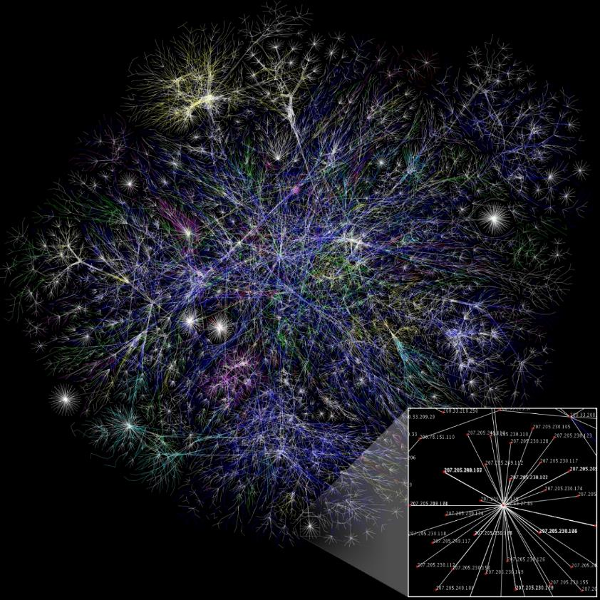
Computer Networks?
Network: a set of computers connected together for the purpose of sharing resources.
Internet: a network of peer networks.
Notes:
Internet http://www.nickh.org/computer/glossary.html#I
The most effective productivity destroyer in business today.
Designed originally as a way for geeks to communicate with each other,
it was later found that geeks were barely able to communicate,
so it was opened up to the general public.
A computer network is “a set of computers connected together” for the purpose of “sharing resources.”
The most common resource shared today is the “Internet” which is a network of peer networks.
Peer: no sub-network or traffic is more important than any other.
The picture is a small look at the backbone of the Internet. Each line represents two IP addresses, length of lines = latency or the time it takes packets to travel from one end-node to another. Lines are color-coded by groups of top-level domain (TLD) -- Dark blue: net, ca, us; Green: com, org; Red: mil, gov, edu, other colours for different geographic groups of countries.
Paul Krugman, a Nobel laureate in Economics, said in 1998…
"The growth of the Internet will slow drastically, as the flaw in "Metcalfe's law"--which states that the number of potential connections in a network is proportional to the square of the number of participants--becomes apparent: most people have nothing to say to each other! [in a way, that is still true] By 2005 or so, it will become clear that the Internet's impact on the economy has been no greater than the fax machine's." [odd for an economist to say that given internet traffic in 1998 was 66.67X more than in 1995]
"As the rate of technological change in computing slows, the number of jobs for IT specialists will decelerate, then actually turn down; ten years from now, the phrase information economy will sound silly." [True. It is now called the digital economy.]
Krugman, P. (1998, June 10). Why most economists’ predictions are wrong. The Red Herring - Economics - June 1998. https://web.archive.org/web/19980610100009/ (http://www.redherring.com/mag/issue55/economics.html)
https://en.wikipedia.org/wiki/Metcalfe%27s_law
1995 – internet traffic was 200 TB/month. 1996 was 10X that. In 2019, traffic was 87X that of 1996.
2023 – traffic was 25% more than 2022, and 2022 was 25% more than 2021. This is expected to continue at that rate until 2026.
2023 – total internet traffic of >150.7 exabytes per month has doubled in 4 years or 750,000X that of 1995
2/3 of the >8B people on Earth now have internet connectivity.
World population has grown only 1.57X since 1998 but total internet traffic has grown 12,500X more than in 1998 when Krugman said it would "slow drastically."
https://radar.cloudflare.com/year-in-review/2023 https://gitnux.org/internet-traffic-statistics/ https://en.wikipedia.org/wiki/Internet_traffic https://www.macrotrends.net/countries/WLD/world/population
https://qz.com/1705375/a-complete-guide-to-the-evolution-of-the-internet/

Slide 7
Types of Computer Networks
WAN = Wide Area Network, e.g. public Internet
Intranet = inside a private network. PCs, BYOD, servers for file + print + storage + data sharing.
  LAN = high speed Local Area Network for an Intranet
  VPN = Virtual Private Network – remote connection to a
  private intranet across a public network via IP tunnelling.
MAN = Metropolitan Area Network, TTC subway station WiFi is on a MAN from BAI Communications
Notes:
Internet is not the only public network. Public networks exist in coffee shops, on the TTC, Go Transit, airplanes, airports, Toronto Public Libraries. WIFiMap.io reports ~12,000 free public networks in Toronto. The purpose of those public networks is to connect to the Internet WAN.
Be aware, that everyone in the same coffee shop is on a single WiFi LAN Intranet. Theoretically, all devices attached to the coffee shop's WiFi could communicate directly with each other.
The coffee shop is a BYOD = Bring Your Own Device environment.
Large organizations and enterprises use VPNs allowing employees to access their company's intranet from outside the office. Site-to-site VPNs allow employees in geographically separate offices to share one cohesive virtual network.
An IP tunnel is an Internet Protocol (IP) network communications channel between two networks. It is used to transport another network's protocol (your Intranet) by encapsulation of its packets within the packets sent over the Internet. VPNs use authentication, tunnelling, and encryption for secure communications over public networks.
RAN is a regional area network. This is a large network like one made by an ISP (Internet Service Provider)
https://en.wikipedia.org/wiki/Bring_your_own_device
https://en.wikipedia.org/wiki/Wide_area_network
https://en.wikipedia.org/wiki/Virtual_private_network
https://en.wikipedia.org/wiki/Tunneling_protocol
https://en.wikipedia.org/wiki/IP_tunnel

Slide 8
Success of the Internet
Open Standards: TCP/IP, HTTP, HTML, WWW browser
  Sir Tim Berners-Lee 1990. Marc Andreessen 1993. W3C 1994.
Open Source: GNU/Linux 1991, Apache Web Server 1995
World-wide networking from glass fibre & telecom goldrush
Affordable bandwidth: speed + capacity grows for same $
Decentralized, cooperative infrastructure. e.g. peering
Growth by cooperation. Innovation by competition.
Net neutrality: all packets are created equal
Notes:
Television was the internet of the 1960s, the telephone before that, and radio before that in the early 20th C. The telegraph (19th C) and newspapers, and before that, pamphlets in the 16th C were the internet before radio. Like the internet, they were all methods of moving information around the globe and making it accessible to people. Snail mail was delivered and picked up TWELVE TIMES A DAY at people's homes in 1889 London, England.
By the mid 1970s, the US Defense Department ’s ARPANET project had grown to 60 mainframe nodes with fixed point-to-point connections using a variety of networking protocols. This was neither scalable nor flexible for inter-networking in which multiple separate networks could be joined into a network of networks. In 1982, the Internet protocol suite (TCP/IP) became the standard on ARPANET which later grew into the Internet as we know it.
TCP is the rules of the road. IP is the truck with the delivery (packets). HTTP is the cargo.
TCP/IP uses both the client-server model and peer-to-peer networking (more about that later in this ppt).
e.g. browser and web server as the client and server. Peer to Peer means each end is independent of the other. (a stateless connection) Traffic is sent on a best-efforts basis. Packets are not guaranteed to arrive nor should they be expected to be received in the order they were sent. Guaranteeing sequence and arrival would create traffic jams between networks (end nodes). TCP/IP is for inter-networking. Once the data arrives, it is up to the host end, to figure out what to do with it. think MVC: the data is the Model, TCP/IP is the Controller, the host end manages the View which is the browser or webserver.
Transmission Control Protocol is the network connection-oriented service for transmitting and routing traffic between end nodes,
Internet Protocol is the connectionless layer for relaying datagrams across network boundaries. The data payload, encapsulated within the IP packet, is processed at the end nodes. This is why and how HTTP, a new messaging/application protocol, could be implemented – it is independent of and carried by IP which is independent of TCP.
TCP/IP started in a 150+ year dive bar near Palo Alto in 1976. See https://getpocket.com/explore/item/how-the-internet-was-invented
“Vague, but exciting” is what Berners-Lee's boss, Mike Sendell, wrote on the proposal for an information management system in 1989.
"The reason the Web took off is not because it was a magic idea, but because I [Tim Berners-Lee] persuaded everyone to use HTML and HTTP." Back then, there were not that many everyones to persuade. Also, more importantly, because it was open and non-proprietary, and therefore free. Free as in speech and free as in beer. Through his World Wide Web Foundation, he continues to keep it open, non-proprietary, and free.
N.B. nothing kills a project within a bureaucracy faster than asking for a budget allocation. Time you can have: work as much unpaid overtime as you like. One of the many reasons Open Source has been successful – it doesn’t need as many layers of approval.
The first web page is found at http://info.cern.ch/hypertext/WWW/TheProject.html https://www.wired.co.uk/article/first-web-page
The invention of HTTP Hypertext Transfer Protocol and the textual browser in 1990 by Berners-Lee called “WorldWideWeb” and Marc Andreessen’s visual GUI Mosaic three years later (→ Netscape → Mozilla → Firefox)
made the Internet easy to use and accessible to the average person (multi-media in a single window and multiple protocols like HTTP, FTP, Usenet) and sparked growing demand for connectivity in the mid and late 1990s.
http://info.cern.ch/Proposal.html?mc_cid=5a1c84b122&mc_eid=71134692e2
See https://www.wired.com/2012/02/tim-berners-lee-patent/
Marc Andreessen https://www.wired.com/2012/04/ff-andreessen/
The Mosaic/Netscape browser software was FREE for non-commercial use. Building a business by giving stuff away was a revolutionary model.
https://www.internetsociety.org/internet/
https://www.inverse.com/article/14959-celebrating-23-years-of-the-www-how-tim-berners-lee-open-sourced-the-internet
https://home.cern/cern-people/opinion/2013/04/twenty-years-free-and-open-www
https://opensource.com/life/14/4/25-years-world-wide-web
https://webfoundation.org/about/vision/history-of-the-web/
https://www.theguardian.com/technology/2017/mar/11/tim-berners-lee-web-inventor-save-internet
https://www.vanityfair.com/news/2018/07/the-man-who-created-the-world-wide-web-has-some-regrets
http://yourlifesolution.com/7/the-man-who-would-have-been-a-trillionaire/
https://www.youtube.com/watch?v=ykCPFUlasFk (broadcast of Tuesday 12 March 2019, Science Museum & Web Foundation celebrate the web’s 30 years with Sir Tim)
In the 1990s, UNIX was dying in the small to medium sized business world with the rise of Microsoft Server. The IT trade press was predicting the demise of UNIX. In the early 1990s, IBM and Microsoft ignored the Internet as a poor public substitute for high quality private telecommunication networks. If you wanted a web server, you had to make one. Only the UNIX OS was open enough for anyone to develop applications like a web server on affordable micro hardware and deployable on mini hardware (mid-size servers) powerful enough to do the job. Both IBM and Microsoft’s servers were too closed at the time for this type of development. Researchers and innovators accepted the TCP/IP standard and embraced the idea of a network of independent networks and non-proprietary servers.
World-wide communications: 250,000 km of submarine communications cable with a capacity of 2.56 Tb/s by 2002. How did such extraordinary growth take place: fibre optic cables (they are not very big and transmit data farther so are easier to lay than traditional copper cables).
During the dot-com bubble, the days of the “information superhighway”, a large number of telephone companies, known as “telecoms”, built optical fibre networks everywhere. Telecoms were in a greed-fueled race to corner the market in telecommunications by providing a network with sufficient capacity to take all existing and forecast voice and data traffic for their entire region served. This was based on the assumption that telecom traffic, particularly data traffic, would continue to grow exponentially for the foreseeable future (this was mostly true)…and that each telecom would get their “fair share” of the market, their fair share being 100%. (That was entirely false. Tim McKenna was at a New Years Eve party in 2001 where a “golf-pro”, who was just recently a senior VP in a telecom firm, admitted that for all the sales forecasts to come true, North America would have needed over four times as many residents to soak up the capacity on offer.) There was willful ignorance of demographics and blindness to the limits of exponential growth. (See S curve, Logistic function, http://www.slideshare.net/wright4/double-scurve-model-of-growth)
The dot-com bubble burst in 2000. The telecom bubble burst in Spring of 2001; $750B was lost. Investors, already spooked from the dot-com's dot-bomb, saw telecom's waning demand, oversupply, and a business model that had collapsed. By 2002, $5 trillion in market capitalization was lost as a result of both bubbles.
But wait, there's more.
Affordable High bandwidth: The capacity of commercial lightwave systems increased from less than 100 Mb/s when they debuted in the 1970s to roughly 1 Tb/s by 2000. This is an increase of more than 10 000 times in 30 years, but more incredibly, the introduction of WDM wavelength-division multiplexing during the latter part of the 1990s resulted in a factor of 1000 increase in just 10 years. In the early to mid 1990s as the Internet got going, data traffic was increasing faster than capacity to carry it. Telecoms rushed to put fibre everywhere and sign up ISPs. By the year 2000, the situation had reversed, capacity was greater than demand because the bandwidth of a single fibre had increased 1000 times during the decade. As a result, the wholesale price of data traffic collapsed (what your business plan expected you could sell for a $1 in 1992 was going for $0.001 – one tenth of a cent – ten years later) and with it, the rest of the telecoms’ shaky economic assumptions (i.e. Yesterday's needs will be solved by Today's technology; Today's needs will continue Tomorrow, and Tomorrow will never have a better solution than Today's). What was only affordable for businesses throughout the 1980s became inexpensive enough in the mid-1990s for everyone who could afford a PC.
IBM and Microsoft's limited vision of expensive, inherently secure, private point-to-point networks was inexpensively satisfied by the growth of the public insecure Internet overlaid with encryption for security. More and cheaper bandwidth created new opportunities. It wasn’t just data and files going over a network, it became pictures, music, and video that could be streamed. One result of telecom greed was a lot of unlit fibre, known as "dark fibre". Dark fibre is now used for dedicated connections between a company and cloud or network services.
This dramatically reduced the demand for physical fibre by increasing the capacity that could be placed on a single fibre by a factor of as much as 100 during the dot-com bubble. In the late 1990s through 2000, the telecoms saw the market opportunity of data traffic's estimated growth rates "doubling every 100 days" which was optimistic. But they did not take into account the capacity to carry that traffic was doubling every six months starting in 1992 until a bit rate of 10 Tb/s was reached by 2001. (Proceedings of the IEEE, Volume: 100 Issue: 5. Capacity Trends and Limits of Optical Communication Networks, 2012. https://doi.org/10.1109/JPROC.2012.2182970 ) https://en.wikipedia.org/wiki/Fiber-optic_communication#History
By 2002, an intercontinental network of 250,000 km of submarine communications cable with a capacity of 2.56 Tb/s was completed.
Decentralized : No one is the “boss” of the Internet, no one company owns it. The Internet backbone is a conglomeration of multiple, redundant networks owned by numerous companies. Massive cooperative infrastructure of fibre cables in the ground and under the ocean, many core router nodes (Internet exchange points, IX or IXP) in all major cities with between 1 and 5.6 tera-bits per second capacity. https://en.wikipedia.org/wiki/List_of_Internet_exchange_points_by_size
In only ~25 years, the Internet has grown to be considered a public utility like electricity and water, computers are almost useless without network connectivity. The Internet, i.e. communication, is also considered essential to supporting human rights. Soon, it may be considered a human right in and of itself. In Summer of 2016, the United Nations Human Rights Council released a a non-binding resolution condemning intentional disruption of internet access by governments. The resolution reaffirmed that "the same rights people have offline must also be protected online.“ https://en.wikipedia.org/wiki/Right_to_Internet_access#2016:_UN_Resolution
Net neutrality is the principle that Internet service providers and governments regulating the Internet should treat all data on the Internet the same, not discriminating or charging differentially by user, content, website, platform, application, type of attached equipment, or mode of communication

Slide 9
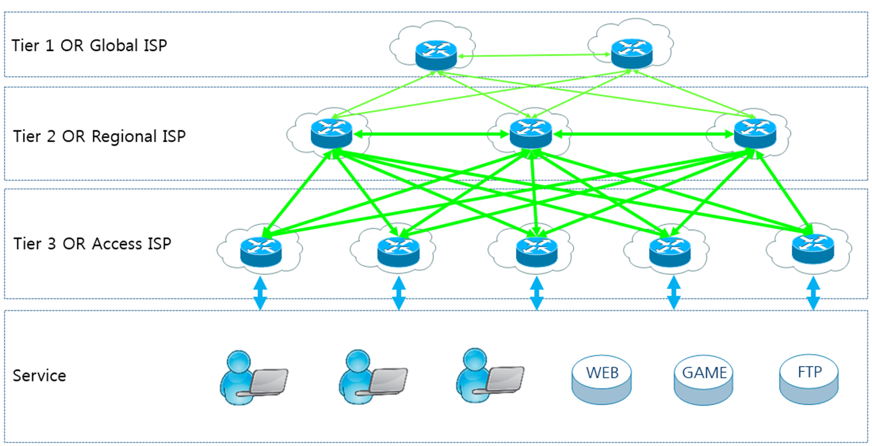
Tier 1 / 2 IXP – Internet Exchange Point Tier 3 ISP – Internet Service Provider
IXP
Peer
IXP
transit
$
Peer
Peer
IXP
transit
$
ISP
transit
$
2B PCs 1B tablets 5B smartphones
Notes:
Growth occurred because of cooperation, innovation because of competition. It was a healthy balance.
The Internet is a collection of separate and distinct networks, each one operating under a common framework of globally unique IP addressing and global routing (each network exchanges routing and reachability information for all other networks). Peering involves two networks coming together to exchange traffic with each other freely, and for mutual benefit. This 'mutual benefit' is often "reduced costs for transit services". neither party pays the other in association with the exchange of traffic; instead, each derives and retains revenue from its own customers within its own network. https://en.wikipedia.org/wiki/Peering
Tier 1 networks peer with each other exchanging traffic without charge but charge their Tier 2 customers for 'transit'
Tier 2 networks peer with each other exchanging traffic without charge but charge their Tier 3 customers for 'transit'
Tier 3 networks charge you for transit.
Business model: peering (cooperative, no charge for exchanging traffic) and transit (competitive, chargeable)
Peering involves two networks coming together to exchange traffic with each other freely, and for mutual benefit. This 'mutual benefit' is often "reduced costs for transit services". neither party pays the other in association with the exchange of traffic; instead, each derives and retains revenue from its own customers within its own network. https://en.wikipedia.org/wiki/Peering
A peering relationship is one by which you and another entity exchange traffic for each others' customers, and no one else. (between Tier 1 Internet Exchange Points and within a Tier 2 Internet Exchange Point)
When a provider bears traffic for you that is not destined for their customers, you are paying for transit from them. (between Tier 2 IXPx and all Tier 3 networks)
https://en.wikipedia.org/wiki/Tier_1_network
Tier 1 networks (e.g. Amanah in Toronto), which can reach any other network on the Internet, are all peering networks, i.e. "transit free"; Tier 1 networks do not charge other Tier 1s for TCP/IP traffic. But they do charge Tier 2 networks for "transit".
Tier 2 networks (e.g. Toronto Internet Exchange Community–TorIX–https://www.torix.ca/– one of the largest internet exchanges in the world, TorIX members freely exchange each other's traffic) pay Tier 1s for transit to other networks, and charge transit from Tier 3 networks.
Amanah and TorIX (and Coligix and Neutral Data Centres and others) are located in Canada's premier International Telecom Carrier Hotel and Data Center at 151 Front St. West in Toronto (and also at 45 Parliament Street). It is the safest building in the city and the most connected telecom facility in the country with 25 diverse fibre-optic points of entry into the building. It utilizes the latest technologies in advanced direct power feeds, deep water cooling systems, rooftop generators, fire safety, and high-tech security surveillance. See https://www.theglobeandmail.com/report-on-business/a-telecom-nerve-centre-to-a-nation/article560097/
Tier 3 Internet Service Providers (ISPs) initially charged only for connection, not usage. like the telephone, you can talk all you want once you have a connected phone. In the early days, data usage was not metered. Data consumption was limited by slow connections. As connections got faster, applications, web sites, and file sharing became data hungry. Then the tragedy of the commons happened: data was free! so everyone just left the lights on and the taps running. Higher speeds turned into less throughput as bandwidth became saturated. Data consumption came to be metered at the customer level to provide balance and fairness in the overall system or to bilk your bank account depending on your ISP. More recently, with improvements to networks and especially to the last mile (fibre to the premises), data caps are coming off. (Big ISPs hope to control that by getting rid of net neutrality.)

Slide 10
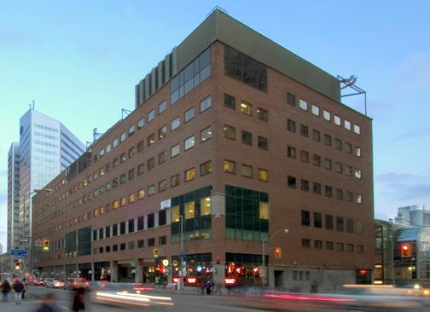
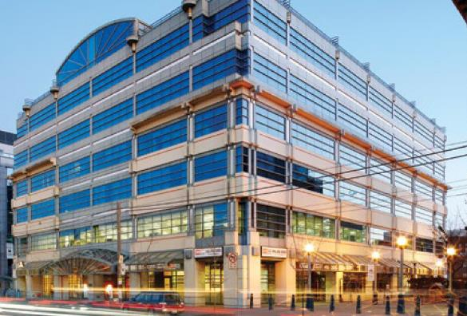
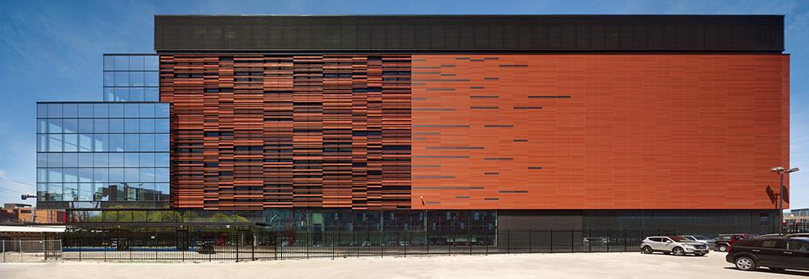
151 Front St W
905 King St W
TorIX
carrier hotels
Tier 1 & 2 connect at Internet eXchange Points (IXP) for peering and transit.
45 Parliament St
Notes:
Fibre Optic cables connect the three IXPs to each other.
Toronto Internet Exchange Community (TorIX) is an Internet eXchange Point.
Per https://www.pch.net/ixp/dir
Toronto Internet Exchange has 250+ ISPs participants ranking it #1 in Canada, #4 in North America, and #38 in the world.
TorIX traffic peaks at 1.5Tbps of traffic each day. By traffic, it ranks #1 in Canada, #4 in North America, and #28 in the world.
See https://www.pch.net/ixp/details/39
TorIX is not-for-profit organization which, as of October 2019, has 257 unique autonomous systems representing 278 peer connections and peak traffic rates of 724 Gbit/second.
https://en.wikipedia.org/wiki/Toronto_Internet_Exchange
https://www.torix.ca/
https://www.torix.ca/peers/ – sort by Gbits/sec column to see familiar Internet companies: Cogeco Cable, Amazon, Facebook, Google, Microsoft, Teksavvy. Topping the list is "Akamai Technologies" who provide numerous networking services from the Edge to Tier 1.
Companies with ASN Autonomous System Number and a presence in one of the above carrier hotels can peer with each other. The Exchange operates a members-only portal that allows peers to publish their peering policies, contact other members with peering requests, configure route-server access and options, track traffic usage, etc. The peering traffic is free.
TorIX charges fees for an organization's presence in the carrier hotel, and for 100GB/sec inter-networking connections (MMR = Meet Me Room).
See Pricing - Toronto Internet Exchange TorIX https://www.torix.ca/pricing/
See https://www.teecom.com/blog/to-the-meet-me-room-and-back-the-most-important-room-in-your-data-center
https://ipinfo.io/countries/ca – list of Canadian organisations with ASN Autonomous System Numbers
https://ipinfo.io/AS10265 Seneca College of Applied Arts and Technology with up to 65,536 IP addresses currently active on each network. (Does 65,536 look familiar? It is the number of values a 16-bit integer can hold.)
Seneca peers with 31 other large networks within its Tier 2 provider GTAnet, including other Tier 2 network providers, and Humber, Centennial, UofT, YorkU, OCAD, TMU (Ryerson), ROM, many Toronto hospitals.
Tier 2 AS549 – GTAnet Networking http://www.gtanet.ca/ has transit with three Tier 1 providers
Seneca, because of its presence at TorIX, has Meet Me Room presence with its major providers: Microsoft 365, AWS (Blackboard), and others.

Slide 11
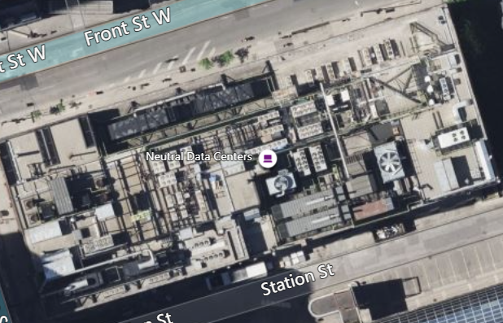
151 Front St. West
not a normal commercial building's rooftop
cooling towers, diesel generators, chillers, and condensers
Notes:
https://cologix.com/data-centers/toronto/tor1/
https://info.gocologix.com/hubfs/Marketing%20Assets/Spec%20Sheets/SS_TOR1%20Toronto%20Data%20Center%202022%20Spec%20Sheet.pdf
https://www.fullhost.com/company/infrastructure/toronto-datacenter/
https://www.theglobeandmail.com/report-on-business/a-telecom-nerve-centre-to-a-nation/article560097/

Slide 12

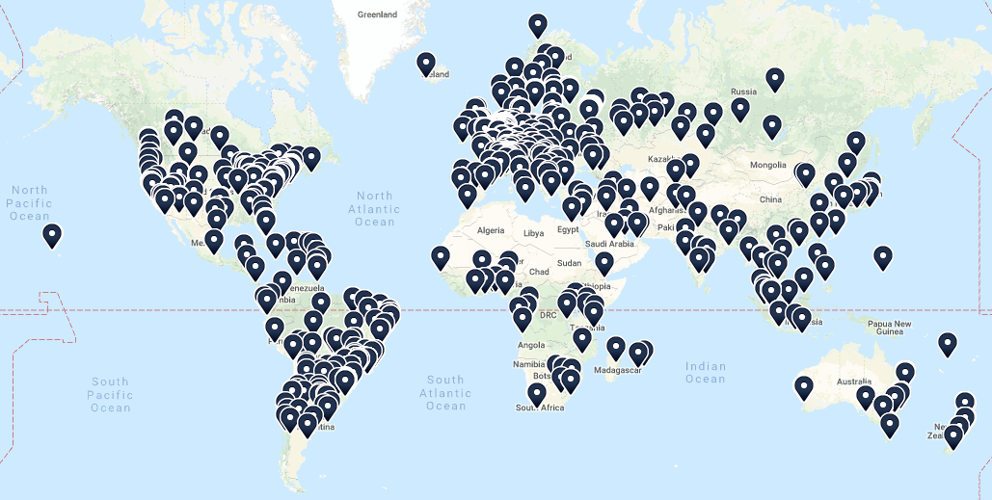
Tier 1 & 2 Internet Exchanges
Notes:
https://www.dw.com/en/the-worlds-biggest-internet-hub/av-37146102
https://www.internetsociety.org/issues/ixps/
https://www.ixptoolkit.org/ixps/
https://www.internetexchangemap.com/
Zoomable map. Can drill down to a street address.
TORIX
https://www.internetexchangemap.com/#/building/8158
https://www.torix.ca/
https://ix.equinix.com/
https://www.megaport.com/

Slide 13
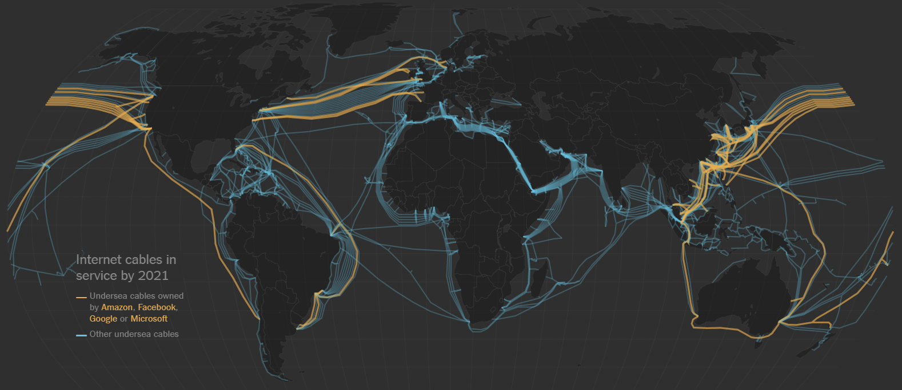
IXPs connected through the oceans
Notes:
IXP = Internet eXchange Points for Tier 1 & 2 providers
https://www.nytimes.com/interactive/2019/03/10/technology/internet-cables-oceans.html
"about 1.2 million kilometers of cable connect the continents in 2019" or 3 times the distance to the moon.
https://www.submarinecablemap.com/
Content providers like Microsoft, Google, Facebook and Amazon now own or lease more than half of the undersea bandwidth. They maintain their own private world-wide networks co-located and interacting with Tier 1 & 2 providers in IXPs.
Google has 13 data centers open around the world, with eight more under construction — all needed to power the trillions of Google searches made each year and the more than 400 hours of video uploaded to YouTube each minute. Demand for undersea cables will only grow as more businesses rely on cloud computing services and the use of artificial intelligence increases. Areas in the world without internet access are now getting access, with the United Nations reporting in 2019 that, for the first time, more than half the global population is now online.
But, in Africa, only a quarter have online access due to lack of infrastructure and high cost. See
https://qz.com/africa/1656262/google-facebook-building-undersea-internet-cable-for-africa/
How Netflix works: the (hugely simplified) complex stuff that happens every time you hit Play
https://medium.com/refraction-tech-everything/how-netflix-works-the-hugely-simplified-complex-stuff-that-happens-every-time-you-hit-play-3a40c9be254b

Slide 14
The Internet is brought to you by…
Browsers (Firefox, Chrome) process JavaScript and render Internet content into a consumable form for end users
Search engines (Startpage, DuckDuckGo, Google, Bing) help you discover online content
Content creators author the content you see online. (Human beings who need to eat just like you do.)
App Platforms & Stacks (Facebook, Shopify, Wordpress, Drupal, LAMP, ASP.NET) content deployment and dev.
Hosts (matrix, Amazon Web Services, WHC.ca, Rackspace) provide infrastructure where the platforms live
Internet Service Providers (ISPs) (Teksavvy, Bell, Rogers) connecting end users to the Internet (Tier 3)
Transit Providers connect you from the last mile (Tier3 ISPs) to the rest of the Internet (Tier 2 & 1)
Reverse Proxy/CDN^{[1]} (Akamai, Cloudflare, AWS) provide networks to cache content and protect from attack
Recursive DNS^{[2]} providers (CIRA, Quad9, OpenDNS) cache info to resolve end users' DNS queries quickly
Authoritative & Root DNS (Dyn, Cloudflare) official reference of domains, names, and related IP addresses
Registrars (e.g. Tucows) registers domain names. ICANN^{[3]} governs internationally. https://whois.icann.org/en
Registries (cira.ca, Verisign) administer top level domains (TLD) .ca, .com IANA & RIR^{[4]} govern the TLDs
[1] CDN = Content Delivery Network distributes traffic better than a single server and protects from DDoS attack
[2] DNS = Domain Name System/Services translates human usable domain names into IP addresses
[3] ICANN = Internet Corporation for Assigned Names and Numbers sets rules for Registrars and Registries
[4] IANA = Internet Assigned Numbers Authority & RIR = Regional Internet Registries provide IP addresses used by Registries and Registrars.
Notes:
Yes, this slide has way too much info on it, done just to emphasize the many "moving parts" it takes to make the internet work.
It's not on the quiz.
CDN - Content Delivery Networks – how FAANG does it
https://varunpriolkar.com/2018/12/strategies-to-build-a-global-cdn/
https://www.internetsociety.org/internet/
DNS = Domain Name System/Services
The Internet Corporation for Assigned Names and Numbers (ICANN) governs protocol parameters, Internet number resources (IP addresses) and domain names (through IANA) on behalf of the global Internet community.
https://www.icann.org
https://www.apnic.net/about-apnic/organization/history-of-apnic/history-of-the-regional-internet-registries/
Speed, Security, and Safety Through DNS.
https://umbrella.cisco.com/blog/2013/12/11/speed-security-safety-dns/
What Is the Difference between Authoritative and Recursive DNS Nameservers?
https://umbrella.cisco.com/blog/2014/07/16/difference-authoritative-recursive-dns-nameservers/
A useful description of how the internet works is found at
https://www.eff.org/document/internet-engineers-commentsfcc-nn
https://cira.ca/blog/information-technology/infographic-%E2%80%93-dns-canada
https://www.dnsperf.com/

Slide 15
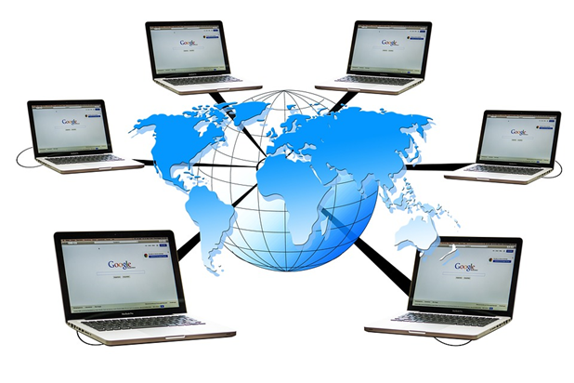
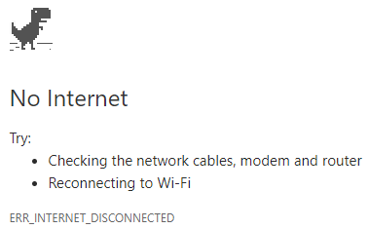
What are the issues of shared computing and networking?
Downasaur
How do you feel
when this happens?
Notes:
"We as a society chose to get more connected, and one of the perils of doing that is, the more connected you are with everybody, the more connected you are with malicious people as well." -- Scott Culp, Manager - Microsoft Security Response Center
People use the Internet because of the opportunities offered by shared computing and (inter)networking…what are the benefits and deficits?
We have come to assume the Internet is like a public utility: you expect electricity and water to be available all the time.
Most people, but not all governments, consider Internet access to be a civil right. Some assert it is a human right.
See https://en.wikipedia.org/wiki/Right_to_Internet_access
We wrongly expect the Internet and its resources to be freely available -- in every sense of "free". This is not about shared computing and networking unless you expect that to exist naturally like gravity and be magically provided to everyone like oxygen.
Downsides (negative) inherent to shared computing and (inter)networking
The effort needed for security measures to guard against exposure to bad actors does slow down the pace of Internet success. It costs more and takes longer to develop and deploy 24/7 web applications and to safeguard user privacy … even without the concerns of black hat hacking such as
Hacking, phishing, ransomware, spoofing, spyware, worms, malware, viruses, BOTS, DDoS attacks.
Email & information overload
Email spam (tragedy of the commons and moral hazard)
Surveillance economy: “would you like to share your location?” Our online behaviour has become raw material which benefits others and exploits users.
It is not true that there is "no privacy" on the Internet. There are many services which take extra care to ensure your privacy, e.g. banking and financial, government services like Canada’s CRA. There are many ways a user can maintain their privacy, e.g. clearing history and cookies regularly, using Firefox & Brave browsers, VPNs, encrypted DNS inquiries, even Tor browsing.
N.B. advertising is not a downside, it supports "free" services like Google and Instagram; this is a bargain we willingly accept by using those services. Just because we don’t like advertising does not mean it is bad in and of itself. Would you think it a good thing if advertising went away completely and Google, Instagram, Twitter, WhatsApp became paid services? …didn’t think so.
Network performance deficits and bandwidth constraints are not bad news for the Internet. The Internet became very popular in the late 1990s even with slow dialup. What is bad news is our expectation that anything and everything should be instantly available. Just because you are not willing to spend hundreds of dollars a month on a 10Gb connection to backup/restore your terabyte of data quickly is Bad News only in the sense that you are not rich enough to afford it. That you must manage dozens or hundreds of user accounts is not Bad News – that tech is part of what makes the Internet successful and usable. Or would you like to go back to standing in line to do your banking at a single bricks and mortar location, Monday to Friday between 10am and 3pm?
Sure, people’s accounts can be hacked, but only the careless people who don’t accept the responsibility of ensuring their own security. Is it a pain to have to dig out your keys and lock / unlock your door? Yes, it is. But leaving your home or car door unlocked, then saying the theft of your stuff is entirely someone else’s fault, is not something your insurance company will have sympathy for.
Upsides (positive) inherent to shared computing and (inter)networking
Wikipedia and the world-wide sharing of information. See https://wikimediafoundation.org/wiki/Home
Connecting people, regardless of geography, with common interests
Order pizza, e-commerce, online shopping. (See what I mean about those user accounts?)
Cheap long distance telephone rates (made possible by fibre optics and digital technology that replaced analog systems)
multiplayer online games and virtual reality communities,
accessible information processing systems such as banking and airline reservation systems that previously required a visit to a bricks & mortar location where experts used the systems on your behalf.
Digital reputation. Uber and AirBnB allow you to get safe transportation and accommodation in a strange city. The reputation of the Uber driver and AirBnB host along with your reputation is what makes those business models work; reputation sharing down to the individual provider and user is supported by Internet systems.
Search APIs that respect privacy:
https://www.qwant.com/
https://swisscows.com/
https://metager.org/
https://searx.be/
https://duckduckgo.com/
Wireless networking and mobile communication predate the Internet. Wireless communication became successful, with Marconi’s help, in the 19th century. People used their mobile phones for text messaging beginning in the early 1990s when access to the Internet was via landline telephone dialup. The Internet itself is not more or less valuable via a wired or wireless connection. It was the Internet’s success that drove demand for easy and ubiquitous communication in order to access the inherent value of the Internet.
Wireless and mobile are not advantages of shared computing and (inter)networking. Long before the Internet, you could order a taxi or book a hotel room with your phone; you did so based upon the advertising by, social circle reputation of, and your own experience with a taxi company or hotel chain. That phone was likely on a land line, available in everyone's house or at pay phones on many street corners, at gas stations, and most public areas.
That you can do the above things from your smart phone is a benefit offered by the smartphone manufacturer and your mobile services provider, not the Internet itself. There is nothing you can do wirelessly that you cannot do at a fixed location computer. In both cases, it is the same Internet.
Wireless frees up the user geographically which makes things more convenient, but not more things possible. Uber has higher value to the end user when out and about so the user is willing to pay for a data plan on their mobile phone. Uber gets more business as a result. But it does not increase the Internet's value, it makes more frequent use of it.

Slide 16
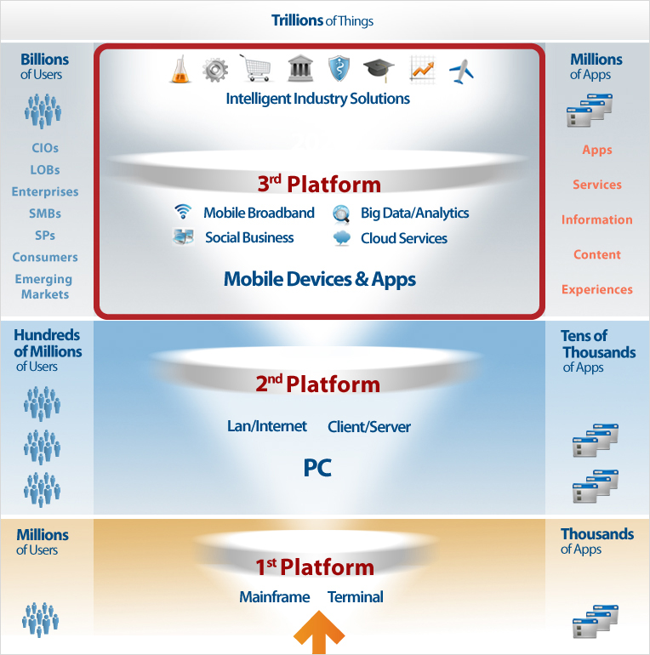
Notes:
General computing platforms
1st platform: single servers to large data centres
2nd platform: 1st platforms interconnected with networks and personal computers
3rd platforms: 2nd platforms grew into clouds with everything to everything connectivity, always on, wired and wireless, intelligent end points like smartphone
4th platform will be edge computing where end points become end nodes that can computer together without needing a cloud connection. i.e. Distributed computing.
Edge computing – Wikipedia https://en.wikipedia.org/wiki/Edge_computing
Graphic from https://idc-cema.com/eng/consulting/technologies
https://en.wikipedia.org/wiki/Third_platform
https://www.forbes.com/sites/steveandriole/2019/02/06/the-microsoft-amazon-ibm-google-clouds-enable-emerging-technologies-and-everything-else/
https://www.infoworld.com/article/2683784/cloud-computing/what-is-cloud-computing.html
https://www.datamation.com/amp/cloud-computing/how-the-public-cloud-drives-emerging-technologies.html
CIO = Chief Information Officers
LoBs = An LOB (line-of-business) is a general term that describes the products or services offered by a business or manufacturer. A company that manufactures solid state disk drives, for example, might claim their LOB is data storage.
Enterprise = a for-profit business or company. In the context of ICT, it often means 'systems at scale' to support a very large business.
SMB = Small to Medium sized Business. aka SME Small to Medium sized Enterprise
SP = Service Provider
Emerging Markets = growing economies
https://www.raconteur.net/technology/cloud-computing-emerging-markets
http://conferences.computer.org/ccem/about.html
https://www.i-scoop.eu/digital-transformation/the-third-platform/
https://www.itworldcanada.com/article/master-third-platform-technologies-with-these-3-experts/397842

Slide 17
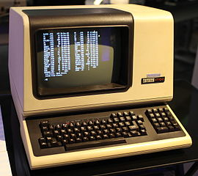
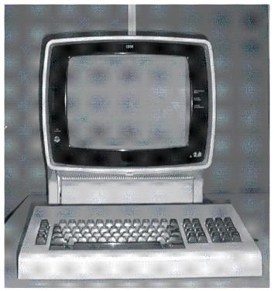
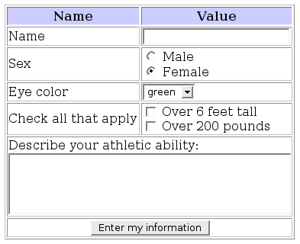
“Dumb” Terminals & Single-Tier design
The server does all computing, processing, storing.
Terminal / Thin client interacts with user as directed by the server.
DEC VT-100, 1978
IBM 3270, 1971
Thin Client HTML5 + CSS3 + JS
Notes:
1st platform
Fixed function terminals, so called “dumb” terminals, are hardware or emulation software whose behaviour is completely controlled by a “host” computer system. The terminal does not change, does not have its own 'state' or local persistent storage, and has little, if any, software logic capabilities (no sequential, iterative, or decision logic ability). As interfaces changed from simple characters to graphics, the term “thin client” came into use. “Thin” distinguished it from general purpose, stand-alone personal computers. See https://en.wikipedia.org/wiki/Computer_terminal and https://en.wikipedia.org/wiki/Thin_client
Only the server's state changes and only it has persistent storage. The client's actions are determined by the server; the client does not make its own decisions. The thin client’s only job is to transfer information from the end-user's keyboard to the host computer system and back to terminal's screen for the end-user to see.
The DEC VT-100 (1978) established the standard for terminal connections to UNIX hosts. It was a video display implementation of old teletype terminals which input from keyboards and punched paper tape and output by printing on a roll of paper similar to a typewriter (line feeds and carriage returns). This “dumb” terminal had lots of smarts for cursor and color control making the entire 24 line by 80 column screen addressable and controllable by a program using ANSI escape codes, i.e. a sequence starting with the character ESC, ASCII decimal 27. These sequences told the terminal to underline, dim, reverse-video, or change colour using line/column coordinates, and especially to simply clear the display and position the cursor. Terminals were "dumb" because they communicated with the host computer keystroke by keystroke. A keycode was sent from the terminal's keyboard to the host computer which recognized it and sent the character back to the terminal to display. For example, the user tripped the switch under the "A" key-cap, the terminal sends the key code to the server, the server recognizes and sends the "a" to the terminal which displays it on the screen. The terminal is so dumb, it does not know what character the user typed until the server tells it.
This is why you can type ahead of the display… it c a n t ak e a long time fo r a charac ter to ma ke a round trip from keyboard to s c r een.
See
https://vt100.net/docs/vt100-ug/chapter3.html
https://en.wikipedia.org/wiki/VT100 and https://en.wikipedia.org/wiki/ANSI_escape_code
http://www.pcmag.com/feature/348634/the-forgotten-world-of-dumb-terminals
PuTTY is a terminal emulator you likely use to sign on to matrix. “TTY” means TeleTYpe. Look at the Terminal features inside the PuTTY config, you’ll see VT-100.
Starting in the 1970s, IBM had "intelligent" block mode terminals which recognized their own keystrokes and exchanged a formatted stream of data with the host instead of just single characters as in the case of UNIX terminals. "By ensuring the CPU is not interrupted at every keystroke, a 1970s-era IBM 3033 mainframe fitted with only 16 MB of main memory was able to support up to 17,500 3270 terminals" https://en.wikipedia.org/wiki/IBM_3270
IBM 3270 terminals were used with mainframes and 5250 terminals were used with mid-range computers. You will program IBM 5250 terminals in the BCI433 course. These IBM terminals had similar functionality to a browser's HTML3 + simple JavaScript using a Textual User Interface.
https://en.wikipedia.org/wiki/IBM_3270
https://en.wikipedia.org/wiki/IBM_5250
https://www.ibm.com/support/knowledgecenter/zosbasics/com.ibm.zos.znetwork/znetwork_261.htm#znetwork_261__disp3270
The IBM 5150, better known as the IBM Personal Computer or PC, replaced physical terminals by emulating their protocols (TN3270 and TN5250).
Browsers and HTML Forms.
Now, browsers are the thin clients as were early Google Chromebooks. Although PuTTY and browsers are software that must be installed on a PC, they are not independent applications. They are terminal emulators or presentation devices under the control of a server.
With HTML5 + CSS3 + JavaScript, web apps can appear as smart as a Client-Server application…but they are not because they cannot change the state of the client system. It is amazing how much can be done through a browser these days, e.g. Office 365 apps and email. But, no matter how smart the browser tab appears, it is still the server telling the client what to do and the data exists only on the server. Functionality is limited by the browser and JavaScript (e.g. browser's security sandbox). A thin client application will not run without a connection to the server, it stores none of the application data (just settings in cookies). Applications that require a high degree of user interaction can feel slow even over a fast network due to latency.
HTTP and the IP part of TCP/IP (.../Internet Protocol) is a stateless protocol which means that the connection between the browser and the server is lost once the web page is loaded. The server forgets about the client. The stateless design simplifies the server design because there is no need to dynamically allocate storage to deal with signed on sessions. If a browser shuts down in mid-transaction, no part of either system is responsible for cleaning up the session state on the server. A disadvantage of statelessness is that it may be necessary to include additional information in every request, and this extra information will need to be interpreted by the server. As a work-around for the lack of a session layer in HTTP, HTTP servers implement various session management methods typically utilizing a unique identifier in a cookie or parameter that allows the server to track requests originating from the same client, and effectively creating a stateful protocol on top of HTTP. That, and a lot of smart JavaScript makes many web applications look stateful. https://en.wikipedia.org/wiki/Stateless_protocol
https://www.google.com/chromebook/
https://www.google.com/chromebook/switch/ -- OOPS! it doesn’t do Skype. Like iOS doesn’t do Flash.
https://www.cnet.com/news/the-five-stages-of-chromebook-acceptance/
https://www.atlantic.net/community/whatis/stateless-and-stateful-models-of-web-development/
https://launchschool.com/books/http/read/statefulness
https://petabridge.com/blog/stateful-web-applications/
Image By File Upload Bot at the English language Wikipedia, CC BY-SA 3.0, https://commons.wikimedia.org/w/index.php?curid=9000152

Slide 18



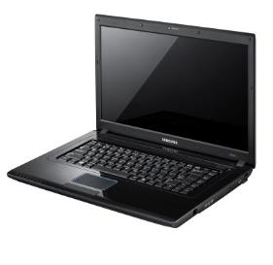
Two-Tier design & Client–Server Model
user's transactions submitted to server
Protocol
state of user's data received by client
Server/Host Business
centralized: multi-user
processing, data store, communication with other systems
Server Thick Client
Streaming ←|→ Client App
App Server ←|→ s-phone App
Exchange ←|→ Outlook
Progressive Web Apps
Back-end ←|→ Front-end
Client is User Facing
distributed: advanced presentation, user data management; tells server what to do
Notes:
2nd platform
In a Two-Tier application, processing is shared between distinctly different sets of software running on a server and a thick client which is a sophisticated application with local processing/memory/data and knows how to direct a server for a specific purpose. Client and Server are cooperative but independent systems sharing a common protocol. In this system design, it is the client that tells the server what to do, it is the client which interacts with the user. The server does not interact with the end user except through the client.
A server supports connections to multiple clients and users ("one to many"). A client maintains a session with a single server ("one to one").
Two-Tier model = a thick client has its own 'state' with local persistent storage where the software can run without a connection to the server. The client directs the server to perform its requests. The server coordinates with other systems and synchronizes its state with the client upon request; the synchronization is bi-directional. e.g. email server sends/receives messages for the client. The term “server”, describing a large, multi-user computer system previously known as a “host”, came into use when the overall application was separated into this modular architecture. It arose in the 1980s and 1990s as PCs became ubiquitous in businesses and computer networks became an established part of the IT, now ICT, infrastructure.
Difference between thin (single-tier) and thick/fat (two-tier) clients
Thin: server tells the terminal/thin client what to do to interact with a user; a thin client cannot run without a connection to server. Only the state of the server is changed, e.g. a database record is updated. The client side remains the same.
Thick: client tells server what to do, client can perform application work without a connection to server. Thick clients run on the local OS and store data locally.
See https://www.webopedia.com/DidYouKnow/Hardware_Software/thin_client.asp
Chromebooks can do what they do because of Progressive Web Apps (PWA). In recent years, Chromebooks have come with some local storage; with configuration effort and planning, they can be useful offline and can be considered thick clients. A "Service Worker" (https://developers.google.com/web/fundamentals/primers/service-workers ) allows PWAs to function offline without an internet connection.
PWA are developed with VS Code and Node.js. HTML5, CSS, and JavaScript are distributed to end users by web servers.
Back-end code: the endpoints needed by your app, when connected to the internet, to retrieve dynamic content that may be stored in a database on your server.
Front-end code: the resources needed for the app to be installed on the user's device, such as HTML5, CSS, and JavaScript code.
Progressive web app – Wikipedia https://en.wikipedia.org/wiki/Progressive_web_app
PWAs Turn Websites Into Apps: Here's How | PCMag https://www.pcmag.com/how-to/how-to-use-progressive-web-apps
https://www.bing.com/search?q=are+pwa+the+future
https://learn.microsoft.com/en-us/microsoft-edge/progressive-web-apps-chromium/how-to/
– step-by-step creation of a temperature converter PWA
Smartphone apps are often in between thin and thick clients. They are thick in that they have their own 'state' (configuration and data). However, many apps are thin in that they do not run without a server connection. New technologies like CloudDB and concepts like http://offlinefirst.org/ are making mobile apps more like traditional client-server architecture. PouchDB allows web developers build browser applications that work as well offline as they do online. It enables applications to store data locally while offline, then synchronize it with CouchDB when the application is back online. https://pouchdb.com/ This further blurs the line between thin and thick clients.
Why bother with an intelligent thick/fat client in this day and age? Because the network is still too slow and servers too busy to handle the sophisticated UI of applications with the responsiveness users expect. Also, the user's data set can be quite large. Functionality is not as limited on the client platform as it is within a browser's web app. (e.g. web app security is bound by the browser's security sandbox whereas local client apps are bound by local permissions which can be to everything.) Client applications with a high degree of user interaction are as fast as the local hardware and have all the UI sophistication of the local platform – this is why there are so many smartphone apps. Almost all of those apps could exist within an HTML5 + CSS3 web app run in a browser but the browser + communications + server overhead can make web apps with a high degree of user-to-server interaction feel slow, are running with a non-native UI, and have to fetch a lot of data from a remote system. See http://offlinefirst.org/ and http://hood.ie/blog/say-hello-to-offline-first.html
See https://medium.com/all-technology-feeds/cross-platform-vs-native-mobile-app-development-choosing-the-right-dev-tools-for-your-app-project-47d0abafee81
and https://www.joshmorony.com/7-lessons-from-3-years-of-html5-mobile-application-development/
and https://www.mobilesmith.com/html5-vs-native-debate-is-over/ (entirely self-interested in selling you their product but a good pro/con summary)
A client application, usually in the form of a compiled locally installed program or "app", establishes a connection with a server. The server typically handles the database and performs business-side functions. The client takes care of the user interface and stores the user's data set; it handles the selection and presentation of data records (sorting, filtering, calculations), validates user input, and commits a transaction to the server. CRUD (eventually) happens on the Server but starts on the Client: Create, Read, Update, and Delete records in a database.
Smart clients can also contribute to fault tolerance by buffering and storing transactions when a connection with the server is interrupted, load balancing is the client doing the work of presentation and validation locally. Security can be enhanced by using proprietary protocols between client and server and by maintaining “stateful” connections. A stateful connection is two systems remaining connected, either can talk to the other, both remember the state (who is signed on, data, multi-stage transactions in progress), the connection is kept open even though the two systems might not be transmitting information (i.e., the connection itself retains state), the connection ends deliberately with a sign off process. A telephone call between two people is a stateful connection.
An application has its own compiled client program running on the local OS which serves as its user interface and had to be separately installed on each user's personal computer. An upgrade to the server-side code of the application would typically also require an upgrade to the client-side code installed on each user workstation, adding to the support cost. In addition, both the client and server components of the application were usually tightly bound to a particular computer architecture and operating system and porting them to others was expensive. (Today, native apps for mobile devices can be hobbled by some or all of the foregoing issues.)
See https://en.wikipedia.org/wiki/Web_application#History

Slide 19


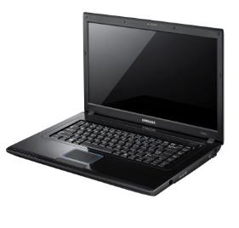
FTP needs Client–Server applications
Client authenticates and makes a connection
Client navigates to directories on both sides
Client requests, Server sends or accepts data
FTP Server
OS
File System
Filename
data
Local FTP interacts with local Operating System.
Each OS maintains its own file system. File attributes/metadata are not necessarily transferred.
Only data is exchanged between platforms.
FTP Client
OS
File System
Filename
data
Notes:
The FTP client is a thick client, it tells the server what to do. Thick clients run on the local OS independently of the server. A thick client performs local file management (changes its persistent state) with or without a connection to a server.
FTP, File Transfer Protocol, needs client – server applications. The protocol allows diverse systems to work with each other at the application level, i.e. independent of the other’s platform (OS & hwr)
The FTP server and FTP client are different software applications both in function and implementation. The FTP server makes changes to its local file system (receives or sends a file) only under the direction of an FTP client.
After signing on, the client program navigates to the server-side directory and its own client-side directory. The FTP client app is subject to the server granting authority for the client's user to access a location in the server's file system. The client sends commands to list a directory, or to get or put a file. In a GUI interface, FTP commands are interpreted from click and drag mouse movements.
It seems like a file is being transferred between the two systems, but the basic FTP protocol sends only the filename, some attributes like a timestamp, and the data within the file. Fidelity/accuracy of transfer relies on the two FTP apps negotiating and resolving differences between their respective systems. Two very separate client and server applications are needed to insulate each other from diverse operating systems, file systems, and character representations. Differences between the client and server platforms are translated by the respective FTP apps.
File attributes and metadata can (and likely does) vary on the two systems. Both the matrix FTP server and WinSCP & FileZilla clients support the MFMT (Modify File Modification Time) command which extends the FTP protocol (SCP = Secure Copy Protocol). However, if either the FTP client or server does not support the extension, the file's original timestamp is lost and is given the current timestamp on the receiving system.
The two systems may use different binary representations of data. e.g. ASCII, EBCDIC (IBM), or Unicode implementations (UTF-8 -16 -32, UCS-2). Differing native character sets can result in file names and/or data not being faithfully translated. A text/source file's line break character(s) are CR LF in Windows, LF in *nix including Apple OS X… , CR in classic Mac. Binary data can be transferred without translation, but the user must be aware that the two systems are compatible.
There may be conflicts / different behaviours when one system uses case independent file names and the other case dependent names. A *nix FTP server can have separate files named "fileABC" and "FILEabc". The FTP client must be case specific to get one of those files. If the FTP client is on a platform where the file system is case independent, such as Windows or IBM, getting either "fileABC" or "FILEabc" from the FTP server will replace "FILEABC" on the client side. Putting "FILEABC" from the client to the server without a target filename will result in three different files on the server.
Students may have noticed the above issues when transferring their C source code files from Windows or macOS to the matrix server.
Notes for ICT people using FTP with command line or GUIs can be found at
https://www.linkedin.com/learning/learning-ftp/what-is-ftp?u=2169170
https://deliciousbrains.com/how-unicode-works/

Slide 20
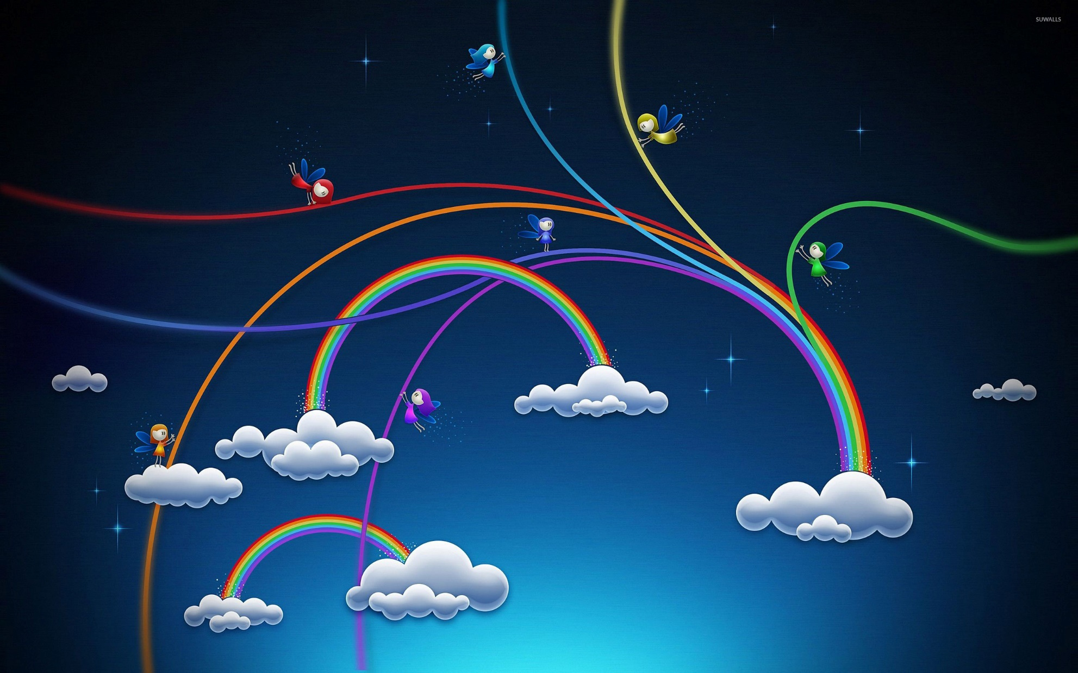
Cloud Computing
Notes:
3rd platform
Non-ICT people think this is what cloud computing looks like.
It’s a mystical place which remembers everything that’s on your iPhone so it’s easy to buy another bigger better iPhone,
or knows everything you watched on Netflix so it can recommend more things to watch on Netflix,
or stores every place you’ve ever been and every thing you’ve ever purchased and every thought you’ve ever had so Google & Facebook can charge more for the micro-targeted ads you see on any platform you use.

Slide 21
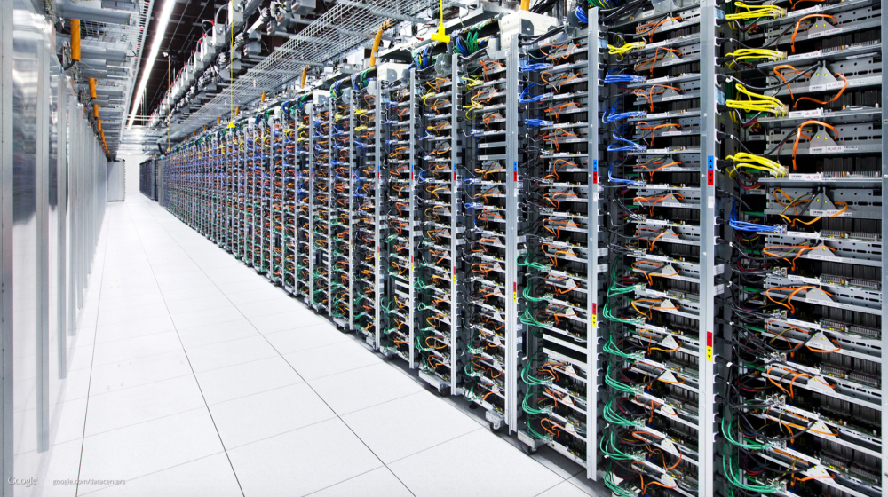
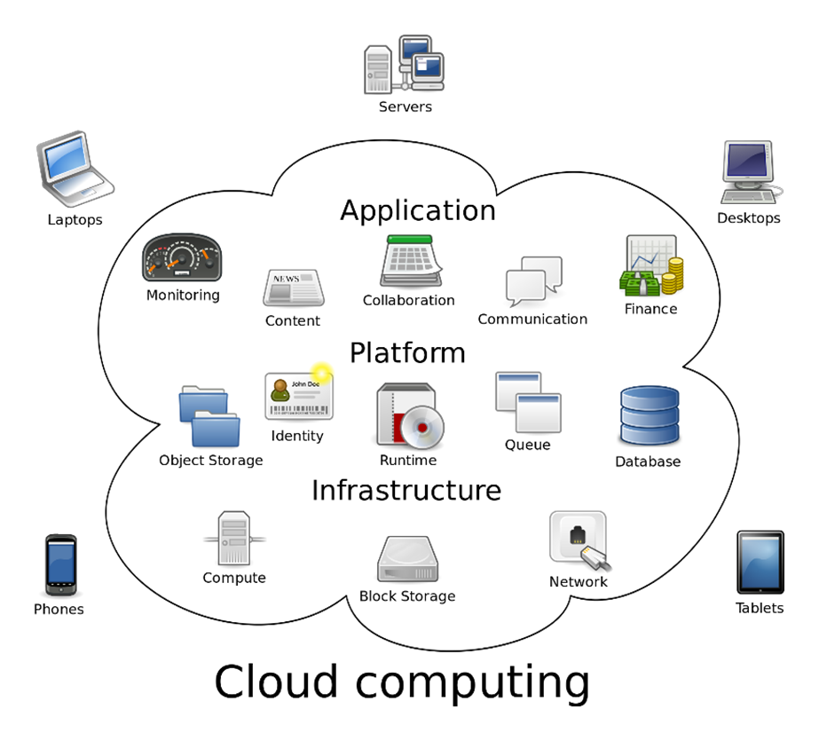
Notes:
There is no such thing as the cloud when talking to ICT professionals.
Photo is of Google's data center in Oklahoma.
https://www.youtube.com/watch?v=XZmGGAbHqa0 Google data center
https://en.wikipedia.org/wiki/Cloud_computing#/media/File:Cloud_computing.svg
Fun fact: me.com redirects to https://icloud.com/
See https://cloud.ibm.com/
AWS Educate - Cloud Services for Education- AWS (amazon.com)
"Build your cloud skills at your own pace, on your own time, and completely for free"
https://aws.amazon.com/education/awseducate/

Slide 22
Cloud Computing – thanks, Internet.
Remote server systems store, manage, and process data for small local servers, PCs, mobile devices, web apps.
Hosted infrastructure, development stacks, applications.
On demand resources rapidly provisioned and released.
  Fast start up, easy mgmt, low initial cost, scalable / elastic.
Distributed Computing: independent systems running processes as part of a larger application controlled by messages passing between those systems.
  Climate Prediction, Distributed Compute Labs, BitTorrent, block chain
Notes:
Your data, your programming (IP), your web site, your business, and your livelihood is still on someone else’s computer. A high level of trust is assumed.
Scalable = quickly provision more always-on computing resources (satisfies growing and ongoing need for long term resources )
Elastic = quickly and temporarily acquire more computing resources (satisfies peak demand periods, higher cost but automatically provisioned for short times as needed)
https://en.wikipedia.org/wiki/Distributed_computing https://en.wikipedia.org/wiki/Message_passing
Distributed Computing: instead of a large cloud system managed by a single provider (AWS, Google, MS Azure), Distributed Computing is a ‘network’ of independent systems supporting a single overall application. Smaller systems on the 'EDGE' of large cloud systems process data and feed results back to a single system to speed up CPU intensive tasks which would be too expensive and/or too slow to run in the traditional cloud or a local supercomputer. In peer-to-peer architecture, there is no single system to fail and nodes can be added or subtracted easily.
OTOH, some Distributed Computing architectures, such as blockchain, have scalability issues. More peers adds incremental processing but exponential message passing.
10 peers + 1 = 10% more processing. But message passing is exponential. 10^2 = 100 messages passed per transaction; 11^2 = 121 messages or 21% more.
10 peers + 10 = twice as much processing, but FOUR times as many messages. 10^2 = 100 messages passed per transaction originally, now 20^2 = 400 messages.
e.g. the Bitcoin application processes almost 7 transactions every second while the Visa credit card system processes almost 1700 transactions every second on average. (https://101blockchains.com/blockchain-scalability-challenges/)
Bitcoin & eCurrency platforms are changing from Proof Of Work to Proof of Stake which will greatly increase scalability.
https://www.techtarget.com/whatis/feature/Proof-of-work-vs-proof-of-stake-Whats-the-difference

Slide 23
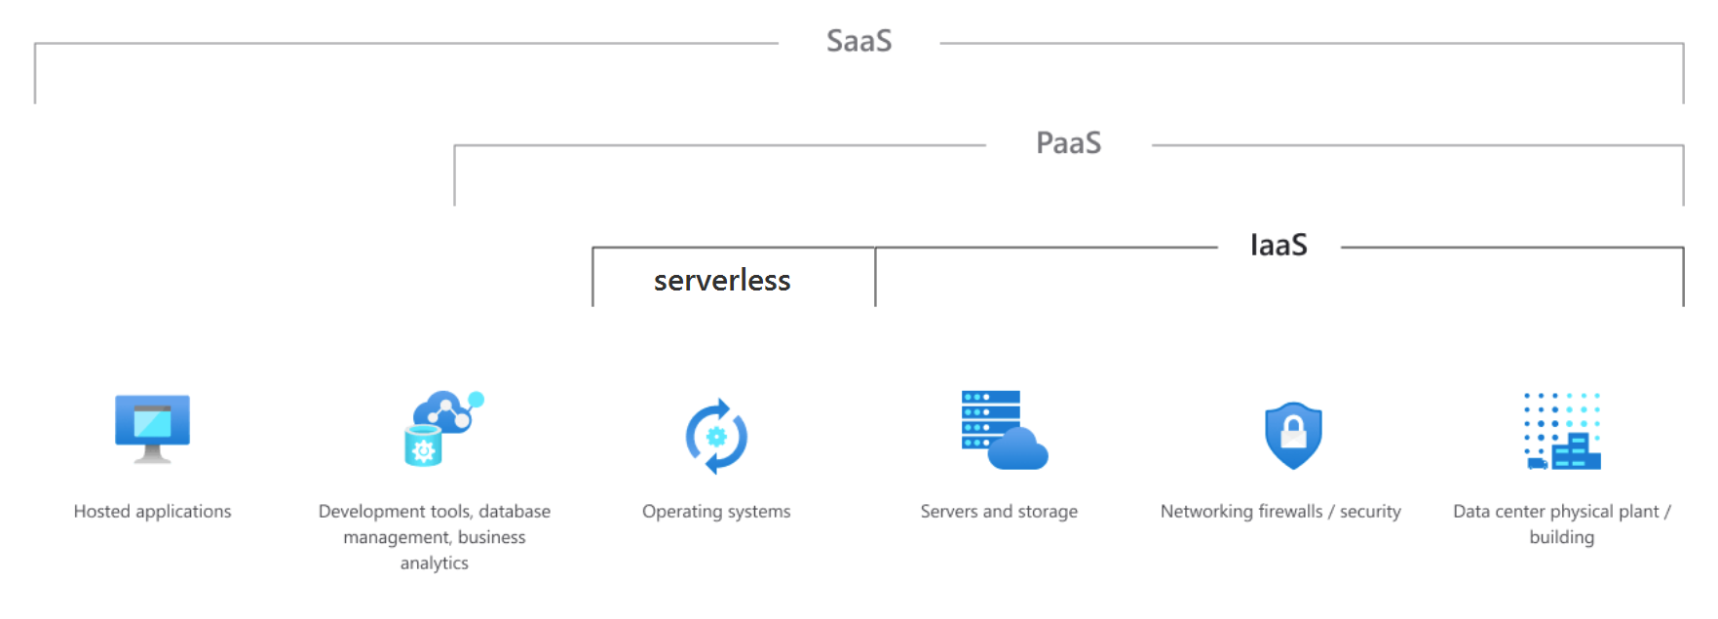
Clouds …as a Service
Software: SaaS | Platform: PaaS | Infrastructure: IaaS
end-user applications | development of end-user applications | remote servers, storage, networking
Notes:
For SaaS, software developers create applications for end users.
N.B. Users run their business on SaaS, with their own data. Otherwise, it’s just a web site, and that’s not SaaS.
e.g. Blackboard Ultra
With PaaS, your programmers use the development stack(s) integrated into the PaaS to create SaaS
e.g. GitHub codespaces
With IaaS, your ICT staff runs all systems from the OS on up. But they don't have to buy and maintain the hardware.
https://www.eginnovations.com/blog/saas-vs-paas-vs-iaas-examples-differences-how-to-choose/
https://azure.microsoft.com/en-ca/overview/what-is-iaas/#overview
“Serverless computing enables developers to build applications faster by eliminating the need for them to manage infrastructure. With serverless applications, the cloud service provider automatically provisions, scales and manages the infrastructure required to run the code.”
https://en.wikipedia.org/wiki/Serverless_computing
https://www.technologyreview.com/s/425970/who-coined-cloud-computing/
https://www.bbvaopenmind.com/en/10-myths-about-cloud-computing/
http://www.zdnet.com/article/stop-saying-the-cloud-is-just-someone-elses-computer-because-its-not/
Mary Branscombe, July 12, 2016, ZDnet:
The cloud is more than just someone else's computer accessible over the Internet. It is a high availability, “hyperscale, automated computer farm run by someone who's better at automation and security than you, and can buy electricity and servers and network connectivity more cheaply than you ”
“This is software-defined computing that's a step beyond hardware virtualisation; the CPU that runs the computation is a fungible resource that's allocated by software, at whatever level of abstraction you want. If you want a server to run your VM, you can have that. If you want to run PHP, Node or .NET code without caring where or how it runs, you can do that. If you want to stream sensor data from IoT devices or index a website or do any other arbitrary computation, you don't need a server to do that -- you just need the compute power available to you over the Internet.”

Slide 24
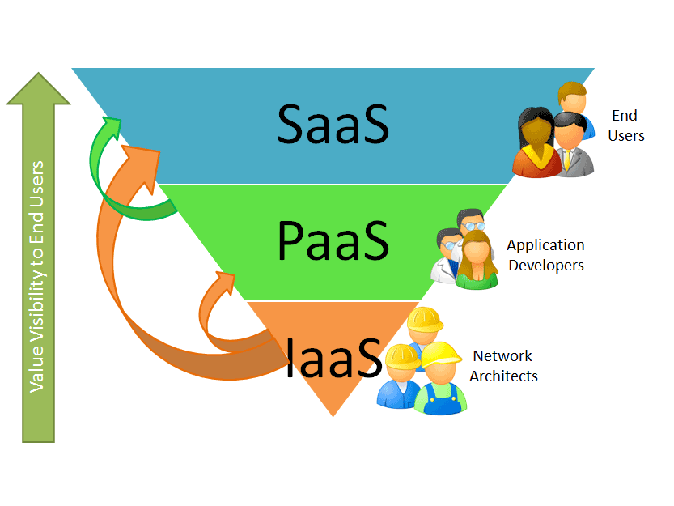
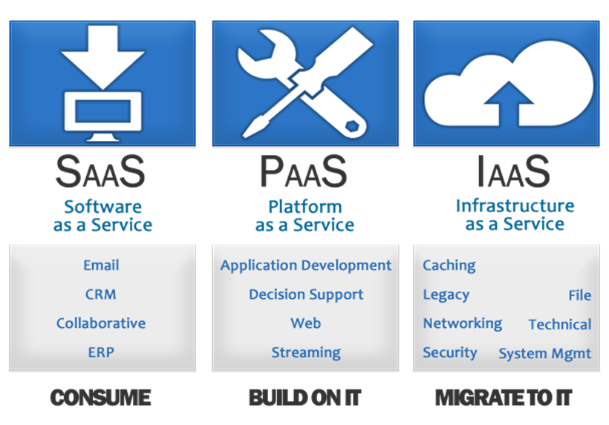
Cloud Computing Services
Software as a Pizza: food court pizza
Platform as a Pizza: pizzeria delivery
Infrastructure as a Pizza: pizzeria franchise
Notes:
This slide and the following slides are important because clients and colleagues will expect you to know the "cloud" has different levels of service.
Software Pizza: preconfigured pizza slices at the food court, or retail grab-a-slice, or frozen at the grocery store – quick, cheap, lots of options but few personal choices: you get what they have to offer, not necessarily what you want…but it's quick, it's cheap, and portable. You can deploy it quickly to your family.
In ICT: Streaming services. Blackboard LMS (Learning Manglement System)
Platform Pizza: your local pizzeria has a pizza production system and they let you take advantage of it. It's full of raw materials, ovens, and expertise. You use it to build a unique finished product. You go there to pick it up or use their transportation platform to have it delivered.
(low code, no code, GitHub Codespaces, Discord, Slack, Teams)
Infrastructure Pizza: a pizza parlour franchise. A turnkey operation that provides the opportunity to create pizzas. They supply equipment, store layout, mechanism for you to order raw materials and to receive orders. It is up to you to run the shop and supply the labour. The franchise infrastructure provides the opportunity, you do everything else to make it into platform or software services.
(Virtual Machines, cloud secondary storage)
Cloud Computing the practice of “using a network of remote servers on the Internet” to store, manage, and process data, rather than a local server or a personal computer.
provides “shared infrastructure, dev platform, or applications, on demand.”
rapidly provisioned (and released) with minimal management effort. Low start up cost.
However, your data, your programming (Intellectual Property), your web site, your business, and your livelihood is on someone else’s computer.
https://www.bmc.com/blogs/saas-vs-paas-vs-iaas-whats-the-difference-and-how-to-choose/
https://apprenda.com/library/paas/iaas-paas-saas-explained-compared/
https://www.cloudwards.net/understanding-cloud-terminology-what-does-iaas-paas-and-
-mean/
https://www.salesforce.com/ca/saas/
https://getnerdio.com/blog/10-popular-software-service-examples/
The authoritative definitions:
Evaluation of Cloud Computing Services Based on NIST SP 800-145
https://nvlpubs.nist.gov/nistpubs/SpecialPublications/NIST.SP.500-322.pdf
This document provides clarification for qualifying a given computing capability as a cloud service by determining if it aligns with the NIST definition of cloud computing; and for categorizing a cloud service according to the most appropriate service model Software as a Service (SaaS), Platform as a Service, (PaaS), and Infrastructure as a Service (IaaS).

Slide 25
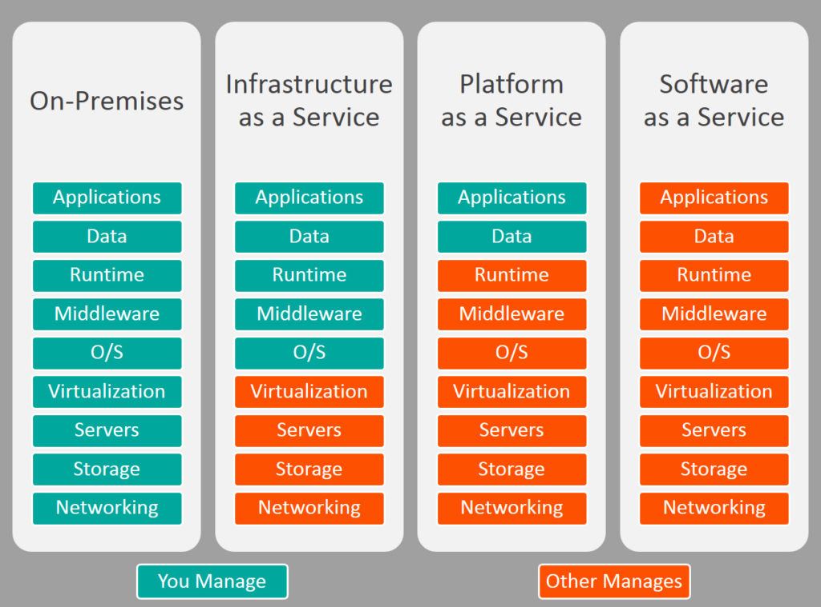
Transportation _aaS
your own car lease / rent taxi, uber public transit
Full Stack
Cloud as a Service
Notes:
FROM RIGHT TO LEFT: Chart from https://www.bmc.com/blogs/saas-vs-paas-vs-iaas-whats-the-difference-and-how-to-choose/
SaaS is using existing transportation services. From least to most expensive: public transit, inter-city bus, ferry, passenger train, air flight. There is no planning / buying / commissioning / setup / configuration / customization, maintenance, and no skills are needed to use the service beyond being a respectful human. If it fits your needs and you can manage the “last mile” from your end points to the system’s entry/exit points, you can use it almost right away.
OTOH, you do not control the route, it does not run on your schedule, it was designed according to someone else's standards, route planning, and provisioning. It is not as convenient as other modes of transit but is easier than walking, swimming, or becoming a pilot.
You change the 'state' of a transportation system by getting on it: you occupy space and add mass which the conveyance must now expend additional energy moving you from A to B.
In ICT, SaaS is Blackboard LMS, some Microsoft 365 apps, your Spotify/Netflix streaming service. You use it they way they provide it; you cannot change it.
Software changes the 'state' of a system because of end user actions but users have no control over the functionality and features of the system. The user changes the contents of a Bb LMS course, the user enters the next great novel into a Word .docx, but the software applications themselves remain constant. Only the SaaS provider changes the software.
PaaS is getting custom, on-demand transportation services along with someone who operates the conveyance you ordered: taxi, uber.
You bring the passengers, and load their luggage.
You tell the driver where you want to go, they figure out how to get you there.
Taxi owners and Uber drivers use the taxi company/Uber systems as-a-Platform for dispatch.
Taxi drivers may use a Taxi owner's cab as-a-Platform.
In ICT, PaaS is low code, no code, GitHub Codespaces, Discord, Slack, Teams, Shopify eCommerce. You use it for your own purposes, not the provider's. You use the platform to create software, applications, achieve a collaboration environment, configure an online business. Unlike SaaS, you can use PaaS in many ways.
Dev stack developers use PaaS, as would MEAN stack "full-stack" developers.
IaaS is like having the personal use of a car without owning it: you maintain the vehicle, do the driving, deal with your passengers, and carry your own bags. There are various contracts from long to short-term use.
Leasing – good if you drive less than average. You are responsible for everything for the next X years except buying and selling it.
Subscription – includes insurance and month-to-month flexibility. Able to scale up or down. Adapts to changing transportation requirements. E.g. convertible sports car in summer, SUV in winter.
Rental – short term weekly or day-to-day needs, anything from a truck to sub-compact. You provide the fuel, they take care of the rest.
Carshare – for hourly needs. They cover everything: fuel, insurance, even parking.
In every case, you decide how to use the vehicle, do the driving, deal with your passengers, and carry your own bags.
In ICT, IaaS is you operating the provided infrastructure hardware as if it was your own server.
Very Full stack developers would use IaaS.
On-Premises Car – you buy it, insure it, maintain it, drive it, and park it.
Why? You commute a long distance every day to work from a rural location. There is no public transit. Taxis and Uber are prohibitively expensive (if you can even get one to pick you up). Leasing would be very expensive because of the high-milage charges.
Full stack, on premises: For your delivery company, you build a vehicle fleet of varying capabilities. There is no interchangeability because the vehicles are all from different manufacturers, but each vehicle is "best of breed." You hire drivers to deliver packages. Drivers complain "the vehicles are too slow."
You buy a truck for the big heavy jobs. The drivers argue every morning about who has to take the truck.
Your boss says you’re overbudget on fuel again but offers the helpful suggestion that drivers could save fuel if you created routes that go only downhill. Instead, you suggest switching the fleet to electric. Your boss gives you a cold, hard, silent stare. She says go ahead but do so within your existing operational budget and capital acquisition allocation. This includes finding funds you don't have to build the charging stations. She says the electric vehicles must have the same range as fossil fuel vehicles, and take no longer to recharge than to refuel else the company will lose customers because of slow service.
You give up on vehicles and convert your fleet to open source bicycles. Only the people who like electric cars ride the bicycles.
You outsource the delivery service to another delivery service. Then retire to a small town where you can walk to almost everything. You have a bicycle but it has no air in the tires. The pump you ordered from Amazon has yet to arrive. It is coming via the delivery service you outsourced everything to. You consider starting a courier company that works for Amazon.
In ICT, on-premises computing is running your own data center.

Slide 26
Cloud Computing – IaaS Infrastructure as a Service
Infrastructure as a Service provides servers, and/or secondary storage, and/or networking services.
  “Lift-and-Shift” on-premises computing to the cloud.
High range of scalability and elasticity
Amazon Web Services (AWS).
Google Compute Engine (GCP)
e.g. your ISP is your IaaS for wide area networking.
Notes:
IaaS can eliminate capital expenditures companies traditionally make to buy their own on-premises hardware, IaaS can be a complete virtualized computing centre.
IaaS has the potential to be more secure than on premises systems.
https://www.itworldcanada.com/article/head-start-helping-amazon-remain-the-top-public-cloud-provider-in-canada/402533
https://aws.amazon.com/directconnect/ <– uses "dark fiber"
See https://azure.microsoft.com/en-ca/overview/what-is-iaas/#overview for IaaS business scenarios and advantages. (Yes, it is marketing but is actually realizable.)
With IaaS, a provider supplies the basic compute, storage and networking infrastructure along with the hypervisor (the virtualization layer). Your company’s ICT administrators create virtual machines, install operating systems, support applications and data, and handle all of the configuration and management associated with those tasks. IaaS often provides a wider range of platforms and growth possibilities than a company could do with its own computing centre.
https://cloud.google.com/
https://aws.amazon.com/
http://www.businessnewsdaily.com/5851-cloud-storage-solutions.html
http://searchcloudcomputing.techtarget.com/definition/Platform-as-a-Service-PaaS
Scaling Up or scalability is the ability to add capacity as your business grows or elasticity to deal with peaks in demand (concert tickets, Christmas buying season, weather and news events, US election night: the Canadian Immigration server (www.cic.gc.ca) crashed as the 2016 November USA election results were rolling in. The site went down about 10:30 p.m. ET that day with intermittent accessibility the next day or two until Americans got used to the idea that Donald Trump would be their new president.
Your ISP provides the networking infrastructure (Tier 3 connection to your house, physical nodes, routers, switches, network servers to Tier 2 network providers who then connect to Tier 1 backbones). For the most part, it is up to you how you use it. You hardly know your ISP is there except for your monthly billing. Infrastructure tends to be mostly invisible. Your ISP may provide other additional services but this is IaaS.
By contrast, IBM Capacity on Demand is a local version of this concept where you can turn on extra server capacity as you need it for your non-cloud infrastructure. It is literally extra CPUs built into the server on your premises which you pay a fee to activate.

Slide 27
Cloud Computing – PaaS Platform as a Service
PaaS provides hosted software development stacks
to create web applications.
  Frameworks to build, debug, deploy, scale up/down.
  Windows Azure runs ASP.NET web applications
  Red Hat OpenShift on Red Hat OpenStack Platform
  Google App Engine, Box.com
PaaS does intelligent things with things you put there.
  File serving: share, version, replicate, cache, synch.
  Cloud hosted database platforms: you configure and populate.
  APIs for web services you provide to other developers.
Notes:
With PaaS, a provider offers more of the application stack than IaaS providers, adding operating systems, middleware (such as databases) and other runtimes into the cloud environment. PaaS can eliminate capital expenditures companies traditionally make to buy their own on-premises hardware and software. Conceptually, PaaS is a Platform which runs on top of Infrastructure (Iaas).
FTP is a very simple form of PaaS. It is an intelligent utility for up and downloading files to and from a server whether real, virtual, or cloud-based. Its API is an FTP command file which includes the ability to call jobs (e.g. scripts) on the server from the client and/or the client from the server. You configure the FTP server’s sites, security protocols, permissions (read and/or write). You deploy client-side requirements for connecting and using FTP services. Although we never called FTP Platform as a Service, you can argue that’s what FTP always has been.
A PaaS provider builds and supplies a resilient and optimized environment on which users (IT developers and administrators) can install applications and data sets. Developers focus on creating and running applications using the virtual PaaS. IT administrators do not have to construct and maintain the underlying infrastructure and services.
Many PaaS products are geared toward software development. These platforms offer compute and storage infrastructure, as well as text editing, version management, compiling and testing services that help developers create new software more quickly and efficiently. A PaaS product can also enable development teams to collaborate and work together, regardless of their physical location.
PaaS is how Shopify performs an average of 6,000 builds per weekday. They build their own PaaS configuration for their many developers to use.
https://www.infoq.com/news/2018/07/shopify-kubernetes-paas
https://engineering.shopify.com/blogs/engineering/shopify-infrastructure-collaboration-with-google
Shopify is a Canadian e-commerce company that offers a proprietary e-commerce platform for online stores and retail point-of-sale systems. That is SaaS to their clients. Shopify currently has 3000+ employees, and the company processed $26 billion is transactions in 2017. The underlying e-commerce software platform sees 80k+ requests per second during peak demand and $82B in merchandise purchased through their systems. Shopify was started in 2004 in Ottawa by three snowboarders starting an online store to sell some high-end snowboards from small snowboard companies.
https://www.theglobeandmail.com/report-on-business/rob-magazine/meet-our-ceo-of-the-year/article21734931/
'The trouble was, the e-commerce software available at the time was, as far as Lütke was concerned, crap. It seemed to have been designed by people who had no experience in retailing. "The terminology was wrong, approach was wrong," says Lütke. "I'm like, You can't organize a business the way this software forces you to." '
– exactly. E-commerce platforms built in the previous 10 years during the rise of the Internet were designed by programmers who didn't understand the problem (online retailing) they were trying to solve.

Slide 28
Cloud Computing – SaaS Software as a Service
Software as a Service is an application delivered over a network / Internet. Companies run (a part of) their business on the service’s software.
Users access the application remotely on smartphones, tablets, browsers.
SalesForce CRM – the original SaaS for the front-office
Back office SaaS – Payroll, Purchasing, Accounts Payable, Inventory and Billing, Accounts Receivable, General Ledger.
Google Apps, Microsoft Office 365, BigBlueButton
Streaming services for consumers
eLearning: Cloud Computing Types
  eLearning Tutorials Login needs Seneca and LinkedIn accounts
Notes:
Conceptually, SaaS runs on top of a Platform which runs on top of Infrastructure.
SaaS is their generic software using your unique data. Different organizations may subscribe to same SaaS – but use it with their own private data.
SaaS is simple to use but may have limited functionality compared to locally hosted applications which frequently have customized software.
Small businesses tend to use back office SaaS applications.
Web sites allow users to input data that belongs to the web site. E.g. social media. E.g. product codes, quantities available, pricing at Amazon.com – the customer is doing their own order entry and payment transactions. This is NOT SaaS.
SaaS: There is a browser and software to interface with anything in the cloud (including IaaS and PaaS); don't think of SaaS as just software or that something is SaaS just because it runs in a browser. Think of SaaS as an application that provides sophisticated functionality to end users using data input by those same users. The application itself runs in "the cloud" and is accessed via a browser which is essentially a dumb terminal with a good user interface; it can also run in a local tablet or smartphone app to provide better use of the hardware than a browser could. The browser is merely the delivery mechanism to the end user, it is not the defining characteristic of SaaS any more than the DEC VT-100 terminal represented UNIX. "An application system is a collection of computer programs designed to perform a group of coordinated functions, tasks, or activities for the benefit of the user. Wikipedia" SaaS does it over the Internet through a browser (or mobile app equivalent) – the only thing on the client end is the User Interface.
Used for Personal software delivery: having your own MS-Office products without managing installation and maintenance on your own machine.
More and more, SaaS is cooperative processing where people collaborate on documents and information centrally rather than the email attachment nightmare of distribution, version control, and amalgamation of revisions from individual documents.
Your ISP provides email –SaaS -- @theirDomain.ca to keep you as a customer. You could run your own email server with a permanent IP address but why bother?…unless you are Hillary Clinton and don’t trust the U.S. gov servers and don’t mind losing an election.
https://en.wikipedia.org/wiki/Software_as_a_service
https://en.wikipedia.org/wiki/Back-office_software
Office 365 Delve, Google Apps.
https://support.office.com/en-us/delve
Microsoft Office 365 is a combined application provided by Microsoft consisting of Microsoft Office Online (for Windows and OS X), Exchange (email), SharePoint (file repository/sharing), and storage space on OneDrive.

Slide 29
Peer to Peer and Blockchain need networks
A peer-to-peer (P2P) network is two or more systems sharing resources without using a central server (no central authority). BitTorrent protocol for file sharing
Advantages: low cost, easy to install, and no need for skilled staff, expensive servers, high bandwidth
Disadvantages: difficulty of administration, issues of security + trust, performance, scalability, reliability
  Blockchain addresses security + trust
Notes:
P2P is decentralized computing or many-to-many processing. It is also the architecture of networks themselves. There is no “boss”, just organizational cooperation on standards. Each peer uses the same software to exchange information. (as opposed to client – server apps such as FTP where each end uses different software)
https://www.howtogeek.com/141257/htg-explains-how-does-bittorrent-work/
https://www.explainthatstuff.com/howbittorrentworks.html
https://superuser.com/questions/245390/how-does-bittorrent-work/274995#274995
https://en.wikipedia.org/wiki/BitTorrent
Disadvantages: there is no central authority to arbitrate disputes, balancing open cooperation (peering) with individual security is hard.
Performance & reliability: if too many peers go offline, the overall P2P system will no longer work as well, e.g. bit torrent file sharing.
If all the peers must work cooperatively, scalability becomes an N-squared problem: every peer must talk to every other peer; with N peers, there are N-squared conversations.
Before blockchain, to use digital money, we needed a trusted third-party to keep a ledger of how much each of us has and owes, e.g. banks and credit card companies. With blockchain technology, a trusted third-party is not needed.
Real life Use Case: www.Ripple.com
Blockchain works on a distributed database that maintains a continuously-growing linked list of record sets called blocks. Each block contains a timestamp, a link and cryptographic hash code representing the contents of the previous block. By design blockchains are inherently resistant to modification of the data — once recorded, the data in any block cannot be altered (unless the cryptohash of every block in the chain is also altered and 51% of all other systems having the same blockchain also do this and agree – none of which can realistically happen)
https://marmelab.com/blog/2016/04/28/blockchain-for-web-developers-the-theory.html
How big is a block? A block is determined by size, e.g. 1MB, or time, e.g. Bitcoin generates a new block every 10 minutes, Ethereum does it every 10 seconds.
https://ftalphaville.ft.com/2017/11/22/2196054/taking-the-block-out-of-blockchain/
A mathematical problem is linked with each block. Miners are constantly processing and recording transactions; they race to ‘complete the current block’ in order to win Bitcoins. When a winning miner is able to solve it (computationally very difficult), the answer is shared with other mining nodes and it is validated (computationally very easy). Every time a miner solves a problem, a newly minted 12.5 BTC (Bitcoin currency symbol) is awarded to the miner and enters the circulation. The first record in that next block is a transaction that awards the winning miner (who completed the previous block) the newly minted BTC. https://www.investopedia.com/terms/b/block-bitcoin-block.asp
The Blockchain incentive for miners keeps them motivated to make the system more efficient – they participate in a competitive market – basic capitalism.
Through the use of a peer-to-peer network and a distributed timestamping server, a blockchain database is managed autonomously. It is a distributed trustless consensus of who has what.
Consensus: For me to send or receive money, I must recognize what’s presented to me really is money, and I must also know that everyone else will also recognize it as such. A medium of exchange is something we both agree as having the same value.
https://dev.to/damcosset/blockchain-what-is-in-a-block-48jo
Distributed: the system of peers must ensure consistency, that is when a transfer is made using the information supplied by one of the nodes it must be correctly reflected in all other nodes. There is no single source of "truth", everyone shares (and can individually verify) the same truth.
Trustless: you cannot trust any one peer but you can trust all the peers together. Peers perform work required to create consensus for the entire network, keeping the network sufficiently large that circumventing it becomes very expensive: a malicious peer would need enough computing power to compete with the entire existing network of peer to override consensus.
https://keepingstock.net/explaining-blockchain-how-proof-of-work-enables-trustless-consensus-2abed27f0845
From https://hackernoon.com/blockchains-dont-scale-not-today-at-least-but-there-s-hope-2cb43946551a …
Why isn’t the blockchain scalable?
Currently, all blockchain consensus protocols (eg. Bitcoin, Ethereum, Ripple, Tendermint) have a challenging limitation: every fully participating node in the network must process every transaction. Recall that blockchains have one inherent critical characteristic — “decentralization” — which means that every single node on the network processes every transaction and maintains a copy of the entire state.
While a decentralization consensus mechanism offers some critical benefits, such as fault tolerance, a strong guarantee of security, political neutrality, and authenticity, it comes at the cost of scalability. The number of transactions the blockchain can process can never exceed that of a single node that is participating in the network. In fact, the blockchain actually gets weaker as more nodes are added to its network because of the inter-node latency that logarithmically increases with every additional node.
In a traditional database system, the solution to scalability is to add more servers (i.e. compute power) to handle the added transactions. In the decentralized blockchain world where every node needs to process and validate every transaction, it would require us to add more compute to every node for the network to get faster. Having no control over every public node in the network leaves us in a pickle.
See (www.computerworld.com/article/2588287/networking/peer-to-peer-network.html)

Slide 30
What is the impact of technology?
Technology disrupts the ecology of space and time, even human relationships.
When you move bits instead of atoms, things change.
A high bandwidth, generally reliable Internet enabling streaming services & subscription software are examples.
Notes:
the ecology of space and time: a candle or lamp expands time after the sun sets, Zoom and Facetime collapse the space between people. Airplanes remove the oceans between continents changing long distance travel from a life changing expedition into a test of one's comfort and sanity; ironically, commercial air travel makes the crossing of a vast space in a short time seem like an endless journey.
Technology is something invented after you were born. Before that, existing technology was part of the ecosystem, part of reality, it was already there…to get water, you don't use 'technology', you turn on a tap –– there's no such thing as kitchen sink literacy. If you adapt your life to it, then it is 'technology'. The tech of indoor plumbing was welcomed over outdoor plumbing. Social media is 'technology' for older people whose lives have been changed by their use of it. For younger people, social media is part of living their lives, like oxygen and gravity. (Old fish passes by young fish and says, "How's the water?" Young fish says, "What's water?")
The big question, of course, is whether technology can solve the problems technology creates. The solution to the problem changes the problem.
Up until the early modern period of history, enjoying music, stories, or plays meant you were present when the artists performed. Since the 15th century, the printing of books and musical scores preserved the essence of those works apart from the live performance. The reproduction and enjoyment was DIY do-it-yourself.
In the 20th century, performances were preserved on analog recordings. But the delivery of music changed music.
For almost a century, 78 and 45 RPM records limited popular songs to about 3 minutes long. Radio stations and juke boxes loved the singles format. (Web search)
The change to digital distribution via CDs and downloadable files should have removed those limits. It did for a while but now streaming is affecting music more than the physical records did. Spotify is making attentive listening not worth the effort.
Hit songs now feature shorter intros, fewer choruses, and shorter overall lengths. The length of the instrumental introduction to a pop song was 20 to 25 seconds in the mid-1980s. By 2015, the intro had shrunk down to a mere five seconds. To make any money, the artist must set the 'hook' in 4 bars to engage the streaming listener before they click NEXT. Songs are getting as short as they were on 10-inch 78 RPM records because Spotify pays artists by the song regardless of length. Two 3-minute songs make twice as much money as one 6-minute song. (Why can't Spotify pay the artist by listening time? They could. Easily. The tail is wagging the dog here.) The under three minute run time saves composers from writing another verse by instead starting with "Don't bore us, get to the chorus", and from coming up with a bridge, yet the most innovative and engaging part of many songs (e.g. Beatles) was the bridge – and those songs were still under 3 ½ minutes. (https://qz.com/1519823/is-spotify-making-songs-shorter/ https://www.theglobeandmail.com/arts/article-juno-awards-2023-song-length-short/ )
Many people no longer have any means of playing a recording because they have few, if any, physical recordings to play. Music, video, and book streaming services offer a catalog more expansive, and far less expensive, than anything a collector might have. Friends now share playlists instead of displaying their taste in albums at home.
The Long Play version:
The music business changed from live performances and sheet music to radio broadcasts and recorded music which copied the performance and reduced the need for sheet music (used for DIY performances). Vinyl LP discs in the 1950s and 60s were a great leap forward from 78 & 45 RPM formats when record sales dominated the music industry. In the 1970s and 80s cassette tape began to erode vinyl but it was not a threat because copying happened in real time and there was a loss of quality. CDs eclipsed both LP records and cassettes by 1990. Unlike vinyl records, making perfect copies of CDs had become easy to do but only by the geeks and nerds with PCs and CD burners. With the rise of the Internet through the 1990s, CD atoms became MP3 bits. Bits are much easier to share than atoms. The bits became Napster – a central directory of sharable files on the Internet, which soon led to BitTorrent – a distributed directory of files on the Internet. The bits also became iPods and iTunes in 2001 which made CDs not worth the effort. Spotify and Netflix have made iTunes and file sharing not worth the effort. Now Spotify is making listening to songs not worth the effort. If a Spotify song does not grab you, what do you do? Press skip. It’s not like you paid $0.99 for it and so must listen through to get your money’s worth. Spotify is a “sunk cost” – the money is gone before you ever get anything for it. Now you pay for songs with your time. If the song is wasting your time, you skip it.
The delivery of music has changed music. 78 rpm records in the first half of the 20th C limited a musical performance to between 3 and 5 minutes. This continued with the later 45 rpm singles. Both formats determined the length of popular songs and radio programming for almost a century. LP records stretched that time limit to 22+ minutes. Longer classical works could now be recorded but were still tweaked to fit. Tempos were sometimes increased, repeated sections of a score were dropped, multi-part works may not play back in order because, in the original sequence, they would not fit into 22 minute blocks. Beethoven's Ninth Symphony is arguable the greatest piece of western classical music. The first movement fits on side 1, the 2nd and 3rd movements fit on side 2 if all the repeats in the 2nd movement are dropped reducing its impact. This also made for some brisk performances of those middle movements. The 4th movement would just fit on to side 3 with some minor compromises. And now, after those ~66 minutes of some of the greatest music ever composed, what do you put on side 4? Only silence can follow the 9th. If anyone ever listened to side 4, they never played it right after side 3. (Live concerts of the 9th begin with side 4 (some piece you've never heard of) and continue with sides 1, 2, and 3.)
CDs play from the inside out allowing any size disc. So what size should a Compact Disc be? 120mm in diameter. That allowed for 74 minutes of music which, according to Phillip's official history, was specified by Sony executive Norio Ohga so Beethoven's Ninth Symphony – all of it, played at reasonable tempos – would fit on one disc.
The change to digital file distribution from physical media should have removed any prescriptive limits on musical performances. It did for a while but now streaming has made it worse. Spotify is making listening to songs not worth the effort. Hit songs now feature shorter intros, fewer choruses, and shorter overall lengths. The length of the instrumental introduction to a pop song was 20 to 25 seconds in the mid-1980s. By 2015, the intro had shrunk down to a mere five seconds…the composer has to get the 'hook' in right away to 'grab' the streaming listener before they click NEXT. And the songs are getting shorter, but not so as you don't get bored and click NEXT. It’s because Spotify pays artists by the song regardless of length. Two 3-minute songs make twice as much money as one 6-minute song. It saves composers from coming up with a bridge, but the best part of many Beatles songs was the bridge. (https://qz.com/1519823/is-spotify-making-songs-shorter/)
According to the Recording Industry Association of America, 75 per cent of recorded music industry revenues now come from streaming. It cannot be ignored. We no longer invest in music for our enjoyment, that is, we don't buy songs or artists or albums. We have a service to most songs, but never to all songs that satisfy your taste. Subscription is a 'sunk cost', paid at the beginning of a month, available whether we use it or not. It is no longer the songs which have value, it is the curated list that panders to our taste and mood. The more songs we skip, the more the service plays songs we don't skip. Eventually, this reductive recursion will play only one song. We'll buy it on iTunes, cancel our streaming service, and set our single song playlist on repeat. (Works only for rap/hip-hop.)
See https://www.cbc.ca/news/entertainment/streaming-songs-changes-1.5002748
In a study from January 2006, P2P (peer-to-Peer) BitTorrent traffic accounted for over 70% of all internet traffic. That has changed. Now, approximately that same amount of traffic is streaming services.
https://torrentfreak.com/bittorrent-the-one-third-of-all-internet-traffic-myth/
Global Internet Phenomena Report 2022 (sandvine.com)
https://www.sandvine.com/global-internet-phenomena-report-2022
It aggregates data from more than 160 Tier 1 and Tier 2 fixed and mobile networks worldwide.
Rapid growth of 1 Terabyte per month “heavy app users,” a trend that is expected to accelerate with the transition from 4G to 5G and the explosion of video everywhere across social, gaming, messaging, and immersive experiences;
First-time “tipping of the scales,” with Google, Facebook, Microsoft, Apple, Amazon, and Netflix generating almost 57% of Internet traffic – more than everyone else, combined;
QUIC multiplexed transport, encryption, and privacy protocols like Apple iCloud Private Relay obscuring network visibility for capacity planning and congestion management;
Mashups of videos, payments, maps, chat, and other features increasing the need for more sophisticated machine learning techniques to measure and deliver optimal app quality of experience (QoE);
Global rankings of “Top-10 Apps” in Video, Gaming, Social, Messaging, Enterprise Conferencing, with Google’s YouTube retaining the top spot in global app traffic share at 14.67% followed by Netflix at 9.39%, as well as other downstream/upstream and regional trends (Americas, EMEA, and APAC).
Sandvine – Global Internet Phenomena Report
https://www.sandvine.com/phenomena
57% of traffic is through FAANG + MS = Facebook (Meta), Apple, Amazon, Netflix, Google (Alphabet), & Microsoft.
Video is 54% of the total downstream volume of traffic on the internet. (YouTube, Netflix, Facebook, Tiktok)
Google is 21% of overall internet traffic, driven by YouTube at 15%, search, and the Android ecosystem.
Netflix is 20% of the total downstream volume of traffic in the Americas.
Gaming traffic and gaming-related bandwidth consumption is increasing as gaming downloads, Twitch streaming, and eSports go mainstream.
BitTorrent is over 27% of total upstream volume of traffic, and over 44% in EMEA alone. (Europe, Middle East, Africa)
Facebook applications make up over 15% of the total internet traffic in APAC (Asia Pacific).

Slide 31
Notes – not on the quiz
background info
in following notes
~ not on the quiz ~

Slide 32
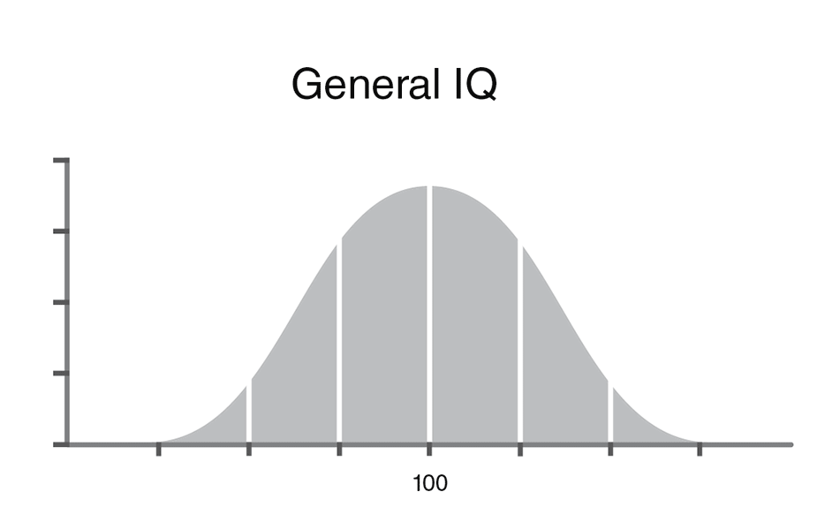
ICT has a great many languages and countless ways to do things.
100
Notes:
The bell curve is the shape of a normal statistical distribution. The mean (average of value), median (mid-point of sorted values), and mode (most frequent value) are all equivalent. In a skewed distribution, those three values are all different – mentioning any one of those values without qualifying that it is from a skewed distribution may be a deliberate attempt to mislead (people tend to assume a normal distribution).
Each vertical bar marks one “standard deviation”, a +/- measure of deviation from the “mean”, the average. Values from -1 to +1 standard deviation represent ~2/3 of the statistical sample or population.

Slide 33
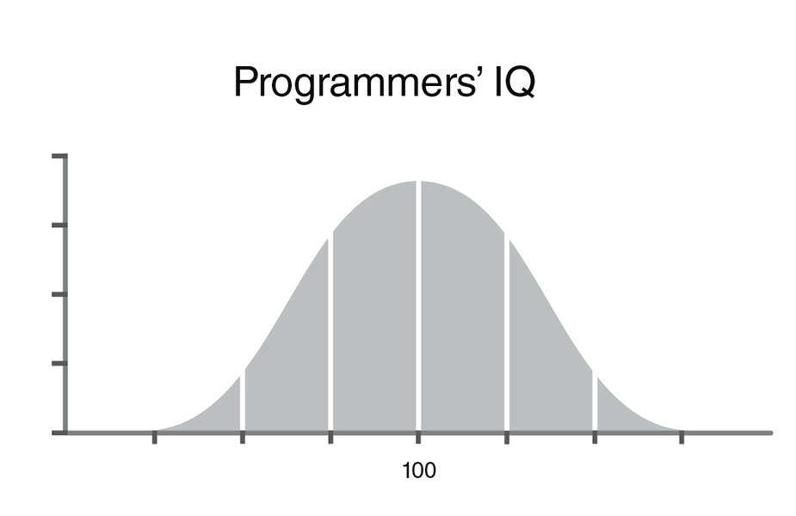
ICT has a great many languages and countless ways to do things.
This is partly why.
110
Notes:
Programmers are likely about 10% above average.

Slide 34
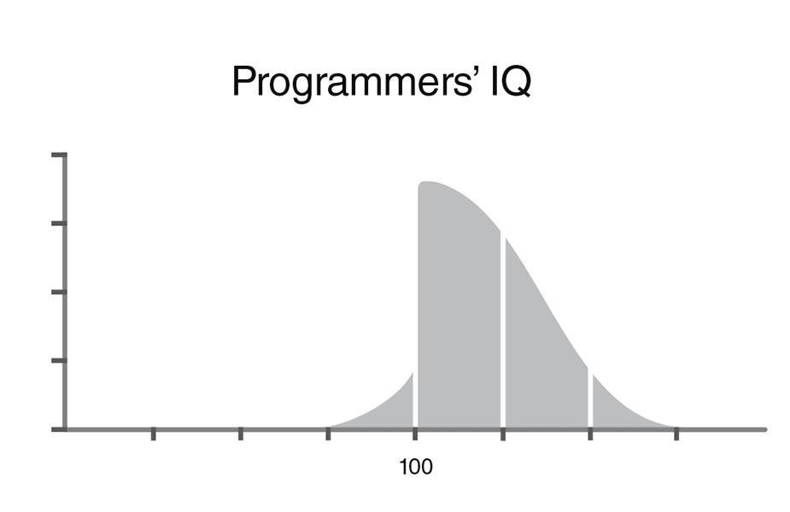
Why does ICT have many languages and countless ways to do things?
This is the other part.
Most programmers rate themselves above average.
110
Notes:
But most programmers think they are above average. (Just like drivers.)
It’s why there are so many languages, frameworks, and JavaScript packages.
Most programmers think they are smarter than most other programmers.
You do the math.

Slide 35
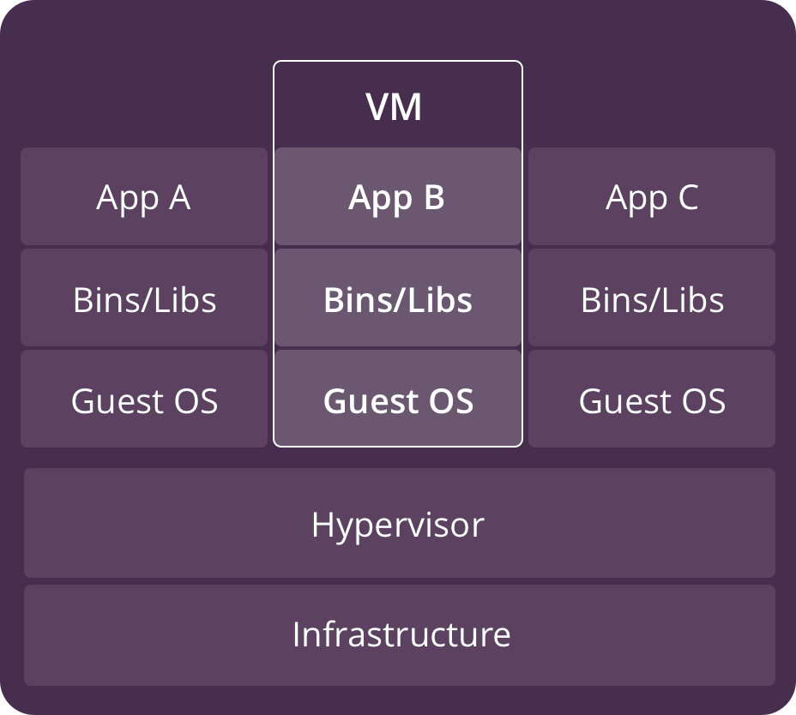
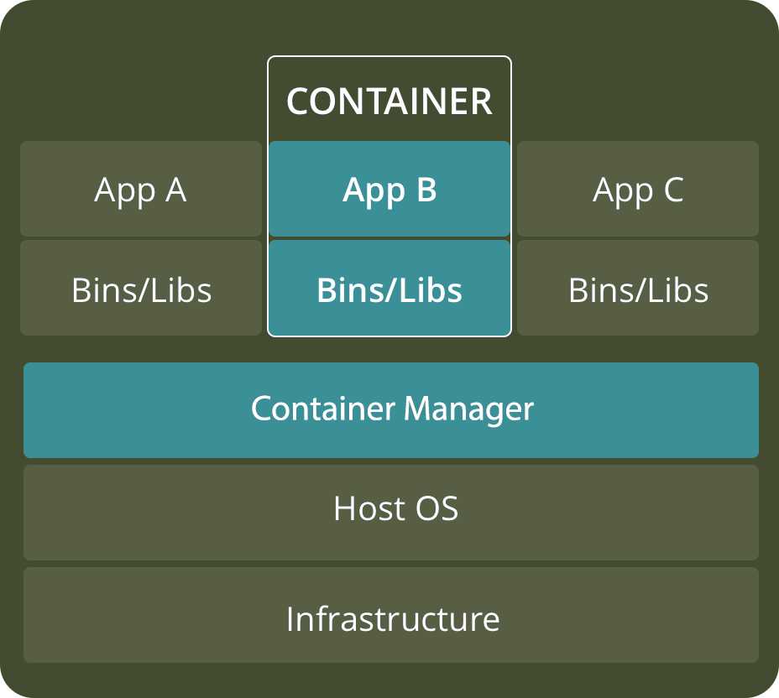
Cloud Organization:
Virtual Machines and Containers
Notes:
Remember, IT geeks and nerds call their computers 'machines' whether it is a PC or a server.
Large applications like database systems, web servers, ERP (Enterprise Resource Planning) run best on their own machine mostly because they assume they are the only thing running and have infinite resources. However, cryptography, hashing, and compression can chew up all the CPU cycles, web services can saturate the network interface, and a DB query can clog all the I/O channels. The host OS can sometimes struggle to balance overall performance when multiple complex systems use the same resources. If an application package became very slow or intermittently unstable – and it coexisted with other applications on the same platform – it was your problem. Each app provider pointed fingers at the other app provider for stealing too many CPU cycles, eating up too much RAM, monopolizing I/O channels. It became a kindergarten class where no one played well with others.
Virtual Machines allows each large software packages to run on what it thinks is its own server. The vendor cannot blame their problem on another application. So long as the VM is not maxed out on any resource, it is the vendor’s problem.
Cloud Computing provides a company with its own ecosystem of virtual machines (VM) and containers along with the communications infrastructure providing high speed interconnections between those VMs and with external services outside the ecosystem. Providing all the VMs a company needs is easily done in the cloud. Cloud companies buy and manage ICT infrastructure with economies of scale and expertise. A company's job is running a business, not a computing centre.
VMs are always on, your company pays for the 24/7 resources allocated to your VMs.
For on-demand and intermittently used services such as small applications, APIs and microservices, "Containers" are used. E.g. Docker (commercial software) and Kubernetes (open source)
https://www.cio.com/article/2924995/what-are-containers-and-why-do-you-need-them.html
Benefits of VMs
+ Can run different OSs on a single large computing platform or "in the cloud". All OS resources are available directly to application software for high performance.
- BUT Heavyweight Hypervisor between guest OS and physical hardware can limit overall performance of the host computer and thus the VMs it is hosting. You can get a bigger server platform which may be better than many individual smaller servers but either option requires expertise (or a very smart Hypervisor) tuning the partitions for CPU, memory, and I/O resource allocations) – Cloud companies are very good at that. Your company should not have to be.
+ Established management and security tools, e.g. VMware
+ Better known security controls aided by Hardware-level virtualization which Fully isolates OS instances and is hence more secure
- Startup time in minutes. May here this as “spool up” or “spin up” time.
Benefits of Containers
A container manager performs OS virtualization (VOS) instead of hardware virtualization.
Used for small applications, also APIs and microservices which are analogous to calling C functions but from the cloud, not within a program.
+ isolating applications in a VOS is lightweight compared to a VM hypervisor BUT gives up direct access to platform features and resources not supported by the Container Manager.
+ reduced hardware requirements, all containers share the host OS (multiple OSs require lots more memory) and get nearer to native performance on the platform (don't have to go through a Hypervisor)
+ Reduced & simplified security updates – only one OS to patch instead of several heterogeneous OSs BUT only Process-level isolation, possibly less secure
+ reduced IT management expertise and human resources needed – there is only one platform to manage with minimal hardware tuning and rebalancing of CPU, RAM, and secondary storage resources
+ Startup time in milliseconds, quick to spin up / spool up apps
+ Reduced size of persistent storage snapshots for backup (only one file system instead of many)
VMs are a better choice for running apps that require all of the operating system’s resources and functionality when you need to run multiple applications on servers, or have a wide variety of operating systems to manage. Containers are a better choice when the biggest priority is maximizing the number of applications running on a minimal number of servers with a homogeneous OS.
https://avinetworks.com/what-are-microservices-and-containers/
https://www.backblaze.com/blog/vm-vs-containers/
https://thenewstack.io/why-parler-cant-rebuild-a-scalable-cloud-service-from-scratch/
This is 2% about Parler (which I have no sympathy for, just to be clear) and 98% about the complexity of set up and management of cloud services.

Slide 36
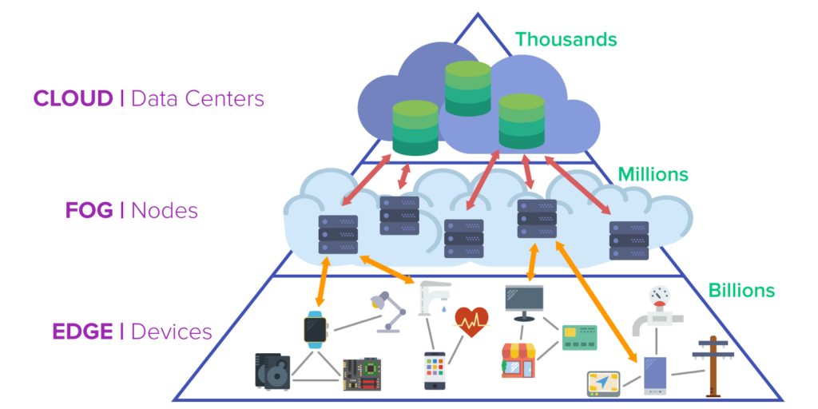
Seneca's Open Source Technology for Emerging Platforms (OSTEP)
and Centre for Innovation in AI Technology (CIAIT)
hyperscale ARM™ servers
DevOps (integrated Development and Operations)
Data Lake for smart buildings analytics
Intelligent Radio Signal Processing and AI-based spectrum analyzer
AI/ML Content-based Tagging to categorize video for Vubble
cybersecurity and regulatory compliance
AI/ML Fintech algo trading framework
Super-Embedded Systems
AI/ML on the Edge
OSTEP & CIAIT are supported by the Natural Sciences and Engineering Research Council of Canada (NSERC)
Notes:
Seneca’s Open Source Technology for Emerging Platforms (OSTEP) applied research program supports the development and commercialization of software for pervasive computing products, from the tiniest sensors to cloud-based back-end systems.
As IoT and mobile devices rapidly increase in number, computing is being pushed outwards.
https://www.itworldcanada.com/article/microsoft-announces-azure-edge-zone-in-partnership-with-5g-carriers/429307
"Microsoft will be partnering with 5G carriers to release Azure Edge Zones and Azure Private Edge Zones.
As its name implies, the Azure Edge Zones are edge computing services that bring data computing power closer to the edge of the network, where the endpoint devices communicate with the service backend. … The goal is to bring ultra-low latency to time-sensitive applications such as gaming, game streaming, online events, and IoT."
https://en.wikipedia.org/wiki/Cloud_computing
https://en.wikipedia.org/wiki/Fog_computing
https://en.wikipedia.org/wiki/Edge_computing
Secure Access Service Edge, or SASE (pronounced “sassy”), is an emerging cybersecurity concept. SASE is the convergence of wide area networking, or WAN, and network security services like CASB, FWaaS and Zero Trust, into a single, cloud-delivered service model.
SASE ➔ https://www.paloaltonetworks.com/cyberpedia/what-is-sase
CASB ➔ Cloud Access Security Broker (CASB) https://www.paloaltonetworks.com/cyberpedia/what-is-a-casb
FWaaS ➔ https://www.paloaltonetworks.com/cyberpedia/what-is-firewall-as-a-service
Zero Trust ➔ https://www.paloaltonetworks.com/cyberpedia/what-is-a-zero-trust-for-the-cloud
See https://www.mckinsey.com/industries/private-equity-and-principal-investors/our-insights/growing-opportunities-in-the-internet-of-things
Cloud computing has expanded to fog and to edge given the explosion of nodes and devices needing cloud services. Edge computing is also about devices talking directly to each other, e.g. cooperative autonomous vehicles which will negotiate directly with each other over 5G mesh networks to make real-time decisions without having to be connected through cloud services which would introduce too much latency.
AI ASIC on phones in next few years. Combined with 5G…look out!
https://medium.com/@alexanderderekrein/ai-asics-in-phones-what-it-means-for-the-world-and-you-9df18bb5c9e6
See https://www.cbinsights.com/research/5g-next-gen-wireless-system/ for overview.
https://www.itworldcanada.com/blog/an-innovative-framework-that-will-help-the-iot-industry-scale-into-the-billions/427907

Slide 37
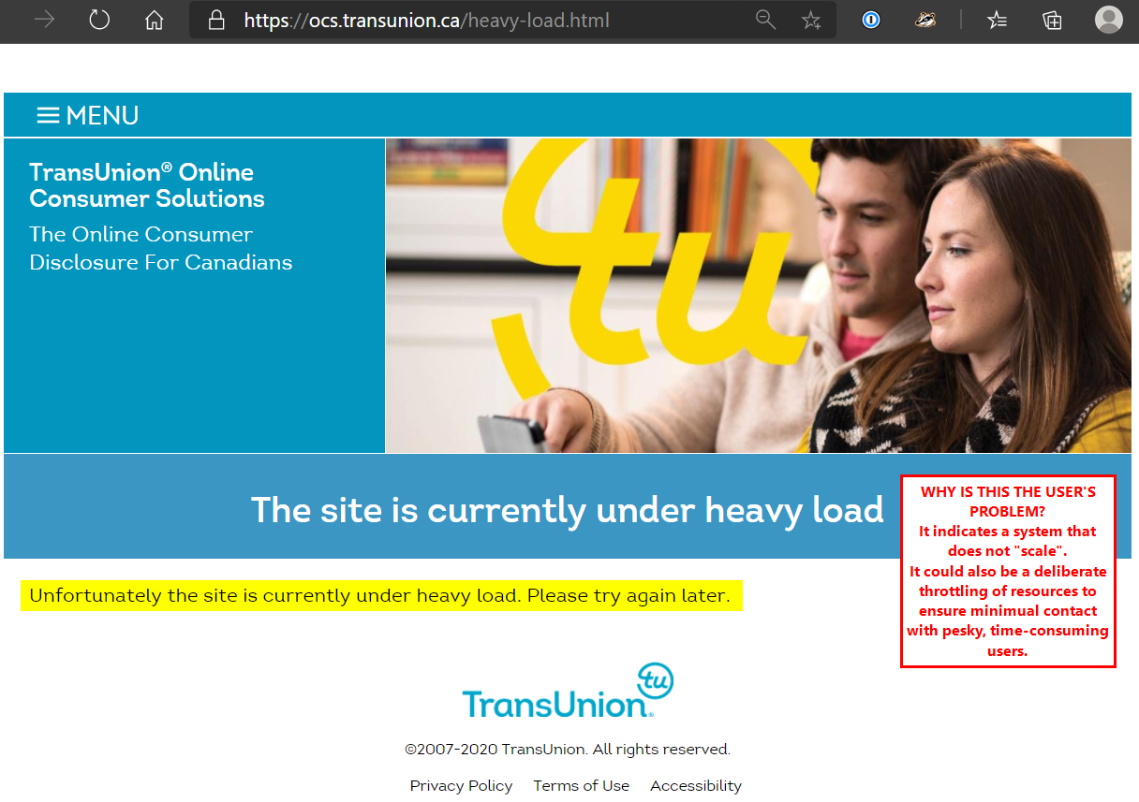

Slide 38
Pizza Tech Stack
Una Pizza pizza pizza pizza
Napoletana frozen delivered food court
Pizza as a Service
Notes:
Chart from
https://www.bmc.com/blogs/saas-vs-paas-vs-iaas-whats-the-difference-and-how-to-choose/
full stack on premises pizza: You are Anthony Mangieri, owner of Una Pizza Napoletana, probably the best pizza in New York City. He controls every aspect from raw ingredients through creation to removing one of the three pies in the oven. Yes, only three pies at a time, each one made by hand. More pies would mean more ovens and each oven needs a clone of Anthony Mangieri. Una Pizza is not franchise-able. You’ll have to figure it out on your own. You consider installing your own wood-fired pizza oven and learning how to make a pie as well as Anthony, but realize you and your users will die of starvation long before any of that happens. https://unapizza.com/about
Infrastructure as a Pizza: a pizza parlour franchise. A turnkey operation that provides the opportunity to create pizzas. They supply store facilities, equipment, and a mechanism for you to order raw materials and to receive orders. The franchise infrastructure provides the opportunity, you do everything else to make it into platform or software services. You choose whether to make Linux, or Microsoft, or IBM pies. It is up to you to run the shop and supply the labour. You wish you could hire Anthony Mangieri but there's no way he'll work in a franchise.
Platform as a Pizza: You call for pizza delivery but Uber Eats is requesting a fortune for delivery from Una Pizza Napoletana, so you look for a local pizzeria. They have many options for pizza customization, but it takes time to decide on the combinations of size, crust, sauce, and toppings that everyone likes. You optimize the combinations and find a pizzeria which can be almost everything to everyone. You create a pizza configurator that sends orders and initiates predictable delivery. The doorbell rings. If you tip generously every time, the pizza arrives hot. You get it out of the box, hopefully without scraping it off the lid, and serve it on paper towels because you blew the budget tipping the delivery person. Later, you argue with your developers whether the box can be recycled. You realize it will be difficult to use any other pizzeria platform because of the deep integration between the ordering system you built and the pizzeria’s underlying platform. You consider moving your office to New York across the road from Una Pizza Napoletana.
Software as a Pizza: You go to the food court at the local mall. There are very large carts making their way slowly between the tables. Each cart has only one style of pizza. You can get only slice at a time. If you’re looking for vegetarian, that cart just passed your table and will not be back for a long while. There are lots of pepperoni carts circulating. By the time a pepperoni cart gets to you, there are no slices left. A couple of Hawaiian pizza carts circulate, taking up room that more pepperoni carts could occupy, but few people take a slice of pineapple and ham. Your users complain it wastes their time when the Hawaiian stops at their table. The food court says it is an unavoidable feature that cannot be changed. When your people are hungry enough, they may grumble, but they will eat the Hawaiian.
The good thing about the food court is you can take your entire company to lunch, each department can eat what they want if they are not too picky, you have little advance planning or set up to do, lunch is provided at minimal cost, food court vendors take care of user’s requirements, implementation and deployment along with support (“yes, you can swap the soup for salad; no, we don’t have vegan egg salad sandwiches on gluten-free bread – nobody does”). There are many alternatives to pizza for departments that once ate Una Pizza Napoletana and will accept nothing less. You carry your own tray and find an empty seat at a table. The better food courts will clean up after you, the cheap ones make you do it. Remarkably, everyone gets back to the office on time although not necessarily happy or well-fed.
frozen pizza – You choose one or more raw pizzas from snack size to big party pie. It is what it is with many options but no opportunity to personalize. You get what you get, fire it up, slice it up, and clean up afterwards. At first it is easy when people accept whatever pizza comes out of the box, but it gets complicated when they start asking for customization (apparently, there’s never enough cheese). You ask but there is no frozen version of Una Pizza Napoletana.
Very Full stack developers would use IaaS.
Dev stack developers use PaaS, as would MEAN stack "full-stack" developers.

Slide 39
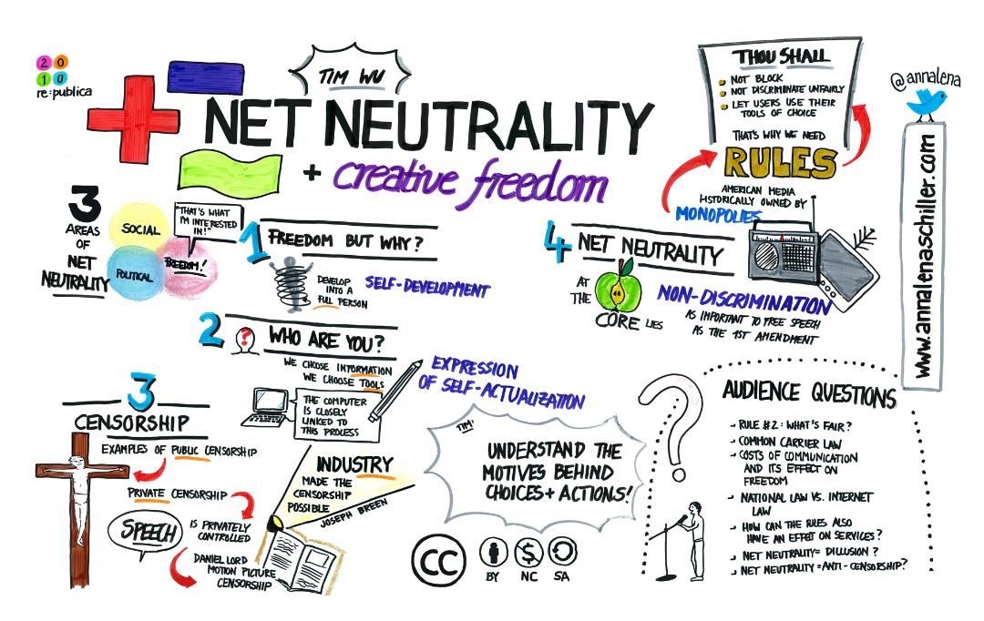
Net Neutrality (Tim Wu, 2003)
Principle of an open, neutral Internet:
Internet providers do not use their privileged position to favour some applications and services over others.
All packets are equal.
Notes:
Net Neutrality And Creative Freedom (Tim Wu at re:publica 2010) by Anna Lena Schiller (CC BY-NC-ND 2.0) https://flic.kr/p/7VfazT
https://en.wikipedia.org/wiki/Net_neutrality
http://www.michaelgeist.ca/tech-law-topics/net-neutrality/
https://spectrum.ieee.org/telecom/internet/net-neutralitys-technical-troubles
Net Neutrality's Technical Troubles
The debate has centered on policy, law, and finance, as if the network itself were a given. It is not.
What…does equal treatment mean? The Net needs to manage its diverse traffic, just as a city must manage the flow of pedestrians, bicycles, buses, delivery trucks, cars, and the occasional emergency vehicle on its streets. Any general rule must affect some kinds of traffic differently from the others, which is why you have car-friendly roads, bike lanes, and malls given over entirely to foot traffic.
Everyone who suffers from Internet traffic jams has a favorite villain. Streaming-video watchers blame carriers for throttling data flow to their phones or computers. Real-time gamers howl that delays and losses in data transmission hobble their competitive performance. This problem is so bad that Riot Games, maker of the popular League of Legends, plans to build a dedicated high-performance gaming network.
The stakes are rising with the promise of new Net applications, such as communication among autonomous vehicles. Also at stake is the future of wire-line telephone service, which FCC chairman Tom Wheeler wants to shift from aging landline networks to the Internet.
Yet so far the debate has centered on policy, law, and finance, as if the network itself were a given. It is not.
“There’s a lot of complexity here at a technical level that is absolutely lost in the policy conversations,” says Fred Baker, a distinguished engineering fellow at Cisco Systems and former chair of the Internet Engineering Task Force. Getting the technology right is crucial for the future of the Net.
The fundamental technical challenge is getting the Net to carry traffic that it was never meant to handle. Internet packet switching was designed for digital file transfers between computers, and it was later adapted for e-mail and Web pages. For these purposes the digital data does not have to be delivered at a specific rate or even in a specific order, so it can be chopped into packets that are routed over separate paths to be reassembled, in leisurely fashion, at their destinations.
By contrast, voice and video signals must come fast and in a specific sequence. Conversations become difficult if words or syllables go missing or are delayed by more than a couple of tenths of a second. Our eyes can tolerate a bit more variation in video than our ears can tolerate in voice; on the other hand, video needs much more bandwidth.
Voice and video can be converted into series of packets coded to identify their contents as requiring transmission at a regular rate. For telephony, the packet priority codes are designed to keep the conversation flowing without annoying jitter—variations in when the packets are received. Similar codes help keep video packets flowing at the proper rate.
In practice, these flow controls are not crucial in today’s fixed broadband networks, which generally have enough capacity to transmit voice and video. But mobile apps are a different story.
“Wireless has a lot of stuff moving around, so it needs much tighter management than wire line,” says a senior engineer at Nokia Networks, where he is responsible for innovation

Slide 40
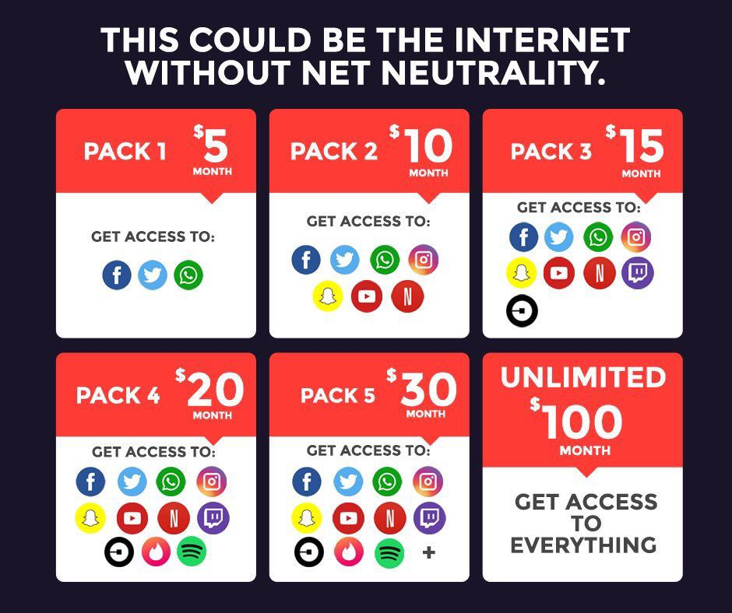

Slide 41
Is sharing music/video files illegal?
© Copyright in Canada as of 2012:
Bill C-11, the Copyright Modernization Act,
allows for private and personal use of
time shifting, format shifting, and backup copies
as long as no digital locks are involved.
online infringement of © — “notice-and-notice”
  “notice-and-takedown” in USA and EU
Notes:
Bill C-11, the Copyright Modernization Act, allows for private and personal use of time shifting (PVR recording), format shifting (between different media, e.g. iTunes ←→ CD, for your own private and personal use), and making a backup copy only for backup/restore purposes. However, if there are digital locks on the media or the source is an on-demand service, the content cannot be copied; those things can be used/played/consumed only from the source media. You can legally lend a physical CD like you can lend a paper book, but you cannot "lend" digital data because the lending creates a copy which violates copyright (as it has always been in the case of copying a book).
e.g. can copy vinyl records or CDs (no digital locks) but cannot copy DVDs (having regional and digital locks).
Canada has charged a levy (AKA tariff) on "blank audio recording media", i.e. blank CDs since 1997 (0.29/disc) “Part VIII of the Copyright Act allows consumers to copy recorded music for their own personal use. In exchange, the private copying levy was created to compensate music rights holders for private copies made of their music. ” This was also done for blank cassette tapes in the era of LP vinyl records.
The levy is collected regardless of the purchaser's end use of the media. The IT industry made major contributions to the music industry when CDs were a common backup and distribution medium for files that nevertheless paid the music levy.
http://www.cpcc.ca/en/ http://www.cpcc.ca/en/frequently-asked-questions
https://en.wikipedia.org/wiki/Private_copying_levy#Canada
https://www.theglobeandmail.com/business/commentary/article-after-supreme-court-decision-ottawa-must-fix-flaws-in-canadas/
The Canadian system for online infringement was formally established in 2012 and came into effect in 2015. The “notice-and-notice” approach grants rights holders the ability to send notifications of alleged infringement to internet providers, which are required by law to forward the notices to the relevant subscriber and to preserve the data in the event of future legal action. The system does not prevent rights holders from pursuing additional legal remedies but internet providers cannot reveal the identity of their subscribers without a court order.
https://www.theglobeandmail.com/business/commentary/article-five-critical-components-of-a-balanced-modern-canadian-copyright/
https://en.wikipedia.org/wiki/Copyright_Modernization_Act
http://www.barrysookman.com/2012/11/07/change-and-the-copyright-modernization-act/
http://www.barrysookman.com/2011/10/03/some-observations-on-bill-c-11-the-copyright-modernization-act/
http://www.huffingtonpost.ca/2015/01/08/michael-geist-copyright-modernization-act_n_6436584.html
http://business.financialpost.com/fp-tech-desk/pirates-in-your-neighbourhood-how-new-online-copyright-infringement-laws-are-affecting-canadians-one-year-later?__lsa=181b-aac5

Slide 42
File Sharing
File Sharing is the practice of or ability to transmit files from one computer to another over a network or the Internet.
File sharing is the public or private sharing of computer data on a network, so that multiple people can access the data to their level of access privilege.
File sharing makes collaboration easier, but is also used for the illegal distribution of music, movies, software, and pornography.
Notes:
Deliberate file sharing via FTP or torrents
Vs
Automatic or synchronized file sharing via cloud services such as OneDrive and Sync
See https://www.cloudwards.net/online-storage-vs-online-backup-whats-the-difference/

Slide 43
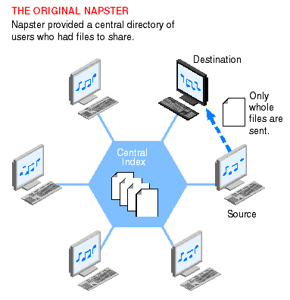
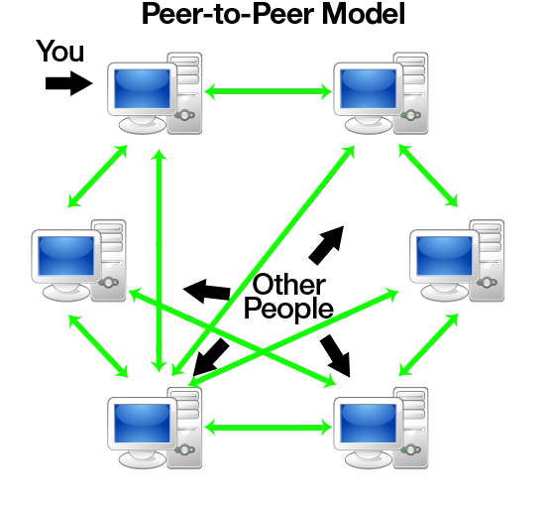
File Sharing: Napster vs BitTorrent
Notes:
Napster started 1999, based on P2P. Its “central database stored the location of all music files” (MP3). Individuals could request a song and the server would provide the location. “Peer computer would download the file directly to the requester.” Napster completely disrupted the music distribution business very quickly. As a result, it was sued by performers and other larger organizations. Napster ceased operations in 2002. It was reopened as an online store in 2006. Was bought by Best Buy in 2008 and sold to Rhapsody in 2011.
BitTorrent, since 2001, is a decentralized Peer-to-peer (P2P) architecture where portions of files can be exchanged. Several factors contributed to the widespread adoption and facilitation of peer-to-peer file sharing. These included increasing Internet bandwidth, the widespread digitization of physical media, and the increasing capabilities of residential personal computers.
P2P is not just for illegal file sharing, cracks, and warez. Microsoft uses it for Update distribution (Windows 10) and online playing games (the mmorpg Skyforge^{[2]}) use it as their content distribution network for downloading large amounts of data without incurring the dramatic costs for bandwidth inherent when providing just a single source.
In 2007, P2P file sharing accounted for 37% of Internet traffic. Today, that portion is streaming…mostly Netflix.
http://www.slideshare.net/srijish/p2p-principle-architecture-and-challenges-presentation
http://www.torrentkittytorrentkitty.com/history-of-torrent/
https://www.lifewire.com/free-p2p-file-sharing-software-programs-818053
https://en.wikipedia.org/wiki/Peer-to-peer_file_sharing

